Slide 1
The Library's role in readying researchers for open data
Evolving your infrastructure to keep in step with changing funder mandates
Claire Turner, July 2023
Notes:
SCALE -- These slides are set up to standard size (ratio of 4:3). To change format please go to >> Page Set up >> change the ratio.

Slide 2
The Digital Science portfolio
Starting life in 2010, Digital Science has invested in new and emerging tech start-ups since its inception
2012
2014
2016
2018
2020
2010
2011
2013
2015
2017
2023
2019

Slide 3
Research Workflows at Digital Science

Slide 4
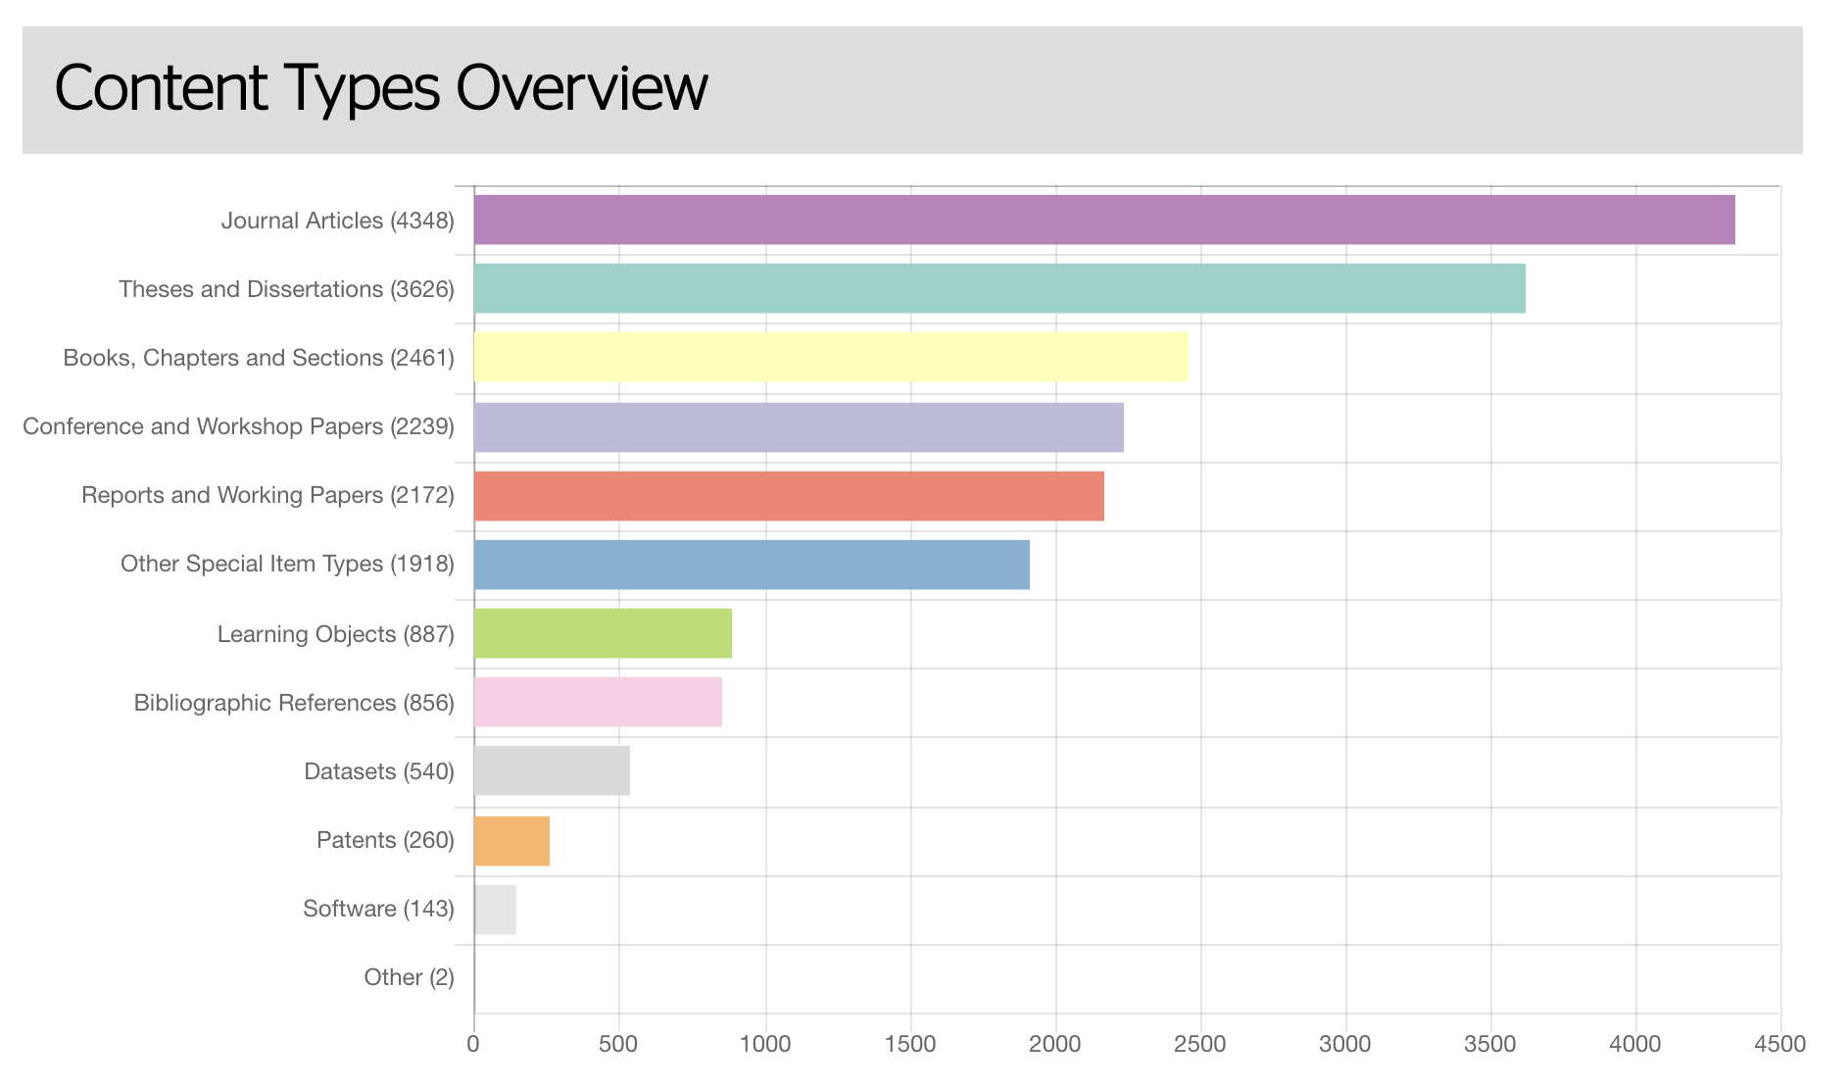
What do repositories currently house?
Source: https://v2.sherpa.ac.uk/view/repository_visualisations/1.html

Slide 5
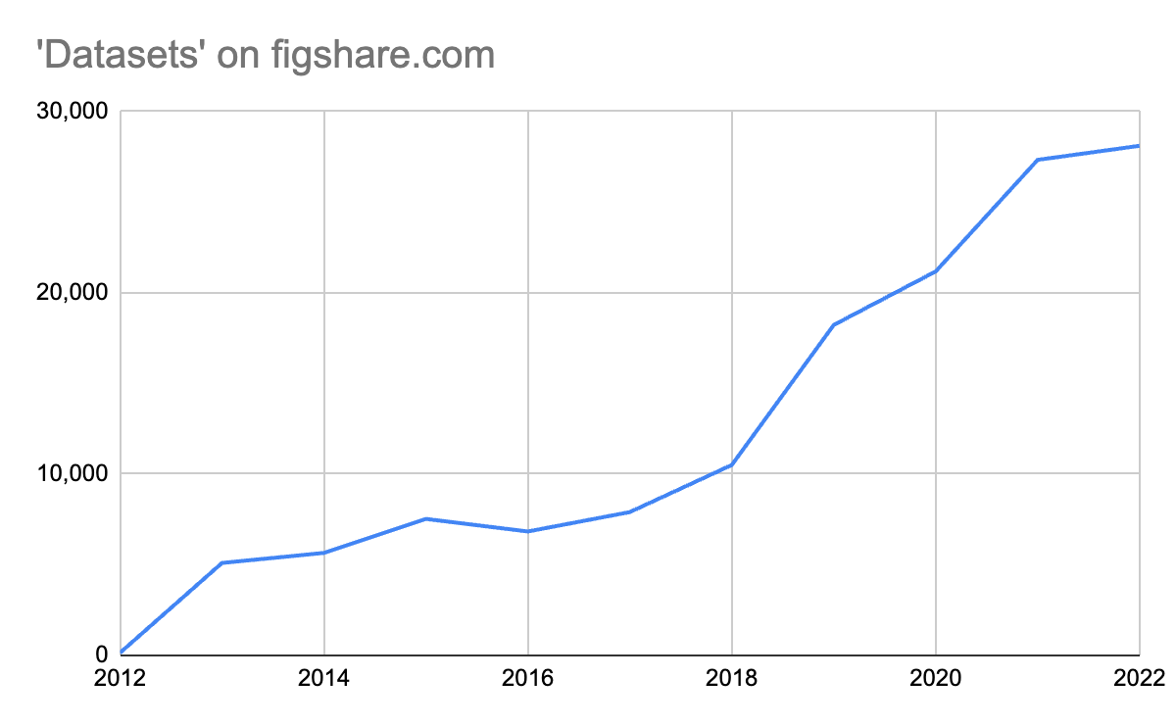
Data as a research output
Last 5-10 years has seen data perceived as a research output
Policy and mandates has driven increase in data sharing
Technical infrastructure has responded accordingly
Approach to conducting research is evolving (DMPs)
https://v2.sherpa.ac.uk/view/funder_visualisations/1.html

Slide 6
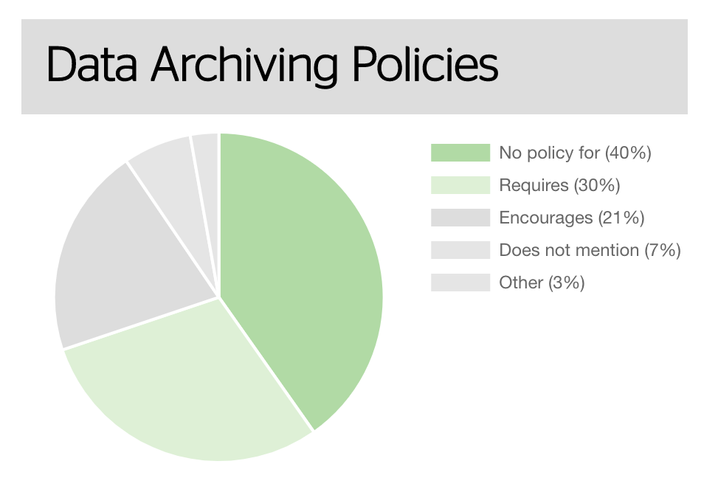
How many funders mandate data sharing?
Only 30% of funders worldwide require data archiving (sharing)
Progress towards open data becoming the standard globally has kept pace with funder mandates
Data mandates are important but present infrastructure challenges for all stakeholders in the research lifecycle when they’re implemented
https://v2.sherpa.ac.uk/view/funder_visualisations/1.html

Slide 7
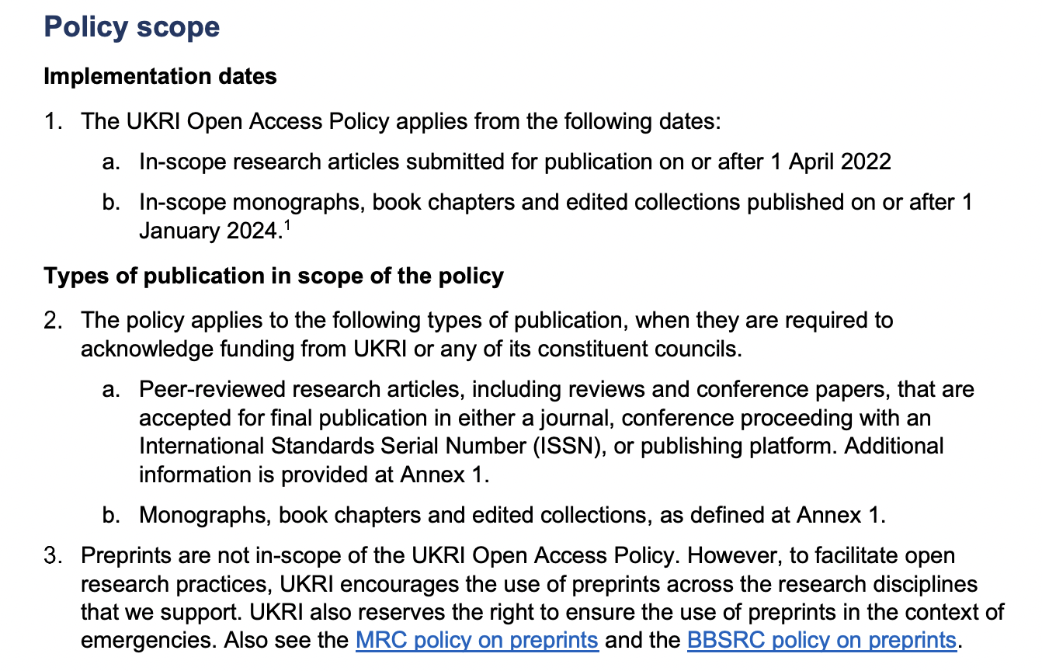
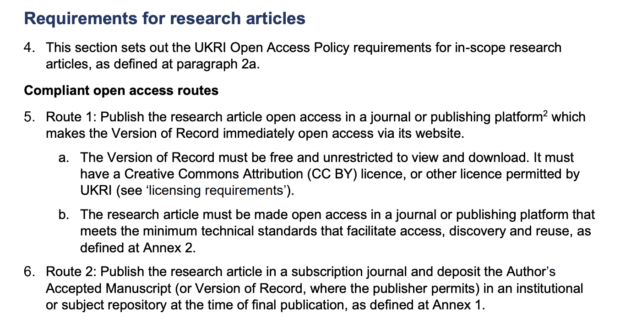
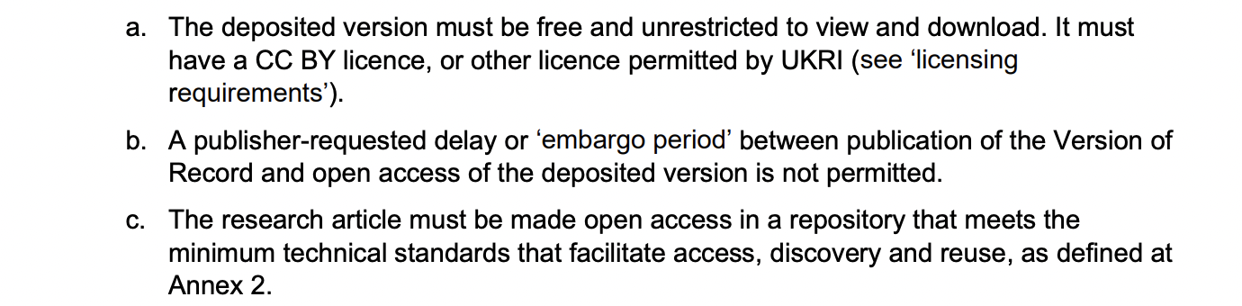
UK: UKRI Open Access Policy
Source: https://www.ukri.org/publications/ukri-open-access-policy/

Slide 8
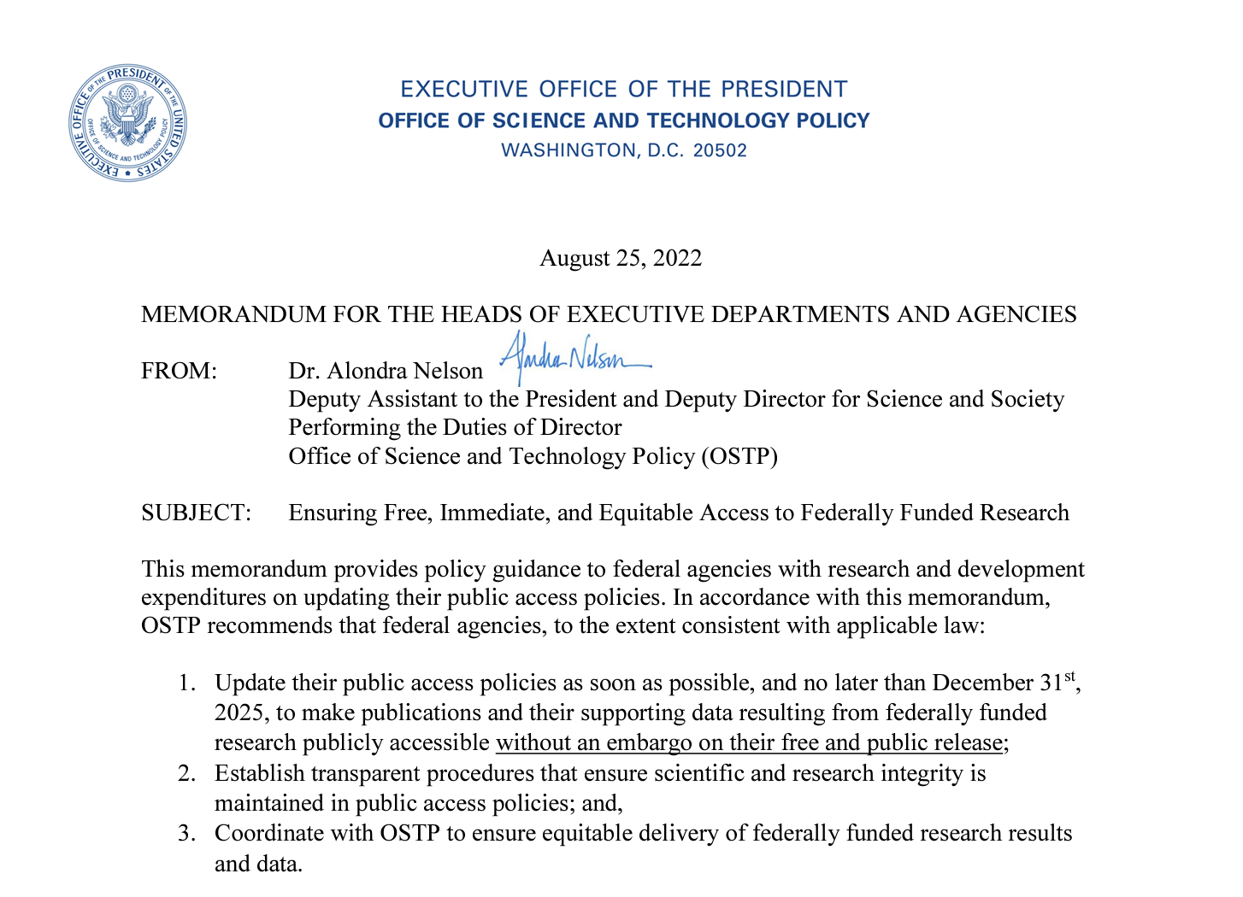
United States: OSTP ‘Nelson’ Memo

Slide 9
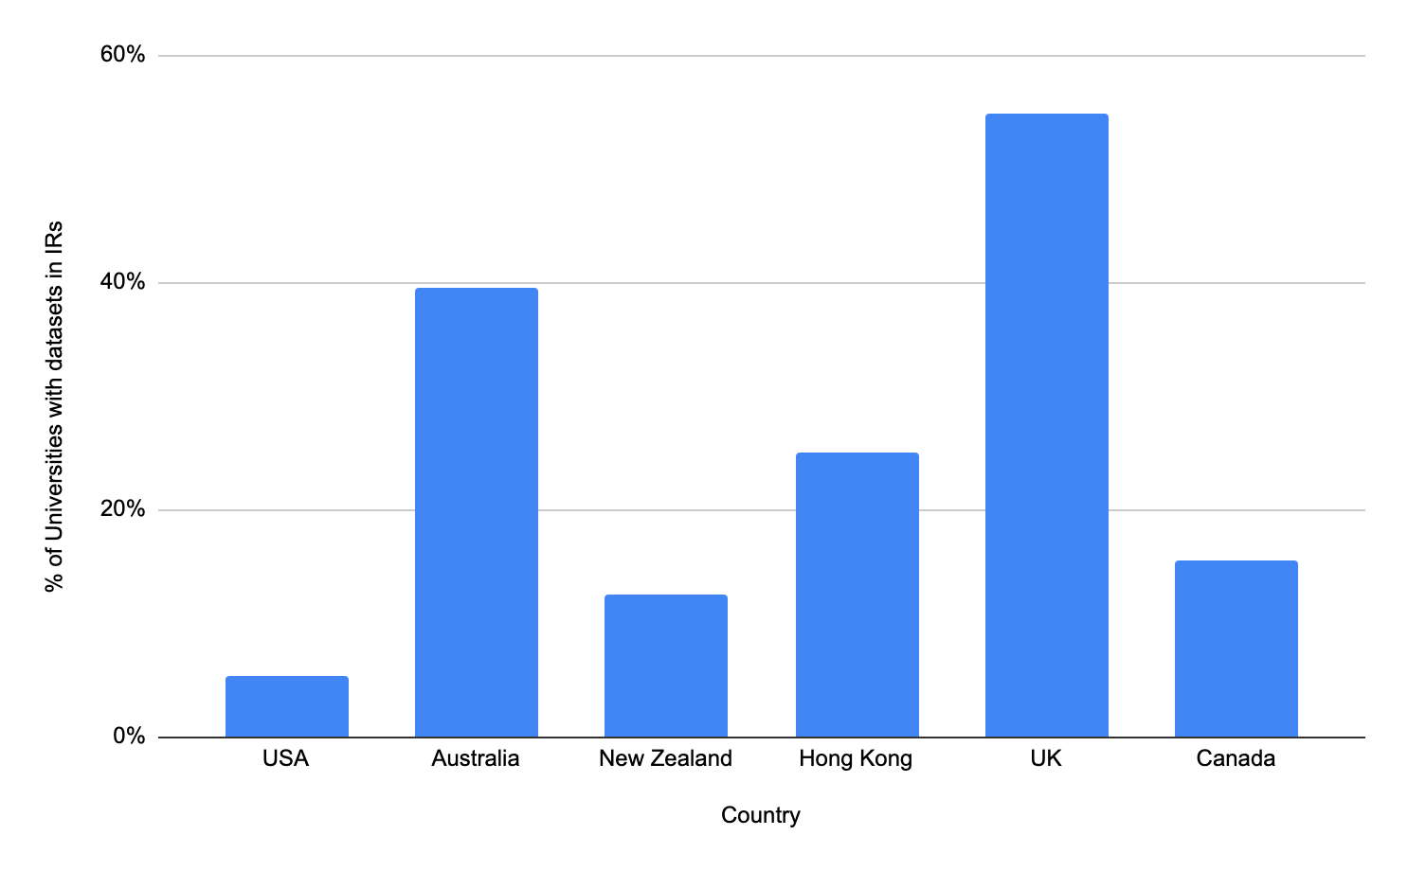
Some countries are more primed than others
Source: https://v2.sherpa.ac.uk/

Slide 10
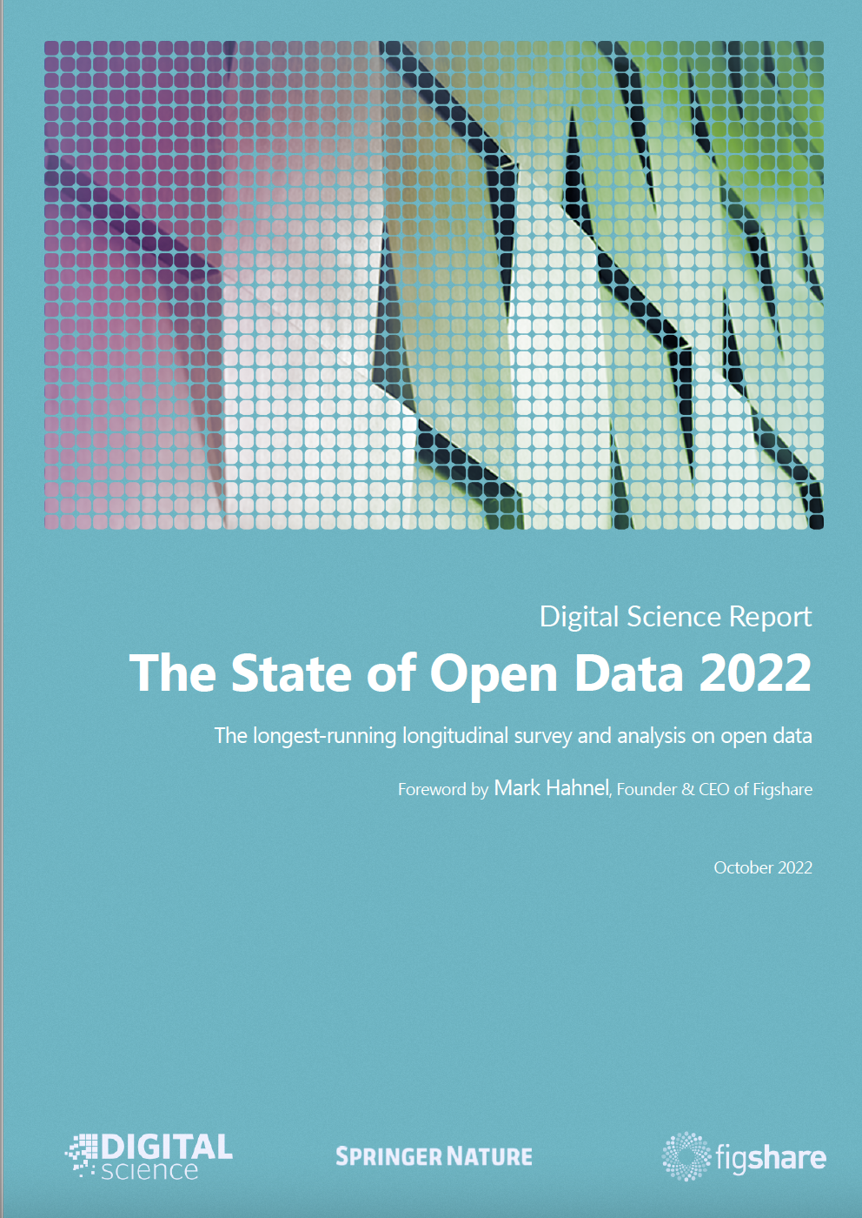
How are faculty feeling about it all?
Drawing lessons from the State of Open Data Report 2022
Key message: The work of compliance is wearing on researchers
88% of researchers think OA articles should be common practice and 79% think research data should be openly available
Researcher support for a national data sharing policy has decreased: 78% in 2019 → 68% in 2022.
Lack of time is the main reason respondents did not adhere to their data management plan (35% of respondents)
Finding time to curate data is what respondents need the most help with (52%)
Source: The State of Open Data Report 2022 - https://doi.org/10.6084/m9.figshare.21276984.v5
Notes:
So the takeaway is that institutions will be faced with increased needs around open access paper compliance as well as a need for increased data sharing support. Institutions that start building capacity in these areas will be ahead of the curve for 2026 and won't have to scramble at the last minute.
72% of respondents indicated that they would rely on an internal resource if they required help with making data openly available.
36% of respondents said that they were seeking more help on how to comply with funder policies (down from 41% in 2021)

Slide 11
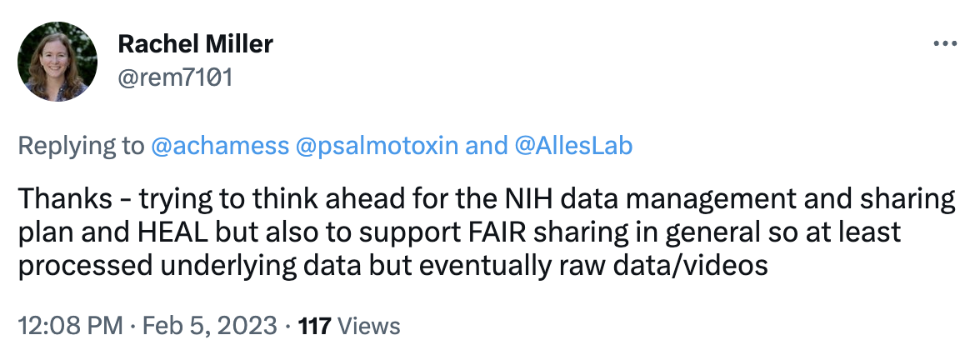
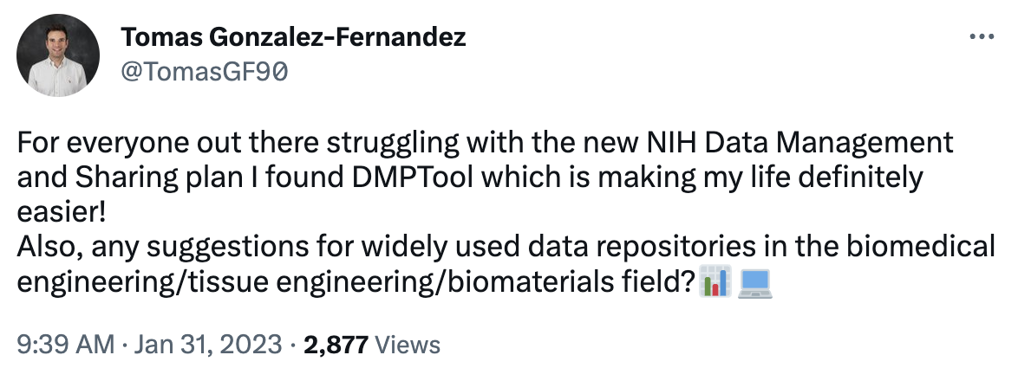
When funders move from ‘recommended’ to ‘required’

Slide 12
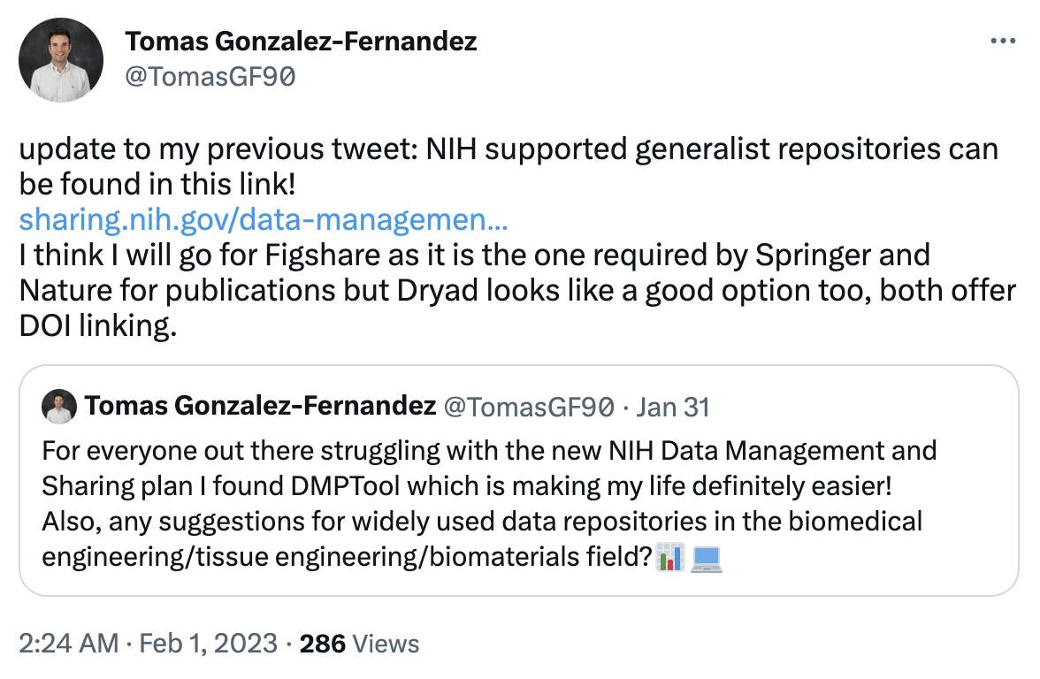
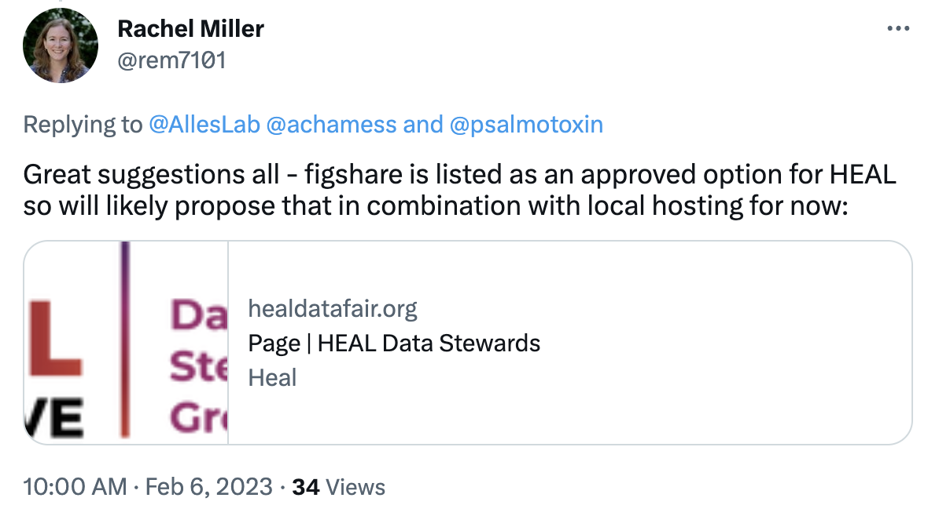
How do researchers choose?

Slide 13
How is Figshare responding to this changing space?

Slide 14
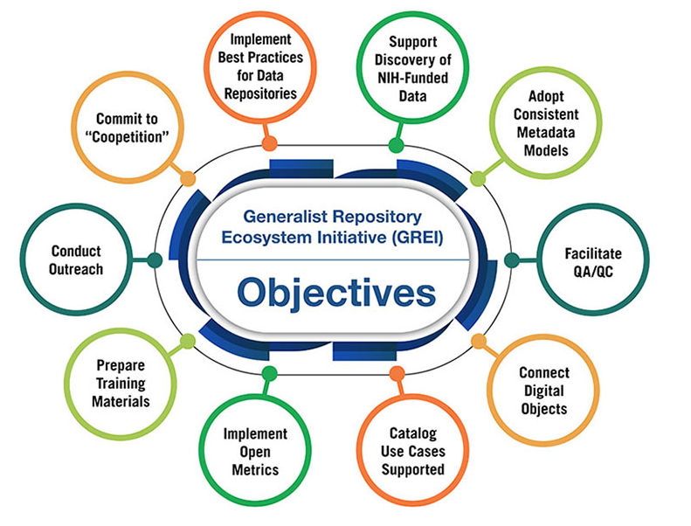
Repositories need to keep pace with landscape
10 years in, sharing research data in Figshare is still a core use case
Partnering with other data repositories through an NIH grant (GREI) to implement best practices for data repositories

Slide 15
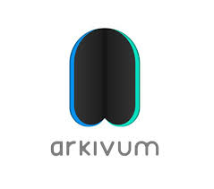
Integrations - make deposit easy
Push to Figshare from tools researchers are already using
Provide guidance and preservation

Slide 16
1st iteration

Slide 17
No mediated deposit

Slide 18
Mediated deposit

Slide 19
Journal workflow

Slide 20
Making data FAIR

Slide 21
Institutional Data Repository Route

Slide 22
Growing maturity of Open Research at Universities
Level 4
Level 3
Level 2
Level 1
Publications repository with core metadata
Separate databases
Separate publications and data repositories
Separate RIMs
Separate Publications and Data Repositories integrated with RIMS
Combined publications and data repository integrated with RIMS
Systems
Tracking # of deposits to repository
Basic reporting on
OA publishing
Tracking publication and data deposits
Tracking OA publishing using curated data
Monitoring % of works deposited and other OA pathways
Introducing grant data
Proactive monitoring of OA publishing and deposits including compliance tracking
Data & Monitoring
Services & Processes
Support for depositing publications
Publishing advice
Support for depositing publications & data
Publishing advice
Streamlined workflows supporting OA engagement for publications and data
Embedded OA engagement and compliance strategy for publications and data

Slide 23
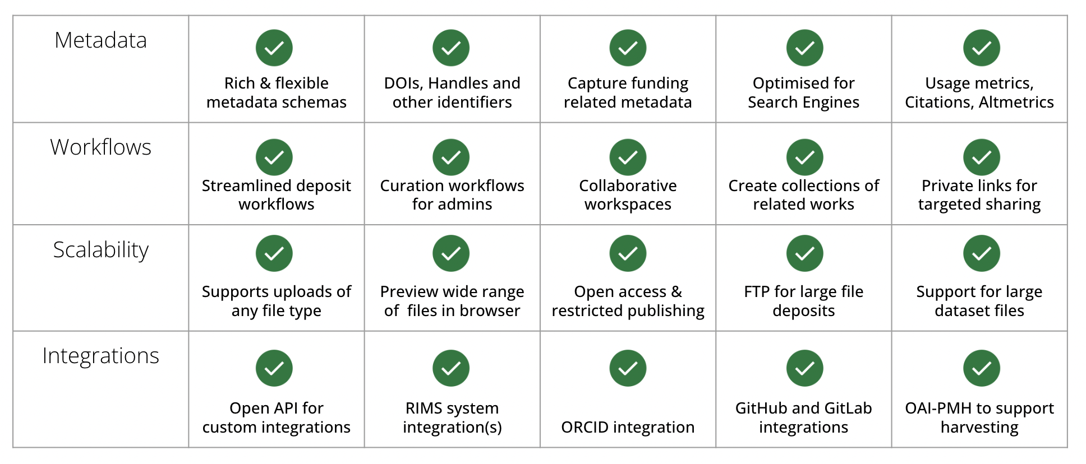
Review your systems’ capabilities

Slide 24
Data on Figshare

Slide 25
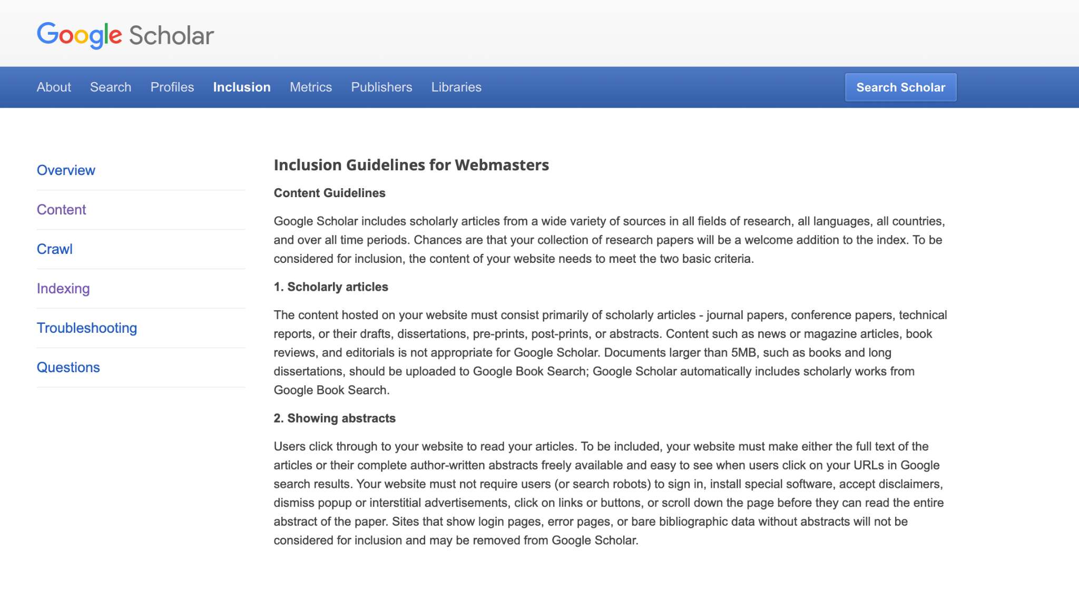
Review your systems’ capabilities
Source: https://scholar.google.com/intl/en/scholar/inclusion.html#content

Slide 26
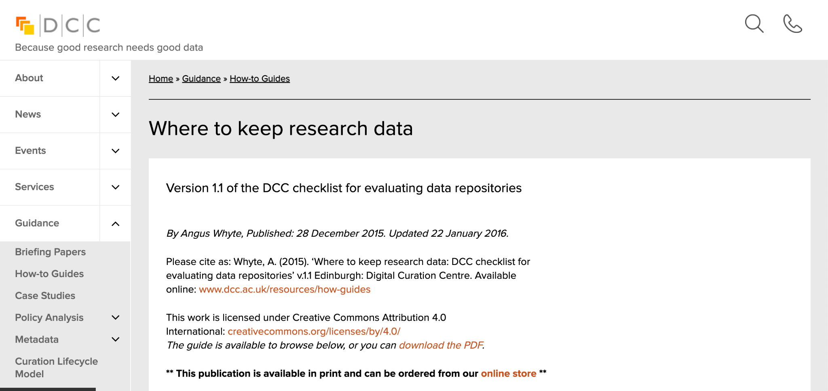
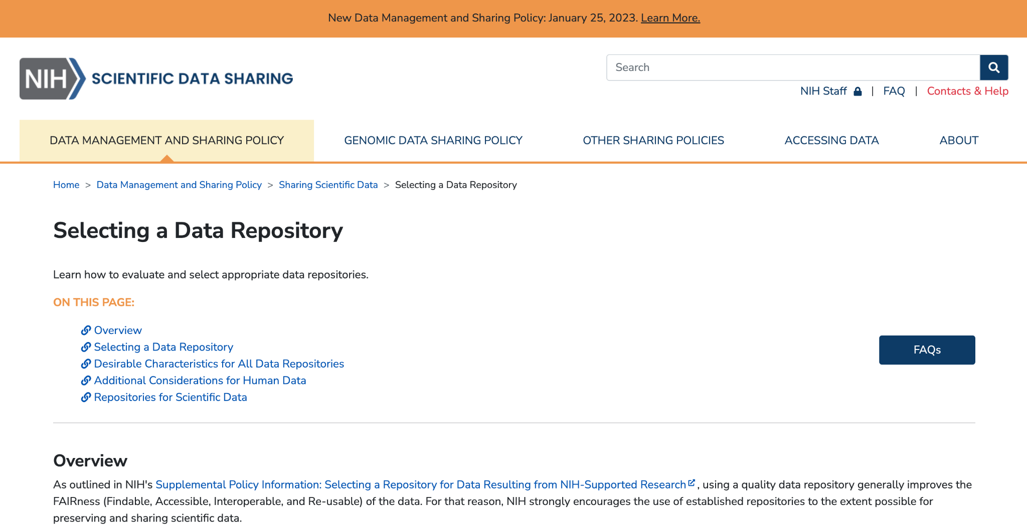
Review your systems’ capabilities
Source: https://www.dcc.ac.uk/guidance/how-guides/where-keep-research-data
https://sharing.nih.gov/data-management-and-sharing-policy/sharing-scientific-data/selecting-a-data-repository

Slide 27
Plan your support structures
Consider how you will support your research ecosystem
Identify how you will support and incentivize your researchers
Plan communication points between stakeholders (Researchers, Research Office, Library, IT)
Review institutional policies and procedures relating to open data
How do systems connect with people?

Slide 28
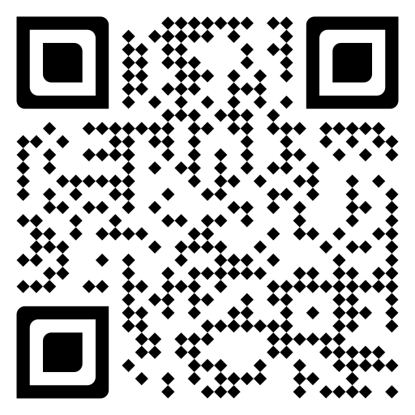
Sign up now

