Slide 1
Intro Slide Title 1
Covid Chronicles at the Open University
How data sharing has given marginalised communities a voice
Isabel Chadwick
Open University Library Services
Wednesday, 03 May 2023
Notes:
Al-rashid, Ahmad (2022): Covid Chronicles: Graffiti art in Birmingham. The Open University. Figure. https://doi.org/10.21954/ou.rd.13005395.v2

Slide 2
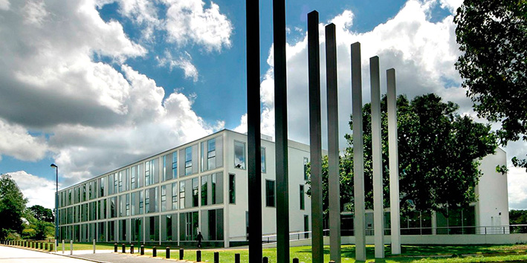
Slide Title 9
About the Open University

Slide 3
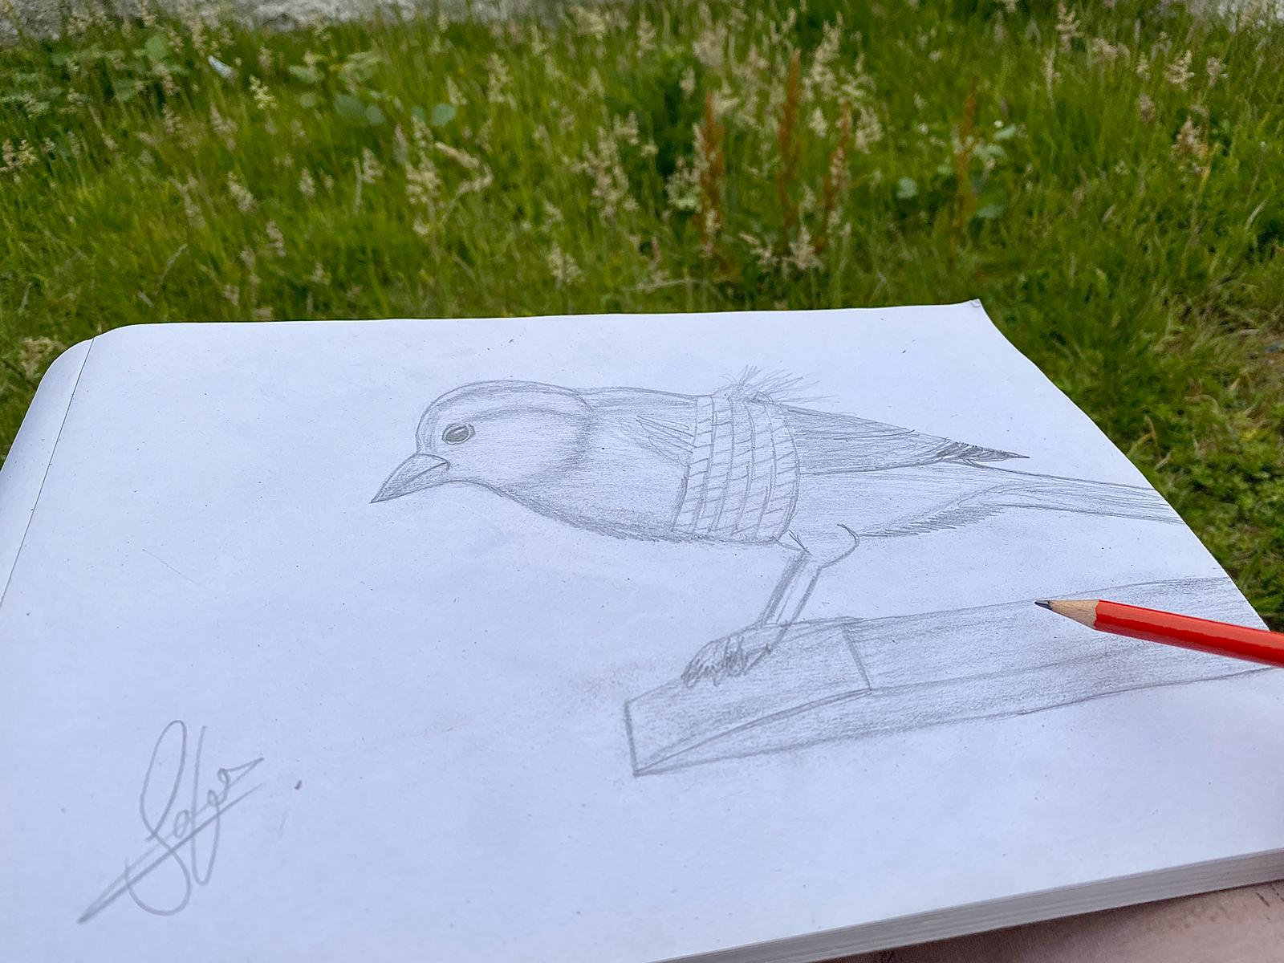
Slide Title 9
Covid Chronicles from the Margins
About the project
Cov19: Chronicles from the Margins investigates how diverse migrant groups (asylum-seekers, refugees, migrant workers and undocumented people) are responding to COVID-19. Those of us who have experienced persecution, war and flight have already had to adapt to radically new circumstances and deal with adversity, marginalization and racism. Detention, long periods of confinement and restricted movement are not new.
author, anonymous; Williams, Jeni (2022): Covid Chronicles: Confinement. The Open University. Figure. https://doi.org/10.21954/ou.rd.12554558.v1

Slide 4
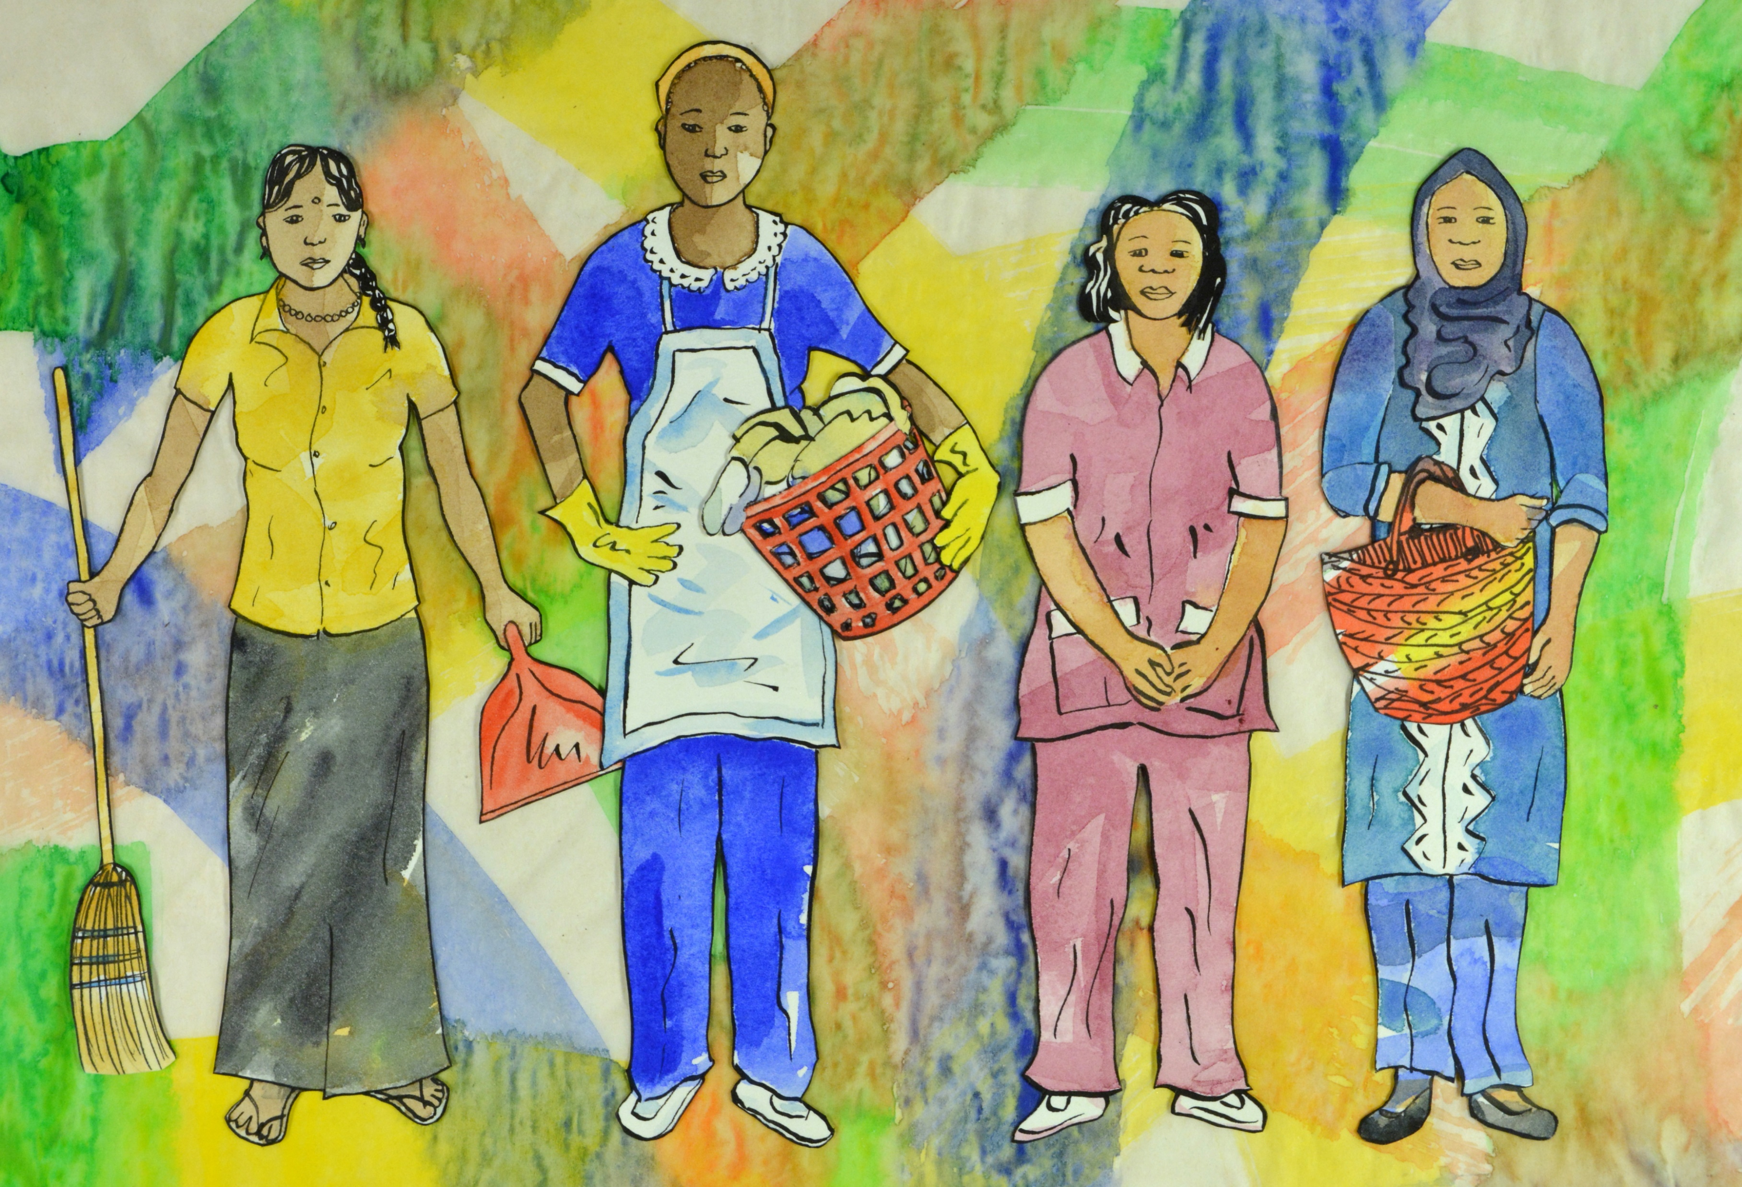
Slide Title 9
Covid Chronicles from the Margins
How the project team used Figshare
Figshare projects
lots of collaborators across the world
many with only mobile phone technology
Gillespie, Marie; Charlesworth, Amy (2022): Locked In: The (In)Visibility of Migrant Domestic Workers during Covid-19. The Open University. Dataset. https://doi.org/10.21954/ou.rd.15173355.v1

Slide 5
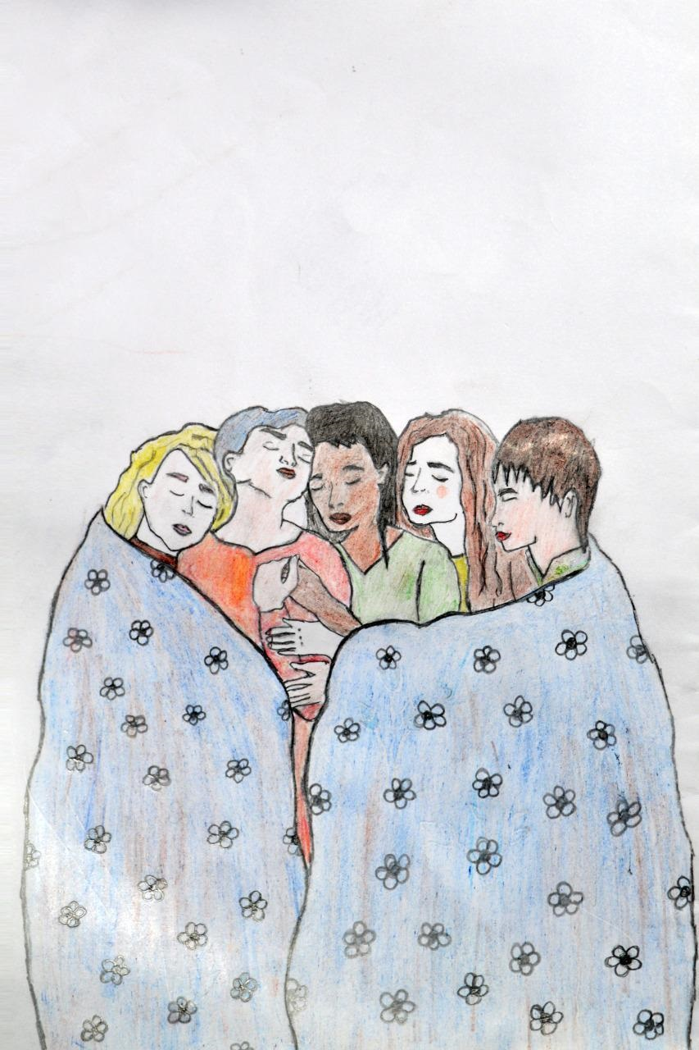
Slide Title 9
Covid Chronicles from the Margins
How the project team used Figshare
Publishing data
Often much later than initial upload to Figshare
Some members of the team had left the project – ownership issues
Quality of metadata after delay
Copyright, GDPR, Ethics!!!
Durrani, Sweeta (2022): Covid Chronicles: They Let Us Go and We Hugged Each Other Tighter. The Open University. Figure. https://doi.org/10.21954/ou.rd.14130047.v1

Slide 6
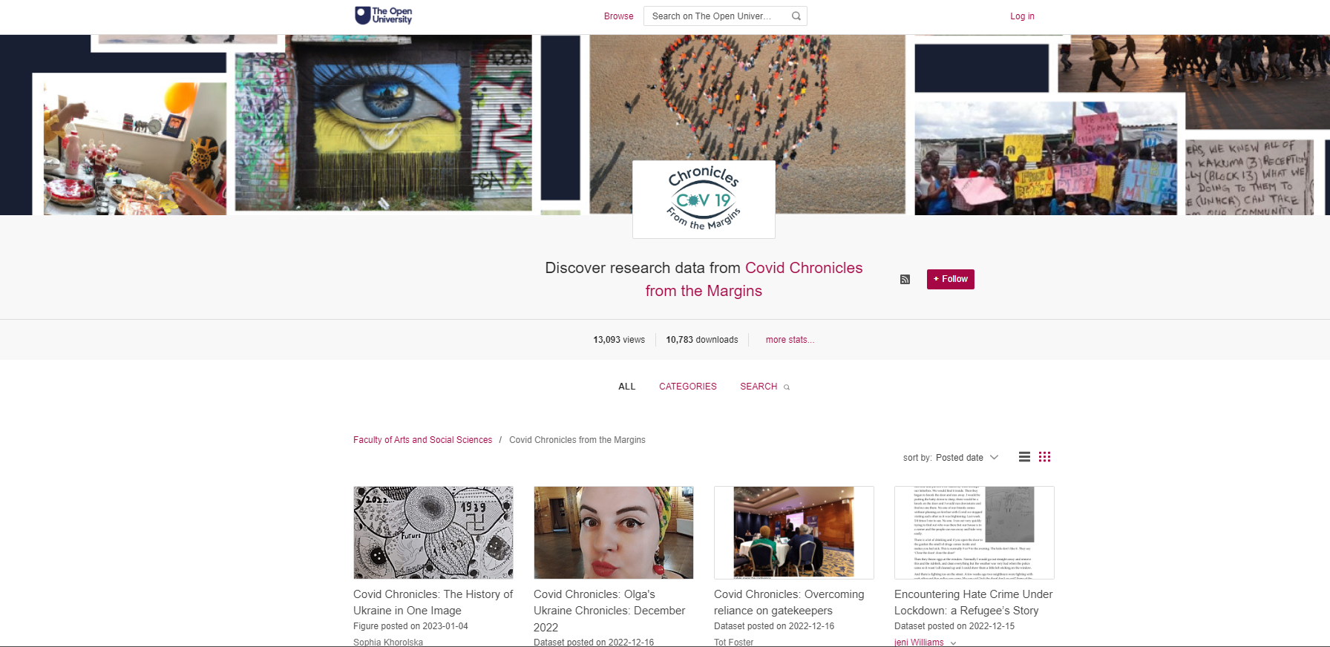
Slide Title 9
Covid Chronicles from the Margins
Setting up a subgroup
https://ordo.open.ac.uk/cov19chronicles

Slide 7
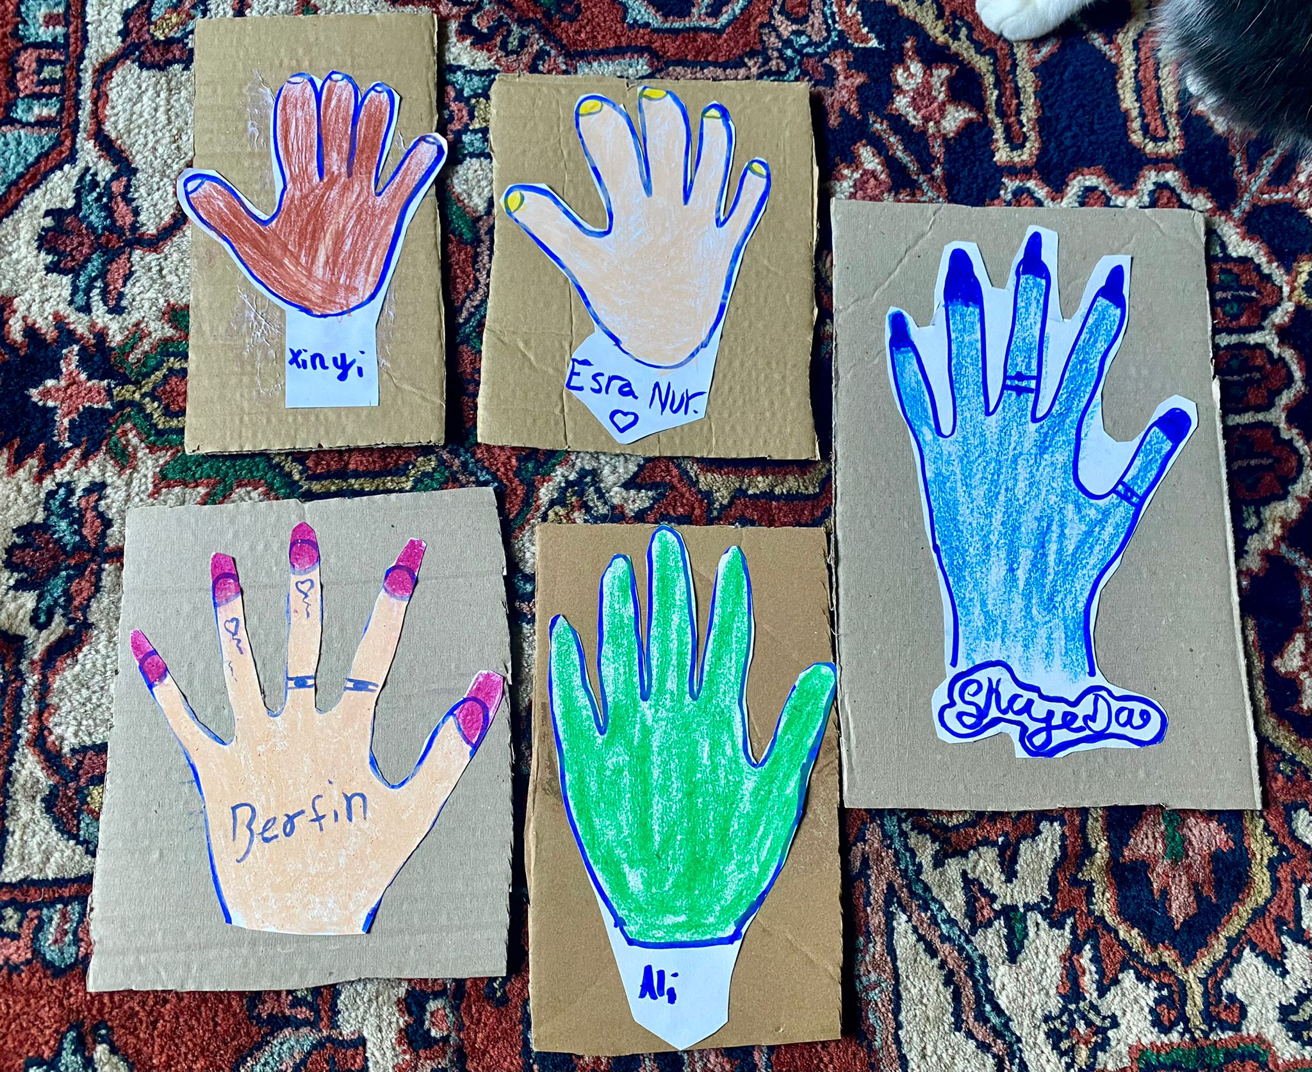
Slide Title 9
Covid Chronicles from the Margins
Impact of data sharing
Sharing our data has already benefitted many migrants by highlighting the creative and resourceful ways that they dealt with the pandemic and strengthened their ties of community and solidarity, but also how they shared so much suffering and grief over those they lost, and the deepening inequalities and social injustices they faced as a result of the UK’s Hostile Environment Policies for migrants.
Williams, Jeni (2022): Covid Chronicles: Beauty Day 19 November 2022 Glynn Vivian Art Gallery (Swansea Women’s Group). The Open University. Figure. https://doi.org/10.21954/ou.rd.21587688.v2
Marie Gillespie, PI of the Covid Chronicles project

Slide 8
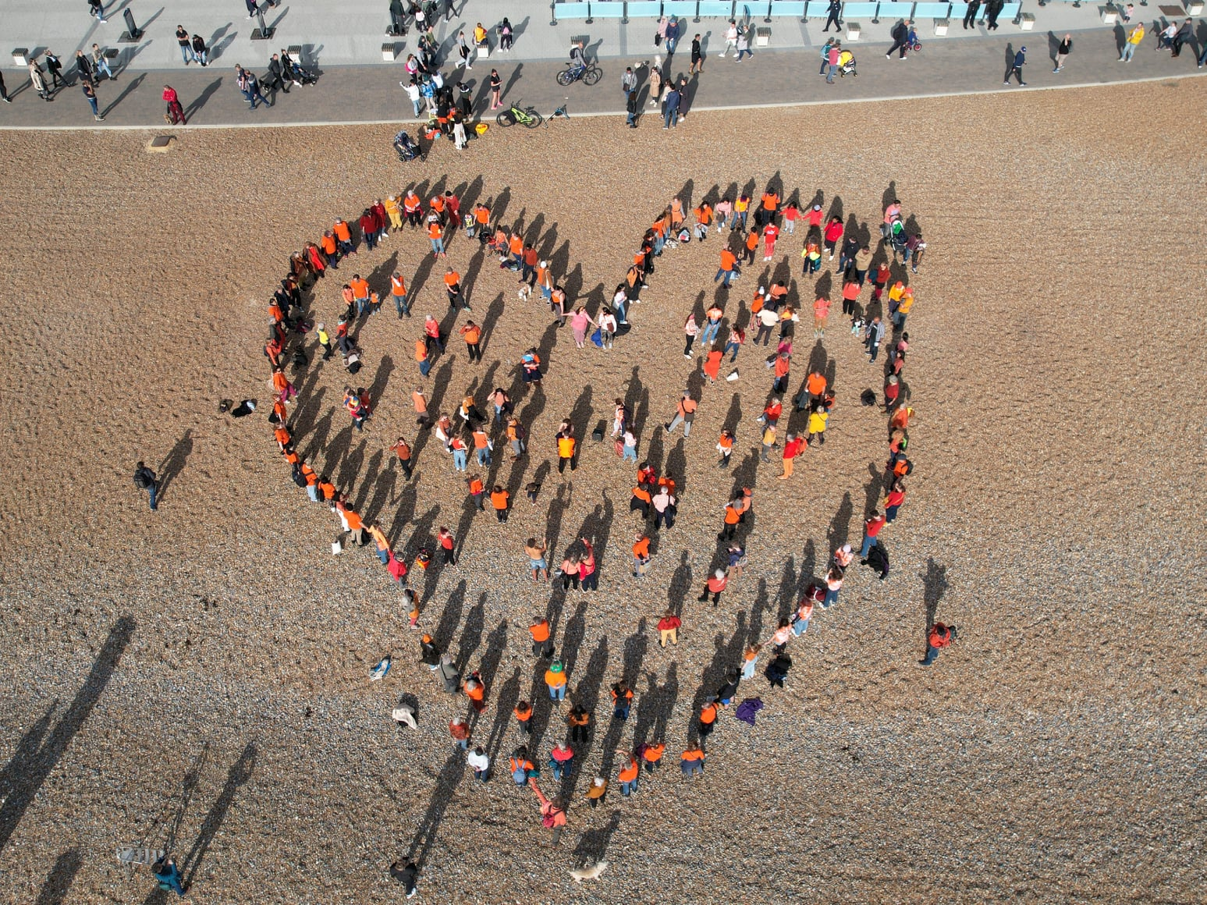
Slide Title 9
Covid Chronicles from the Margins
What’s happening next
The team are still collecting data, which now relates to the war in Ukraine and the impact of the UK government’s policies on immigration
Funding bid submitted over the summer, including Library time so we can continue to support the team with data management
A taught social sciences module at the OU is planning to use a curated collection of Covid Chronicles data on Figshare for students to use in their dissertations
Al-rashid, Ahmad (2022): Sanctuary on Sea: Protesting the UK's Nationality & Borders Bill. The Open University. Figure. https://doi.org/10.21954/ou.rd.16850380.v1

Slide 9
Slide Title 30
Thank you!
Contact the OU Library Support Team
Covid Chronicles from the Margins website

Slide 10
Slide Title 31

