Slide 1
REF 21/27 - The REF Window
adrian.c@figshare.com
visit figshare.com

Slide 2
Agenda
Looking back at REF
Figshare functionality and REF
REF 21 Environment statements
The REF window
Looking ahead to the next REF

Slide 3
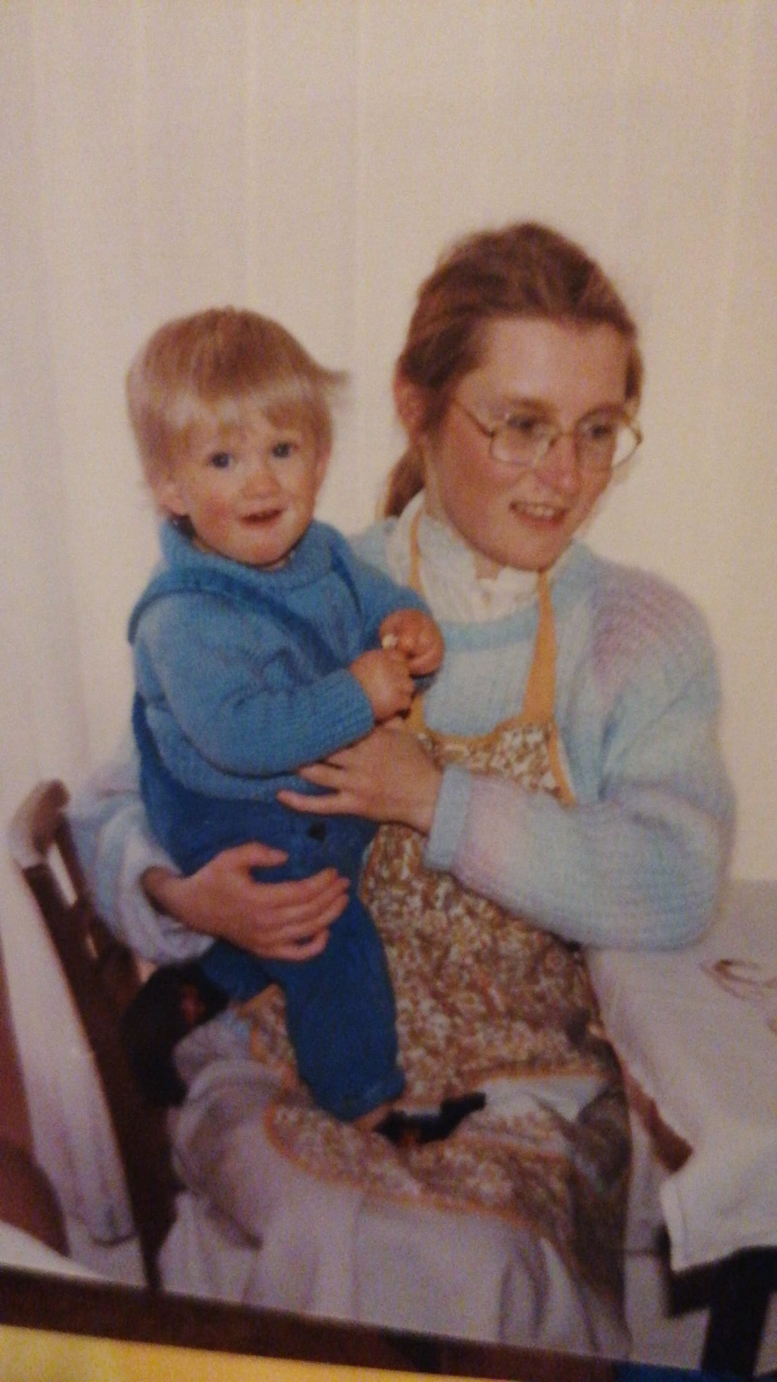
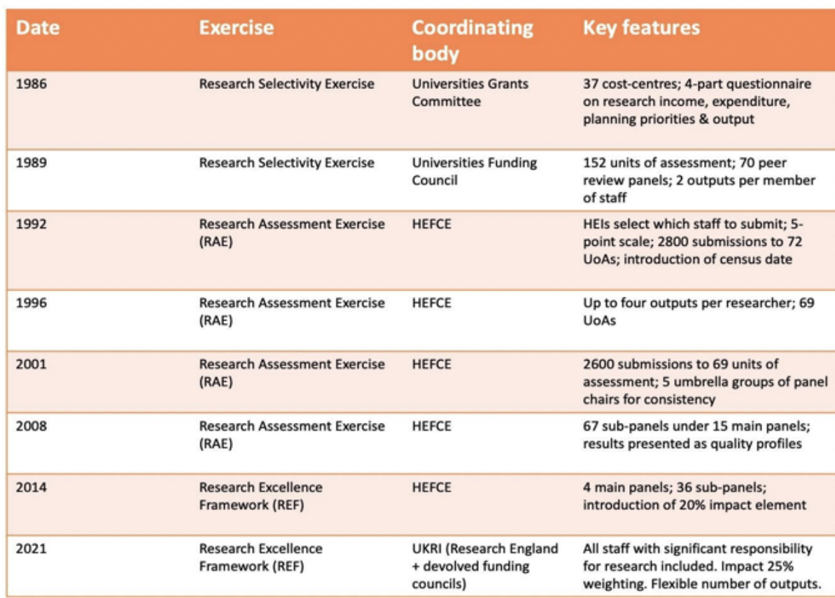
The Research Excellence Framework
What does the REF and this photo have in common?
Curry Stephen, Gadd Elizabeth, Wilsdon James 2022
Notes:
Here’s a picture of me just before my first birthday. What does this photo and the REF have in common, does anybody want to take a guess? They are both from 1986! Taking a look at this table we can see that the REF and it’s predecessors have been around in some form for just shy of 40 years, In fact, the report I took this table from makes the observation that very few people in UK higher education started their career before the REF or one of it’s permutations. What can we surmise about this, except my continued and tragic fashion sense? To misquote Kirkegaard the REF can only be understood backwards but it must be lived forwards. The first research selectivity exercise was heavily focussed on the economics of research production, and throughout its subsequent forms we can see an expansion in scope and purview, and the impact that has on the administration and effort of a quality REF return by institutions and the technology required to facilitate them. Whatever form the next REF takes, we can be sure that it will continue to evolve, compliance and quality will take on a re-focussed emphasis; I’d like to return to that towards the end of my presentation. For now, let’s remind ourselves of what Figshare is and does, and how that supports the REF.

Slide 4
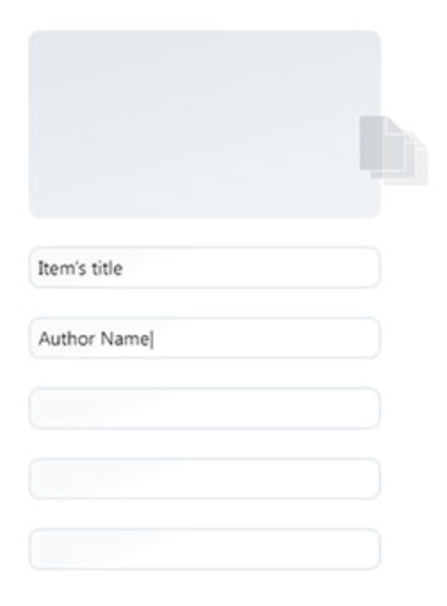
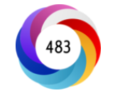
Create valid and persistent identifiers for research outputs
Gain and track
metrics and engagement to published outputs
Describe research outputs in contextual, shareable, and citable manner
Support Creative Commons, Open Access compliance, and adhere to policies/mandates
Ensure outputs are FAIR, discoverable, and indexable by other platforms
Notes:
Every published item on Figshare receives a persistent identifier, making it citable and discoverable. The highly configurable metadata schema allows institutions to describe and report on their outputs. In terms of FAIR, a doi and accompanying item metadata help to make items on Figshare findable. All published items on Figshare are accessible to anybody with an internet connection, no login required no paywall in the way of your research outputs and audience. Interoperable, metadata on Figshare is represented in a number of languages e.g. JSON, Dublin Core and OAI-PMH, as well as being OpenAIRE compliant, in short Figshare can communicate with other systems. In terms of Reusability items are assigned a clear licence with a link to the relevant terms. The default licence on Figshare is CC-BY, and metrics can be tracked from views and downloads to citations and altmetrics.

Slide 5
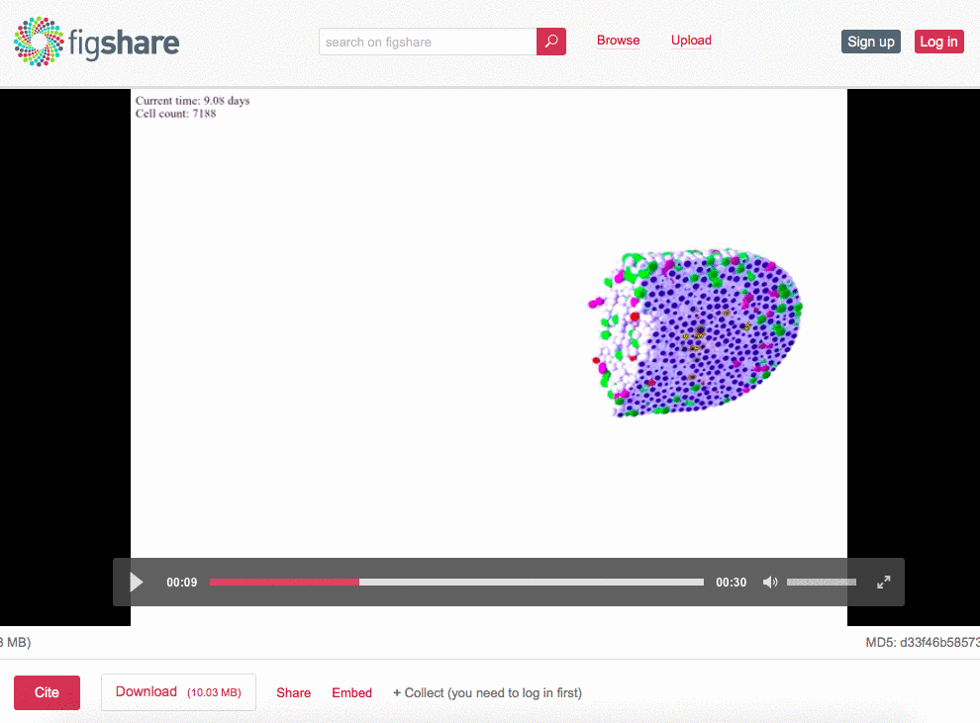
Figshare: support research across all disciplines
Articles & pre-prints
Books, book chapters & monographs
Datasets & figures
Theses & dissertations
Media files (audio & visual)
Software & code
Performances & events
Compositions
Digital collections & archived materials
Transcriptions
Clinical trial records
Presentations & posters
Educational materials & online resources
Reports & grey lit
Physical objects
Data management plans
Notes:
Figshare supports research across all disciplines. There are currently 27 item types in Figshare which comfortably accommodate all the different types of scholarly output on the screen. Whether it’s arts and humanities, social sciences or STEM, that’s thanks in part to our genesis, Figshare was born out of the requirement to host non traditional research outputs, and has grown to encompass traditional outputs, as we have heard from Mark, Figshare’s capability as a institutional repository has and will continue to to meet the demands of REF.

Slide 6
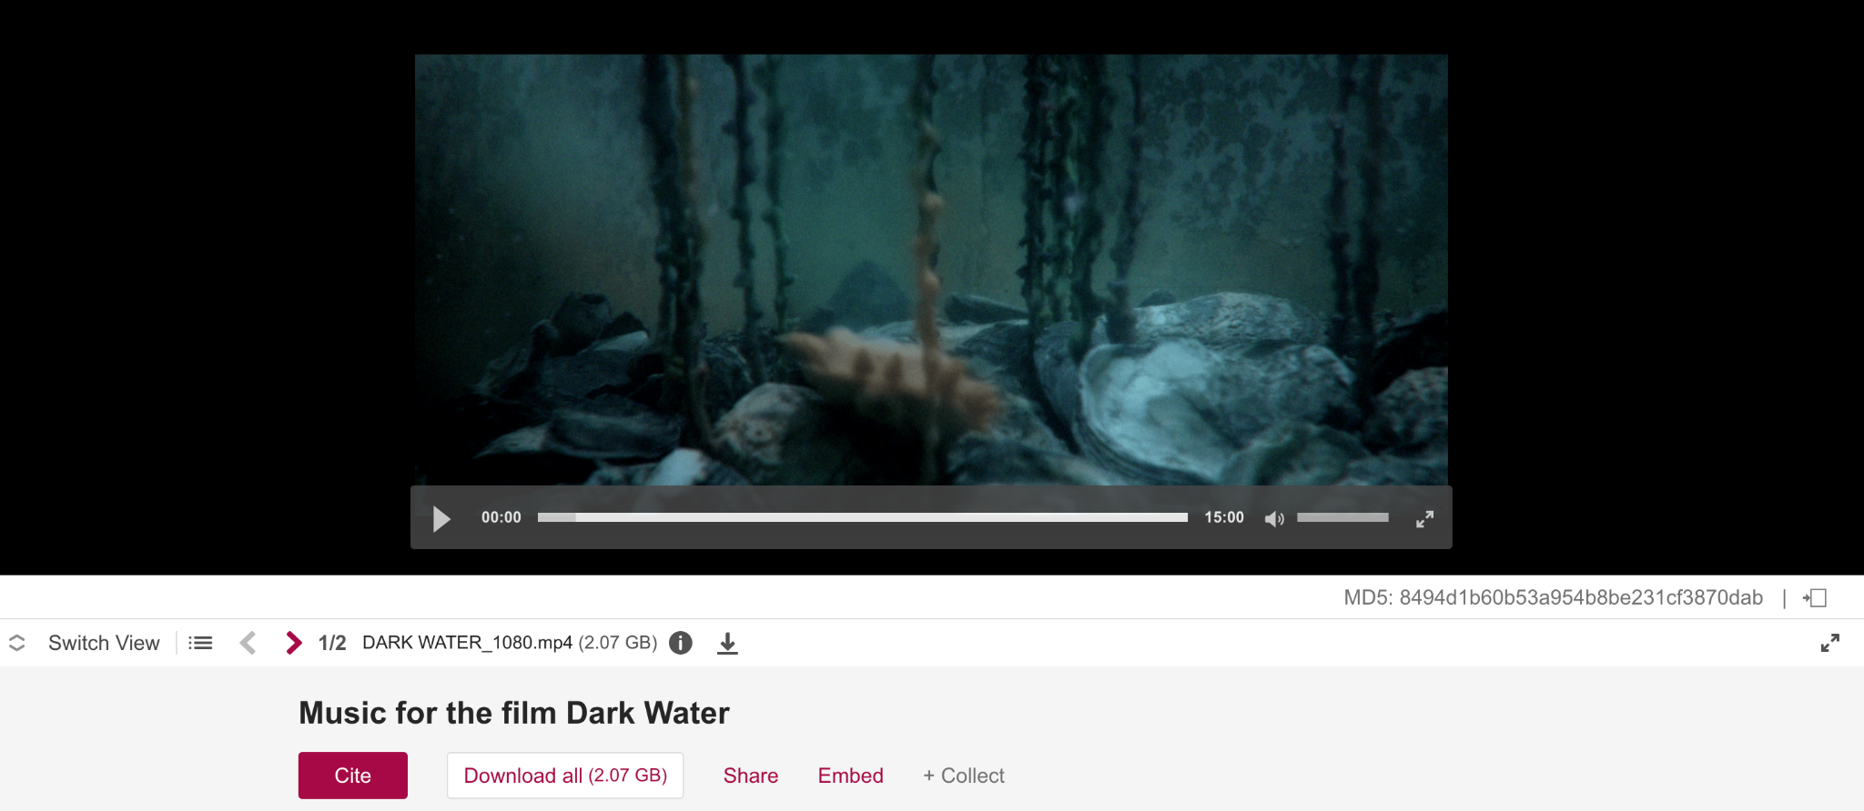
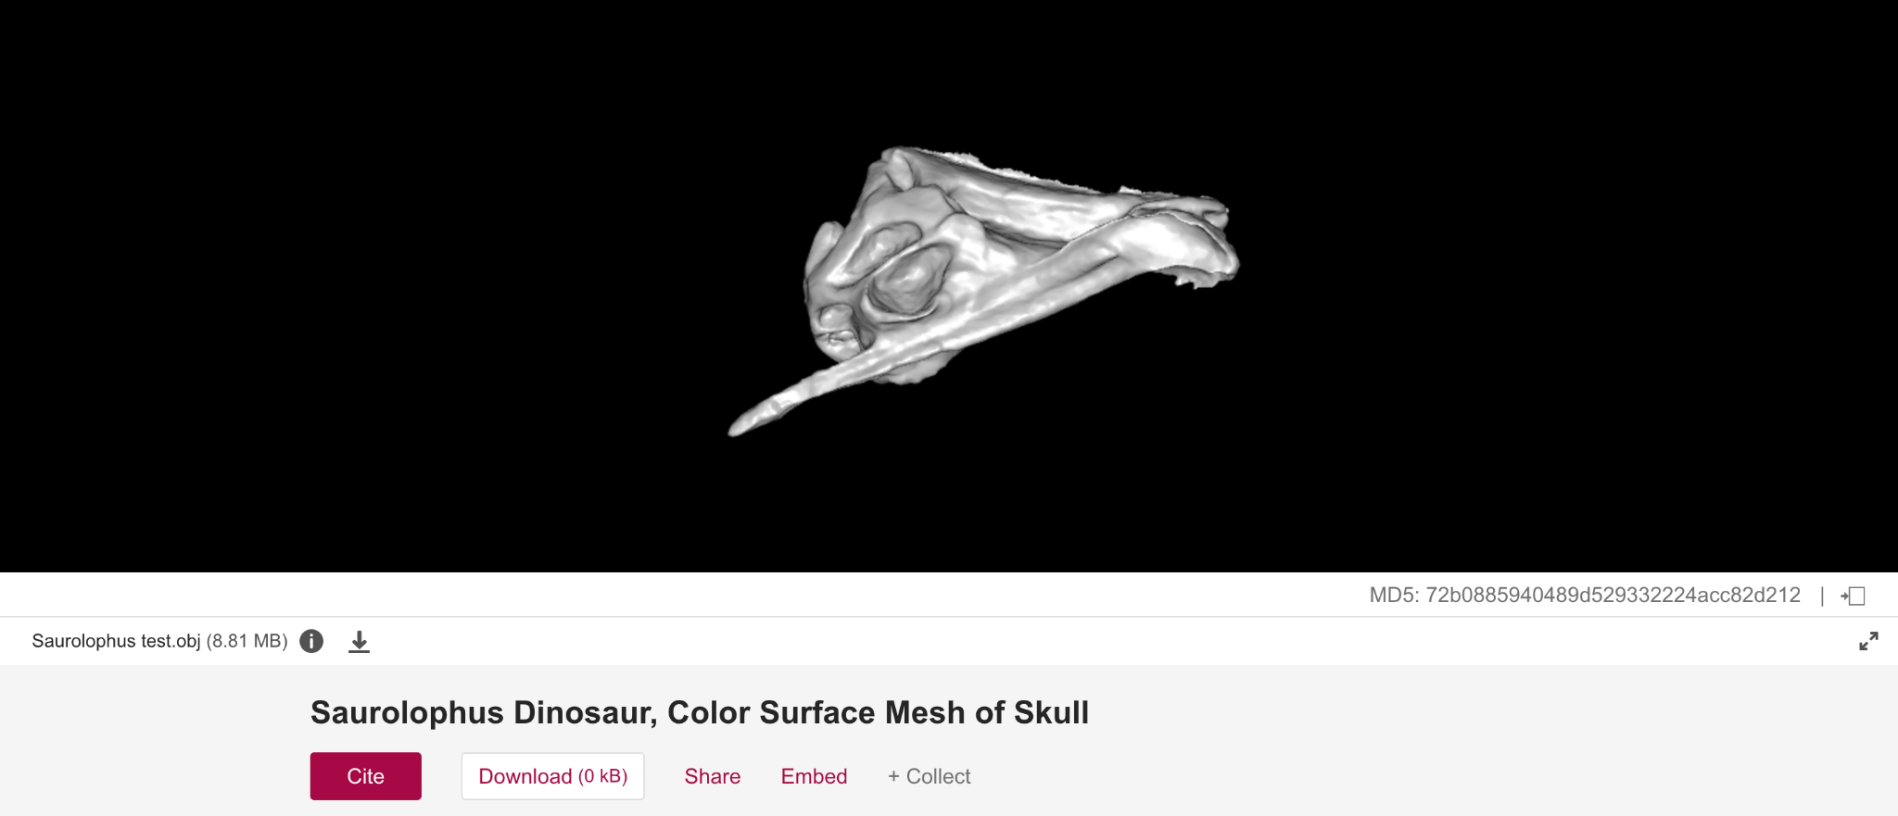
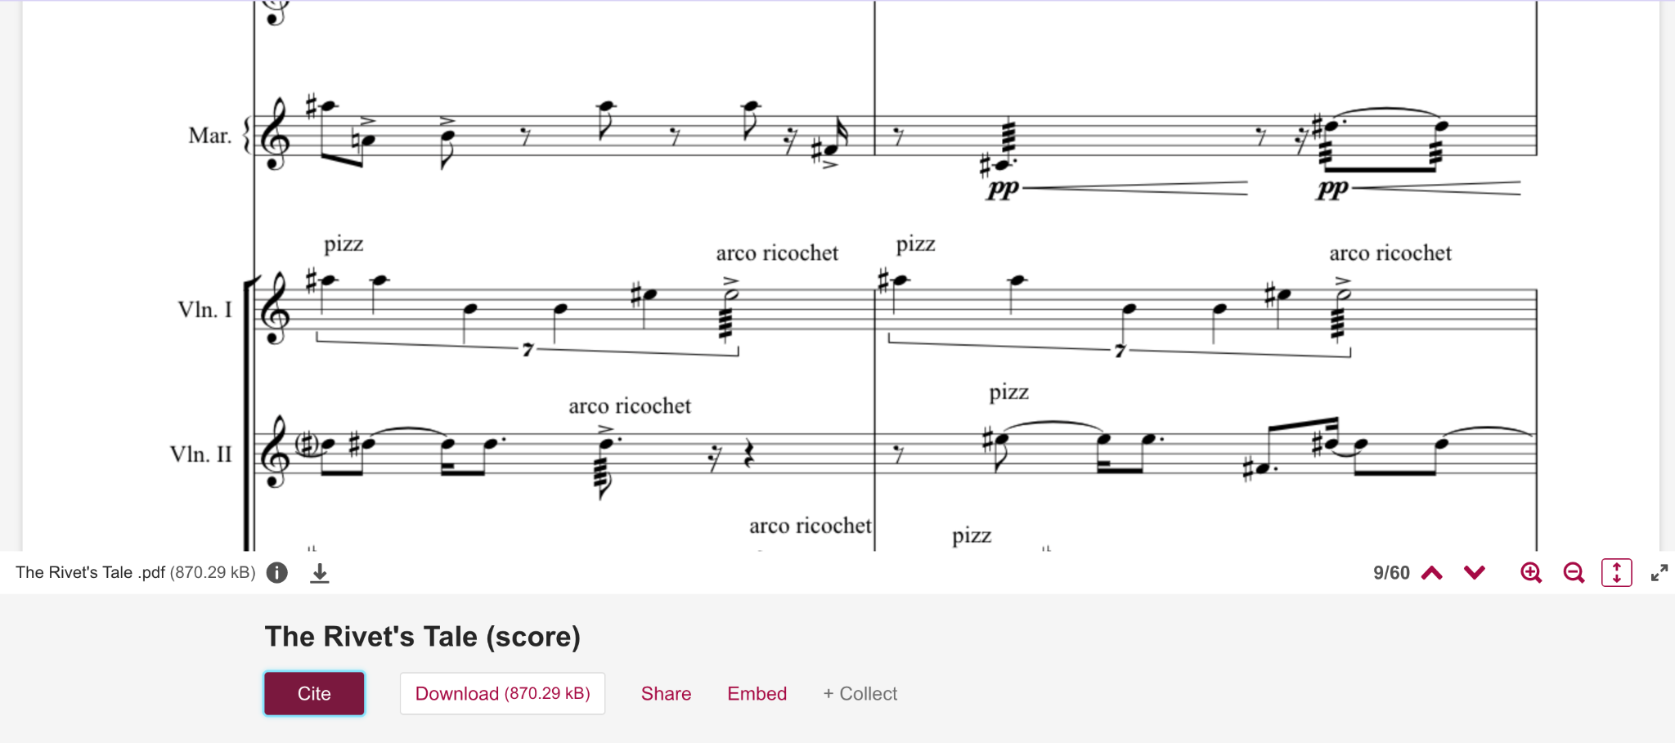
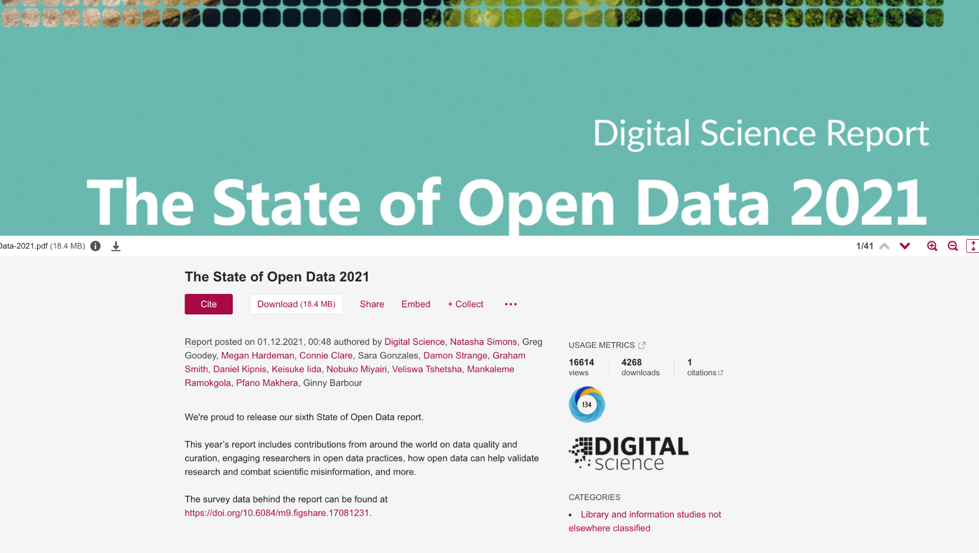
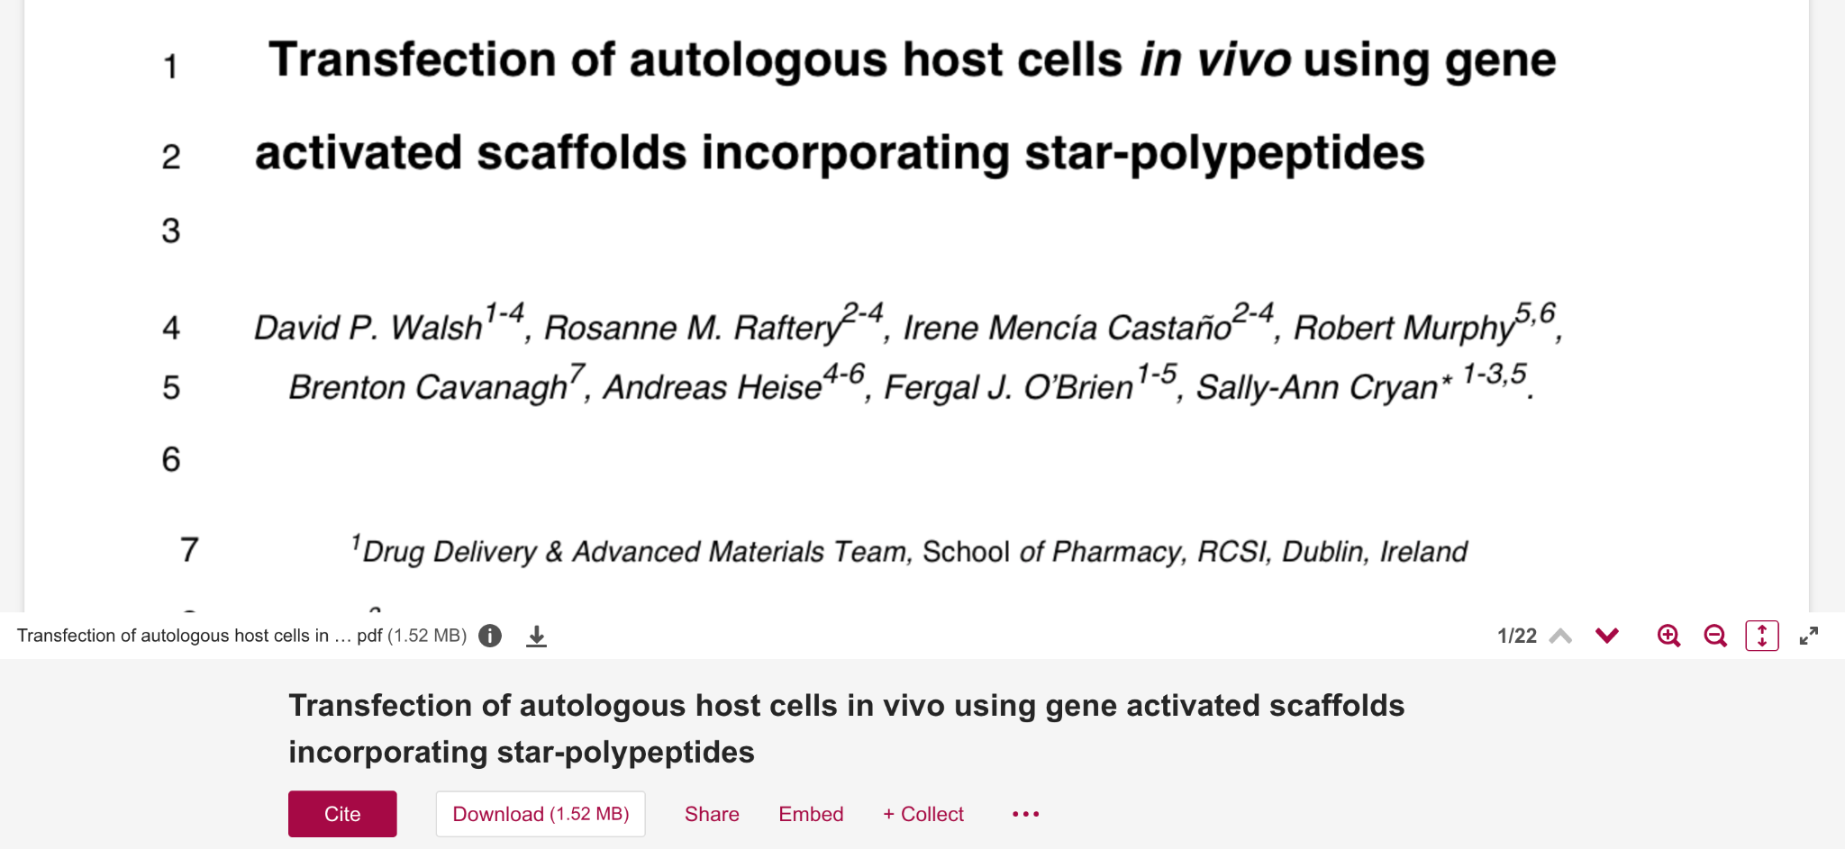
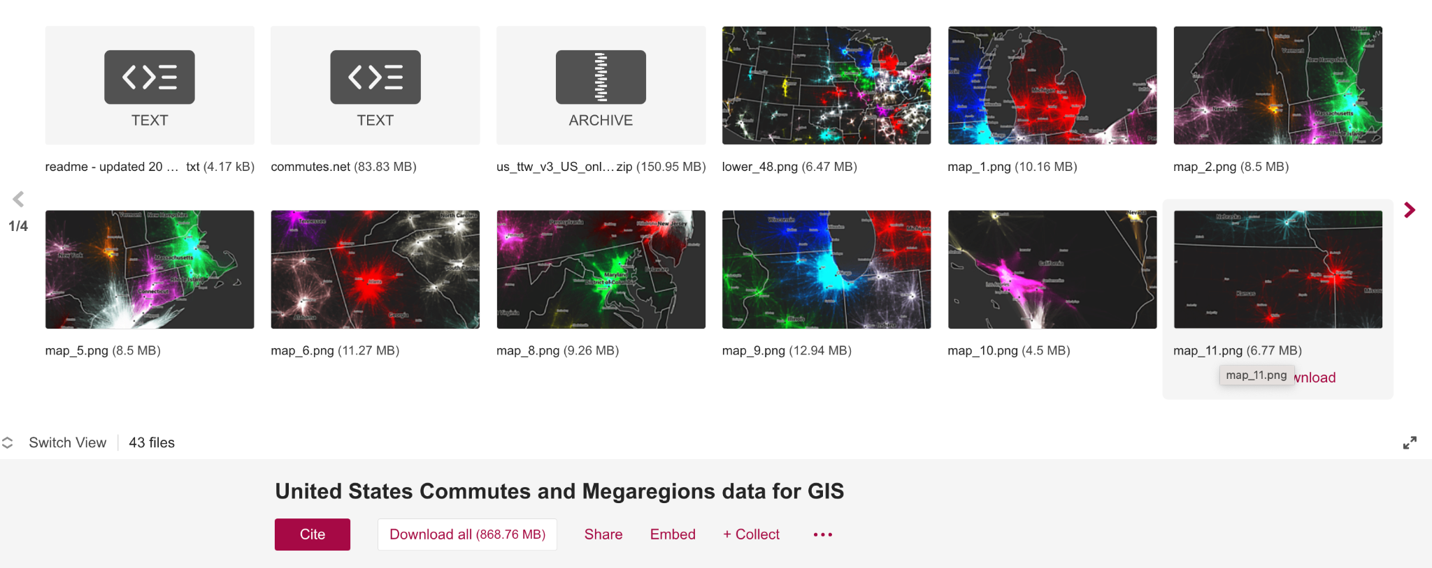
All types of research outputs…
…in any format
Notes:
Public / externally facing examples. Different types of research outputs are supported, with over 1,200 file formats that are previewable in the browser. View research as it was meant to be viewed.

Slide 7
REF 2021 Environment Statements
Notes:
13 partners cited FS in their REF environment statements; the number and diversity of institutions, I think, demonstrates the impact that Figshare has had on UK research infrastructure. Before we take a look at what some of our partners said in their environment statements, let's remind ourselves of the REF 21 access requirements.

Slide 8
REF 21 Access Requirements
241. The output must be presented in a way that allows it to be discovered by readers and by automated tools such as search engines. The discovery requirements should typically be fulfilled through the storage and open presentation of a bibliographic or metadata record in the repository. Once discoverable, the output should remain so.
243. The output must be presented in a form that allows anyone with internet access to search electronically within the text, read it and download it without charge, while respecting any constraints on timing (as detailed in paragraphs 246 to 251). It is advised that outputs licensed under a Creative Commons Attribution Non-Commercial Non-Derivative (CC BY-NC-ND) licence would meet the minimum requirement. Once accessible, the output should remain so.
Notes:
I think I’ve covered most of these requirements and how Figshare meets them when I was talking about Figshare and FAIR. In terms of discoverability. One thing I didn't touch on was persistent availability - Figshare being based on AWS infrastructure is guaranteed for 10 years, and there are specialist preservation software that Figshare integrates with for example Arkivum.

Slide 9
What our partners said: 1
“
Openness and engagement are central to our research culture, and recent investment has extended our open access ambitions. This includes the implementation of ‘Elements’, a Research Information System, and Figshare a digital repository for research data, increasing discoverability and encouraging re-use
“
Image by Lukas from Pixabay
Notes:
Sussex; I really like it how this statement opens with an expression of culture, cultures are about people, and we are not robots. Essentially, the REF is about people, just like most things are. To see Figshare front and centre as infrastructure that is catalysing the behaviours and capabilities of openness and engagement, to me, is really edifying as we move towards open research.

Slide 10
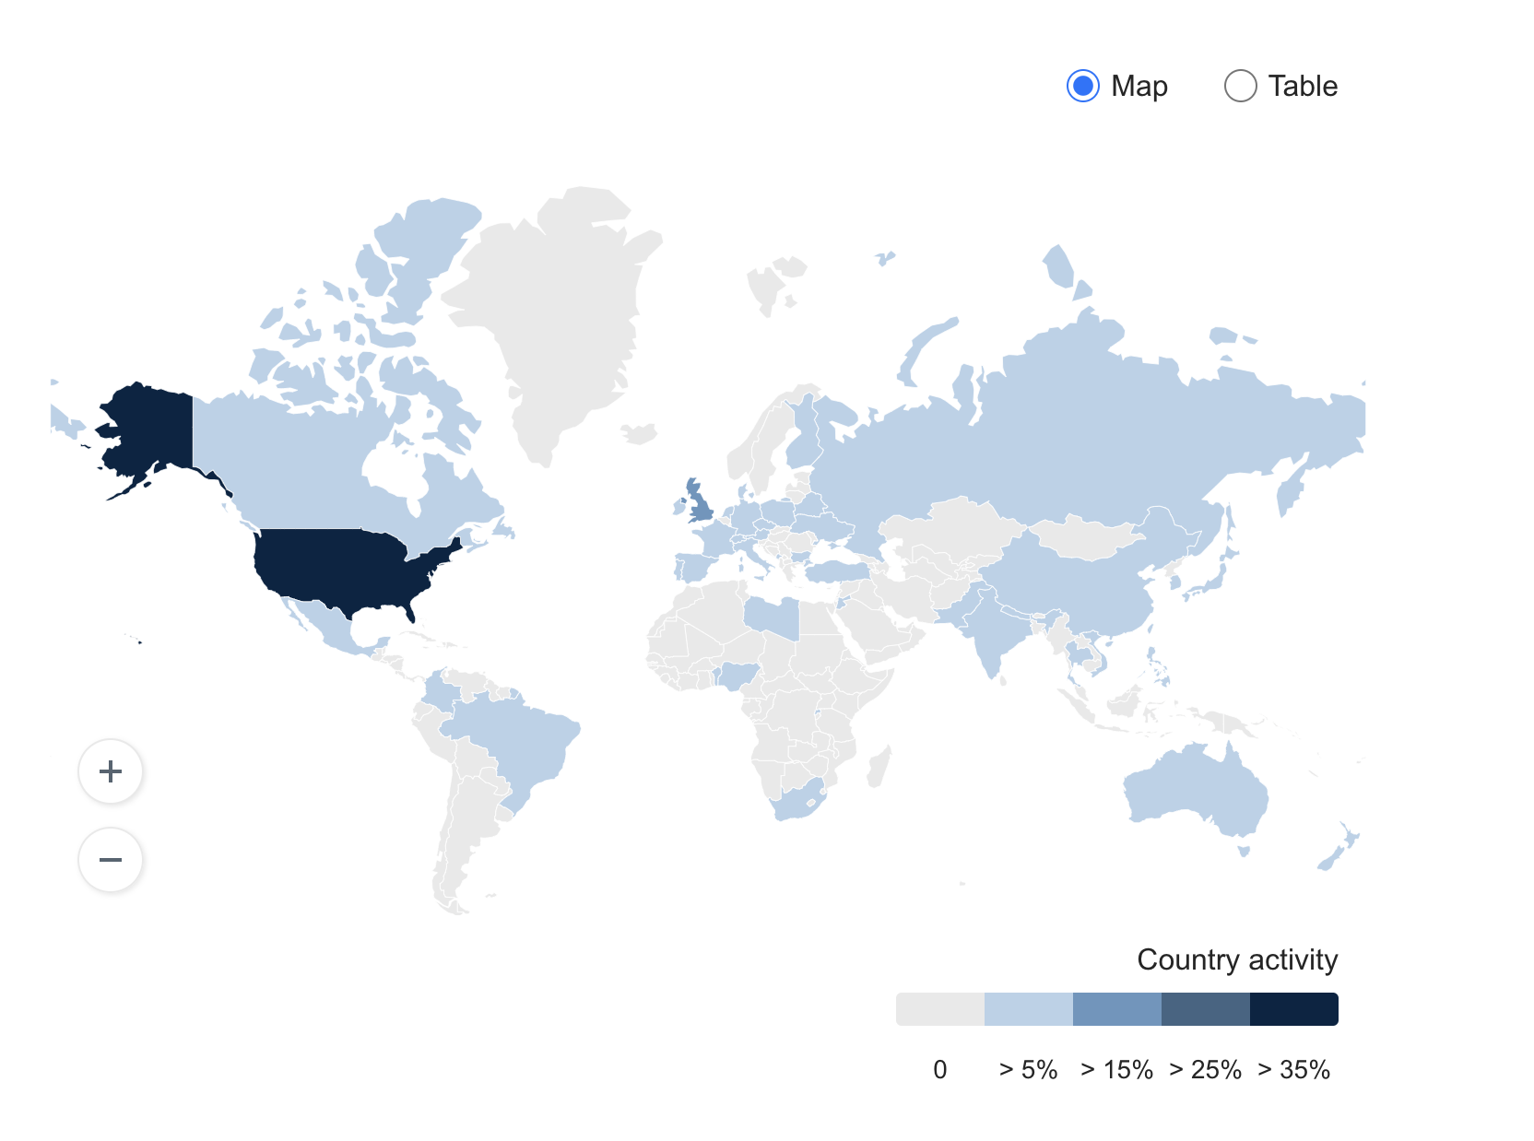
What our partners said: 2
“
Since its launch in June 2019, the Data Repository has seen 200 items published, 1.1TB of data uploaded, 72,000 views and 23,000 downloads across 50+ countries
“
Notes:
UCL; in this statement the focus is on adoption of the repository by the community at this institution. While it’s great to see the uptake and usage of the repository, what I think is most interesting about this example is the focus on the global reach of the research. When we are thinking about REF, or at least when I am, I can very quickly fall into the trap of thinking of it as the research trip advisor - think of the language that’s used - 4 star quality that is world leading, but that’s no good if one person and their dog are interacting with it. Here we can see that is clearly not the case.

Slide 11
What our partners said: 3
“
Figshare securely stores data, allowing exclusive access by an individual, shared access within specific networks of any size and/or, where appropriate, public sharing. Post-REF2021, it will replace **** as our universal repository
“
Image by NoName_13 from Pixabay
Notes:
Cardiff Met; for my third and final example I want to focus on this statement. partly because it profiles very neatly Figshare’s ability to provide controlled access to research outputs and has the ability to highlight the institution’s research to a public audience. Also, because individually a significant number of you have told me that you may be in a similar position, having got through REF 21, and are considering upgrading your data repository to a Figshare powered ful IR - of making one system that submitting to the REF easy - would it make sense to do it all in our system, large UK user base - recommended time frame, in the first year

Slide 12
The REF Window or The Sweet Spot
Business Case
Stakeholder engagement
Contract signed
Deposits into the new IR
2025/6
2023
2024/5
2027
Implementation
Migration
Advocacy and training
Selection of ‘REFable’ outputs and submission

Slide 13
Looking ahead to the next REF: OA Requirements
monographs and other long-form publications
non-text outputs
working papers or outputs submitted to pre-print systems that are not the version ‘as accepted for publication’
the data which underpins some research
confidential reports that are not published because of commercial or other sensitivity
Notes:
List of excluded from OA in 2021 REF - can realistically anticipate the bold points to come in as OA requirements - Figshare can handle these

Slide 14
Looking ahead to the next REF: [not so?] Blue Sky
AI and machine learning
Enhanced and structured environment statements
Openness in research data infrastructure and technologies
Mandatory ORCiD

Slide 15
In summary
Figshare makes research discoverable in a way that complies with REF’s access and discoverability requirements
A single solution for data and papers is under serious consideration throughout 2023
REF could radicalise

Slide 16
Reference List
C. Stephen, G. Elizabeth, and W. James, “HARNESSING THE METRIC TIDE:,” 2022, doi: https://doi.org/10.6084/m9.figshare.21701624.v2
Research England, “REF 2021: Overview of open access policy and guidance,” 2019 [Online]. Available: https://www.ref.ac.uk/media/1228/open_access_summary__v1_0.pdf

Slide 17
Questions

