Slide 1
Case Study
SMU’s RDM Journey – Policy and Engagement
DONG Danping
Librarian, Research Services
YEO Pin Pin
Head, Research Services

Slide 2
Overview
RDM policy development 2017-2020
Implementing SMU’s Research Data Repository
Outreach & Engagement
Paper repository – feasibility study
Learnings & Reflections

Slide 3
Drivers for Institutional RDM
Singapore Joint Statement on Research Integrity Relating to Scholarly Publications (2010, 2018)
Growing number of international journal & funder policies for reproducible research
Early work and indicators for RDM services at SMU Libraries since 2010
Quality
Storage
Preservation
Openness
Compliance
Reproducible Research
Storage space
Archiving and
Transparency &
Funder, publisher and
preservation
data reuse
institution policy

Slide 4
Developing SMU’s Institutional RDM Policy
Existing relationship between SMU Libraries and Office of Research and
Tech Transfer (ORTT)
Formed RDM Policy Working Group in 2017
Studied local and overseas RDM policies
Studied publisher data policies

Slide 5
Developing an institutional research data policy
Draft policy in 2018, final approved policy in 2020
Consultation with stakeholders
School Deans & Academic Faculty Senate, legal office
Interview 18 faculty to understand their current practices and feedback on policy
Key points
Rights to use/ownership
Roles & responsibilities
10-year data retention

Slide 6
Selecting SMU’s data repository platform
Objective: To provide services and support for SMU’s RDM policy
Conducted feasibility study of data repository solutions in 2018
Environmental scan to identify solutions and their strengths/weaknesses
Identify institutional requirements
Prepare specifications and evaluation criteria

Slide 7
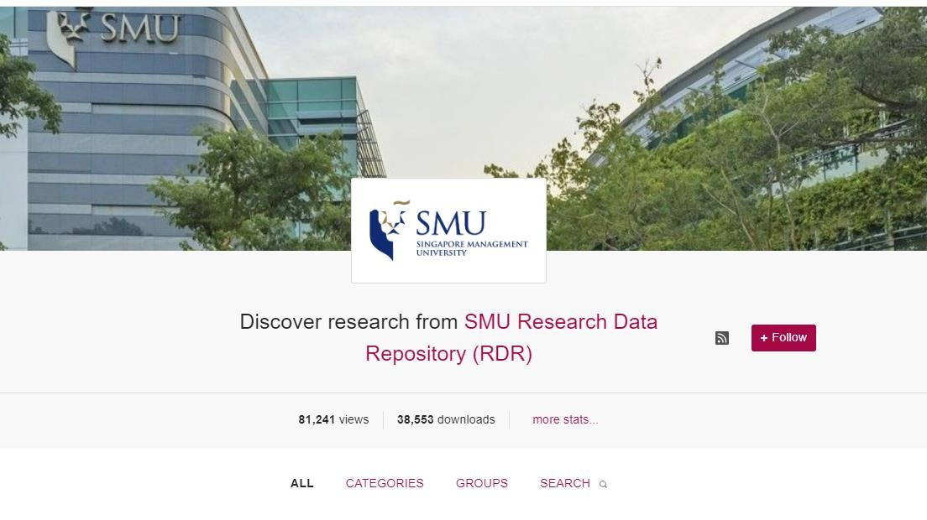
Implementing SMU Research Data Repository (SMU RDR)
Worked together with IITS and research
office (ORTT)
Call for RFQ
Evaluation, award to Figshare, and
system implementation
Launched April 2020

Slide 8
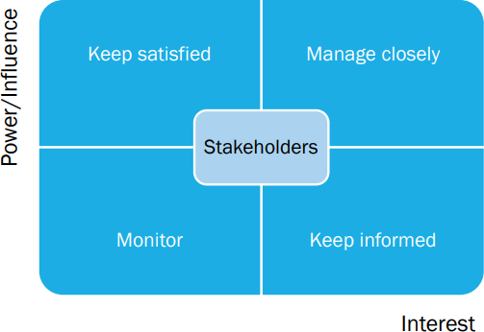
Stakeholder Engagement
SMU President and Provost
Vice-Provost (Research)
School Deans and Vice-Deans for research
Research office
IT
Legal office
Faculty and researchers
Academic faculty senate
Internal stakeholders from the Library

Slide 9
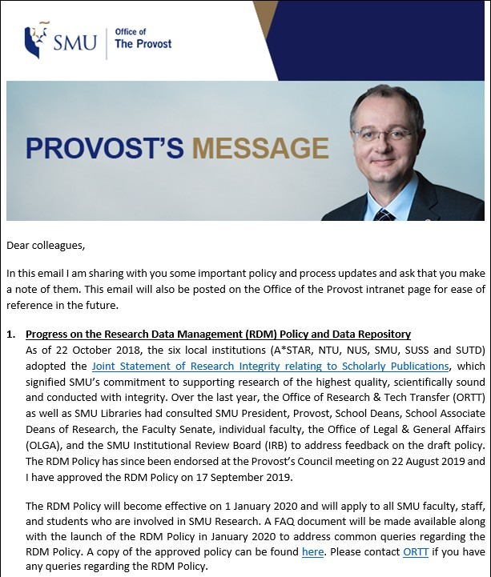
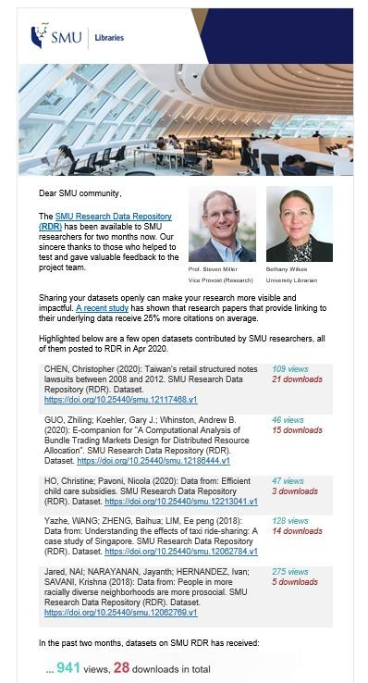
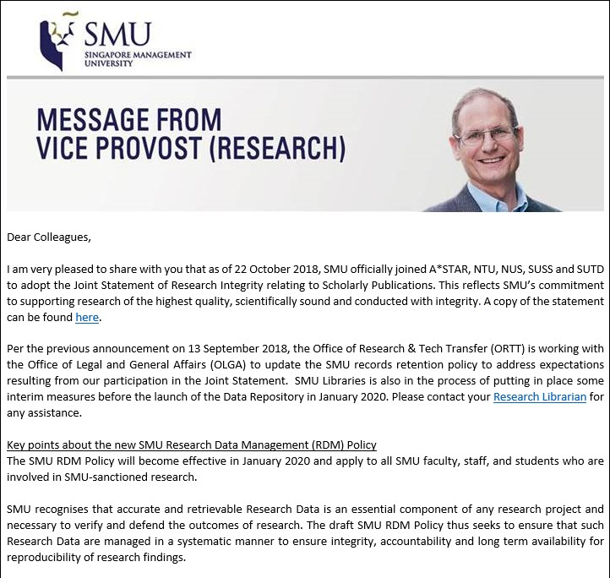
Outreach and engagement
EDMs (University Management)

Slide 10
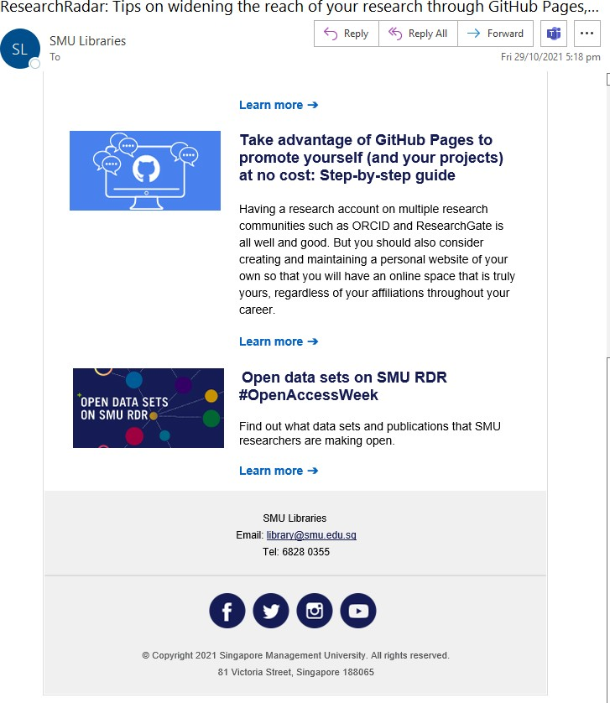
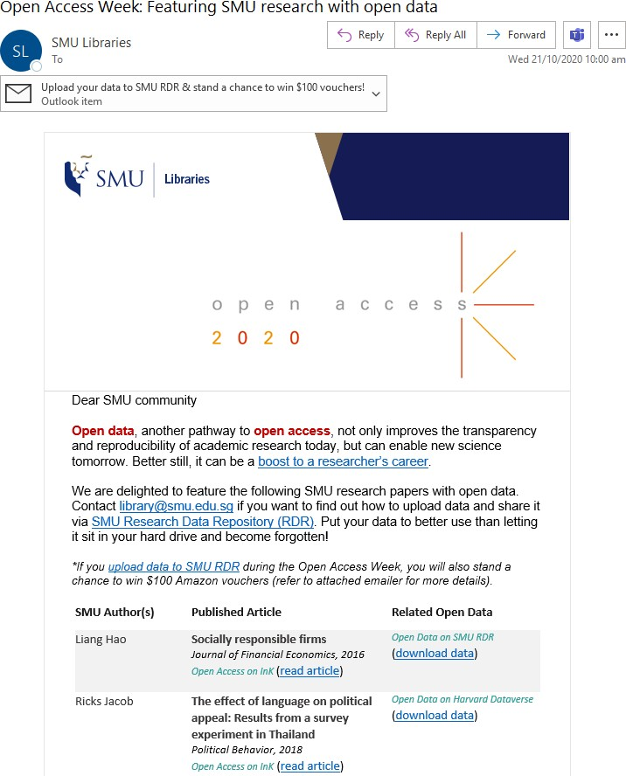
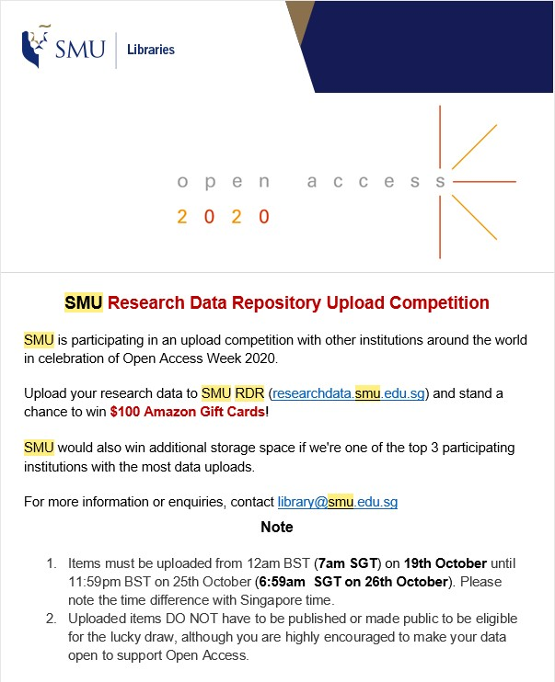
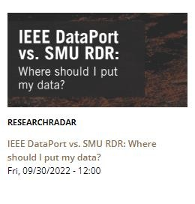
Outreach and engagement
EDMs (Open access week & featured data)

Slide 11
Outreach and engagement
School meetings – awareness raising for RDR and communicate benefits
Engaging individual researchers/research teams
Meeting publisher requirements
Papers mentioning data/code available elsewhere
Faculty personal website
Self-declaration of research data in CRIS

Slide 12
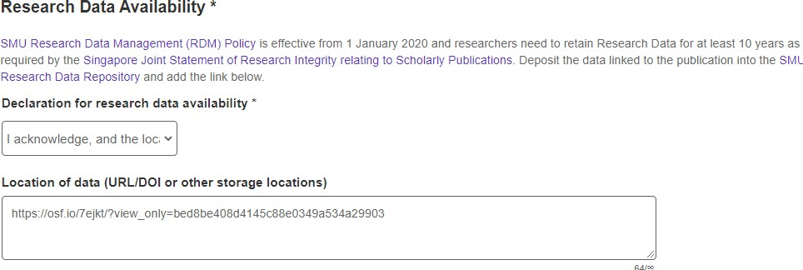
Researcher declaration on data

Slide 13
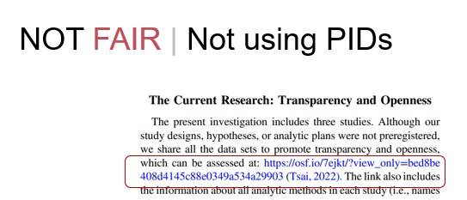
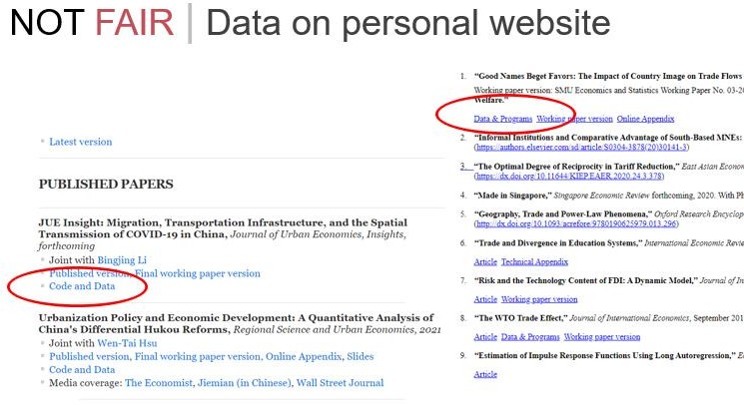
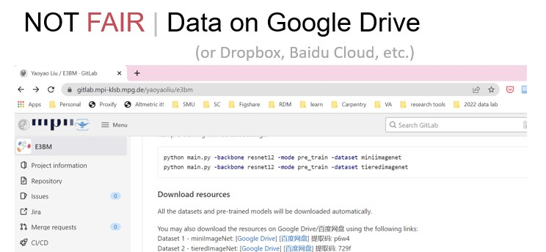
Some ad-hoc observations

Slide 14
Persuading researchers
What’s in it for them?
Storage space 100GB/user
Issue a DOI
FAIR data
Long-term persistence
Discoverability

Slide 15
RDR vs. other data sharing platforms
 | Storage capacity | Notes
SMU RDR | 100GB or more Upload individual files up to 5TB | API or FTP uploader for larger files
OSF | 5GB for private projects 50GB for public projects | Connect with RDR for more space
GitHub | 2GB | Connect with RDR for more space & get a DOI
Mendeley Data | 10GB | Similar to RDR
Zenodo | 50GB per dataset | Similar to RDR
Cloud Drives (e.g. Google, Baidu) |  | Not recommended!

Slide 16
Learnings & Reflections
RDM needs to be a strategic and university-wide initiative
Collaboration & stakeholder engagement
When there is no top-down requirements, the service must provide value
Get involved in other areas of research support
Engage, communicate, persuade

Slide 17
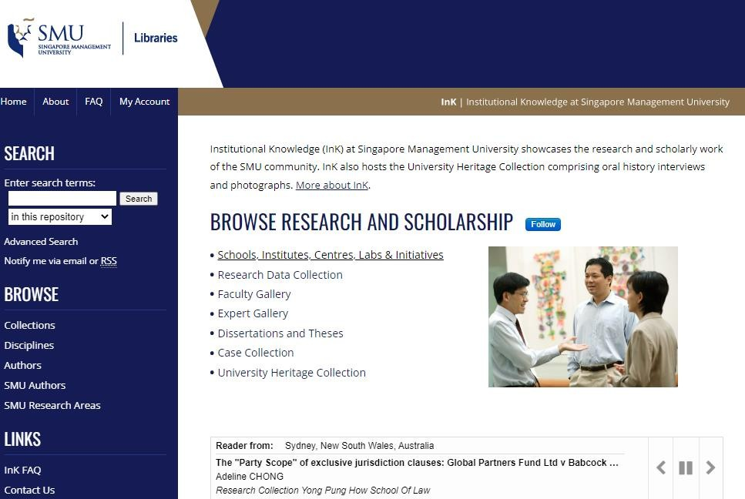
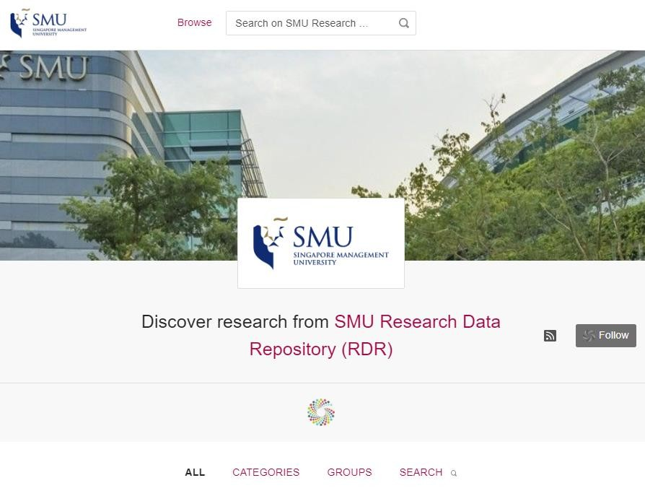
Figshare as a paper repository?
2021 feasibility study – use Figshare as SMU’s IR
Current IR on Digital Commons

Slide 19
Results and Findings
Difference in download counts is not statistically significant
100% of InK records indexed by Google Scholar vs. 77% of RDR
Most of the traffic come from Google, not Google Scholar

Slide 20
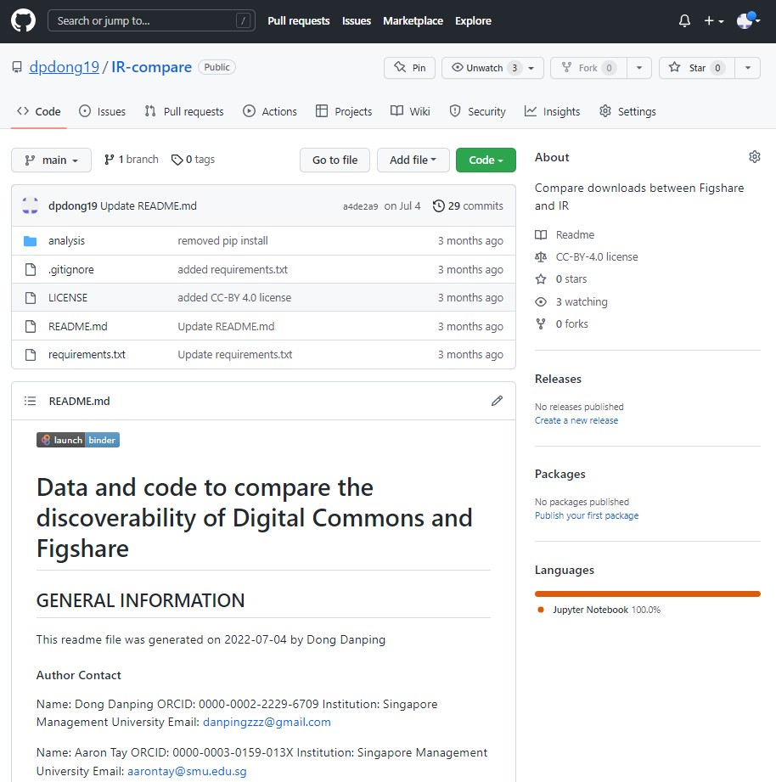
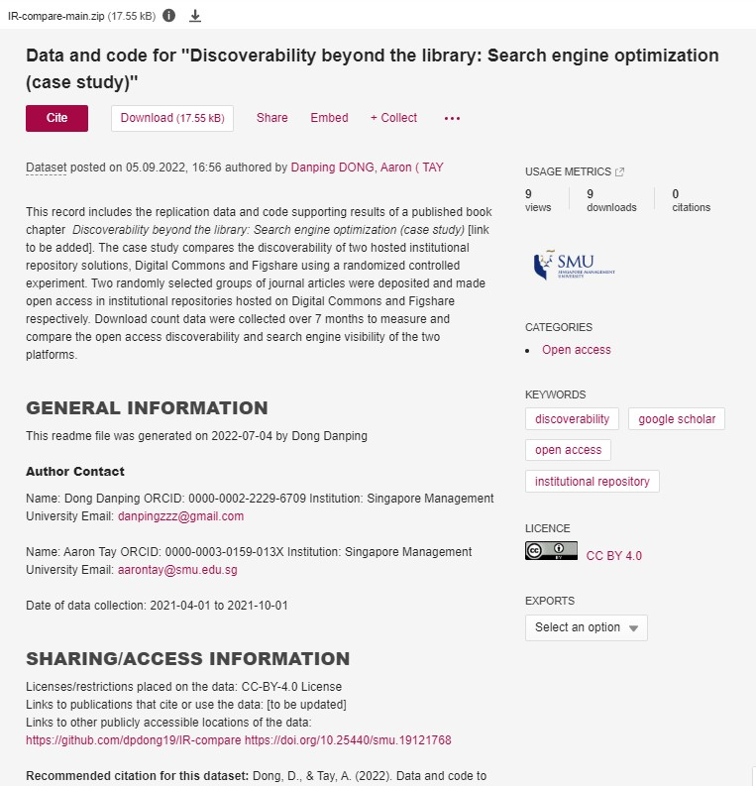

Slide 21
Other considerations
API and integration with CRIS
Branding and user familiarity
Features for publications
Reporting
SWOT analysis

Slide 22
Thank you!
Any Questions?
Danping (dpdong@smu.edu.sg) Pin Pin (ppyeo@smu.edu.sg)

Slide 23
Figshare Fest
October 2022
Christopher Blumzon - Head of Product Development

Slide 24
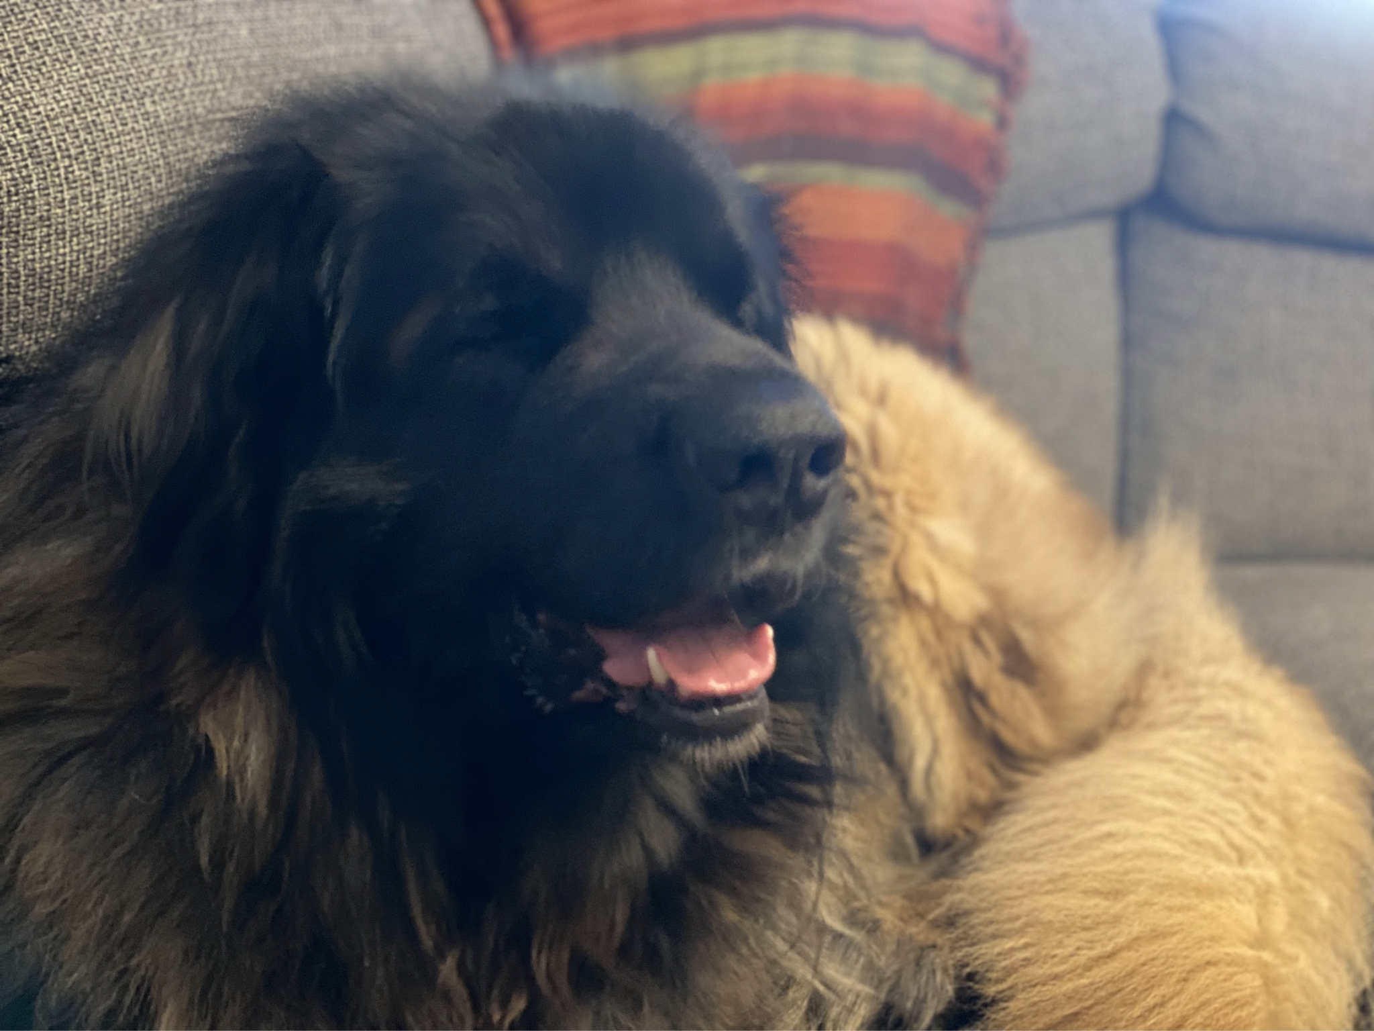
Hello and welcome
I’m Chris Blumzon
Head of Product Development
First UK Hire
Been with figshare almost 10 years
Ask me about Star Wars, books, gaming, films or weightlifting
This is my dog, Chewbacca

Slide 25
What are we talking about today?
An introduction to Product at figshare
Public roadmap - https://tinyurl.com/figgymap
IR Roadmap - https://tinyurl.com/figIR
figsharerepository
A brief rundown of process
A look back over the last year
Our goals for the next year
Some early looks into our plans further ahead

Slide 26
Where do requests come from?
Users
Events
Mandates
New Clients
Sales team
Admins
Internal initiatives
Partner organisations
Legal & Compliance
Digital Science teams

Slide 27
How to we evaluate feature requests
We get a lot of requests!
Retention - Keeping existing clients happy!
Expanding use - How can we help our clients increase the breadth of their usage of figshare?
End user usage - How can we help the experience of using figshare?
Innovation - What can we do to shape the space
Policy, regulatory and legal - Ensuring compliance at every step
Technical feasibility - Is it doable and is it the right time to do it?

Slide 28
The process
Analyzing the request & acceptance
User Interviews
Document initial thoughts
Internal review
Design sketches
Community review (https://tinyurl.com/figsharerequest)
User testing
Development begins!

Slide 29
The development process
Requirements
Design finalisation
Specifications
Technical review & sign off
Development commences
Code review
Testing/QA
Release
Promotion

Slide 30
How has the last year been?
What have done?
Edit Item (beta)
Batch upload
New Text editor
Sherpa Romeo
ORCID integration
New custom metadata long list
TEI viewer
Github/Gitlab/Bitbucket
ROR Migration
FOR 2020 migration
New groups navigation

Slide 31
Edit item

Slide 32
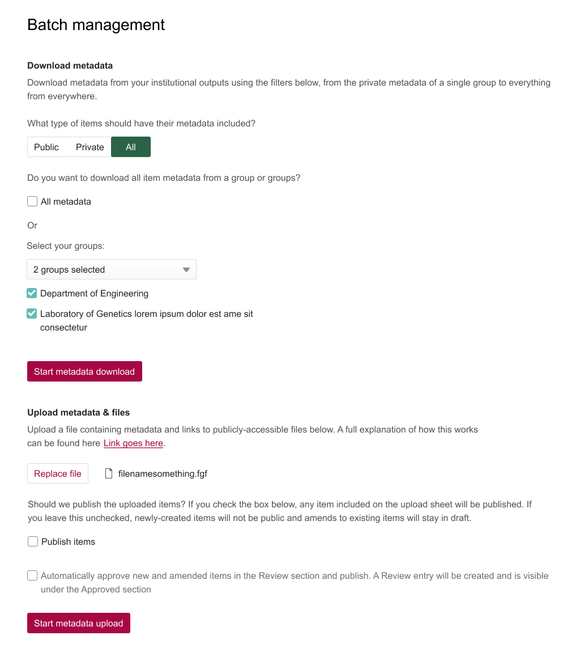
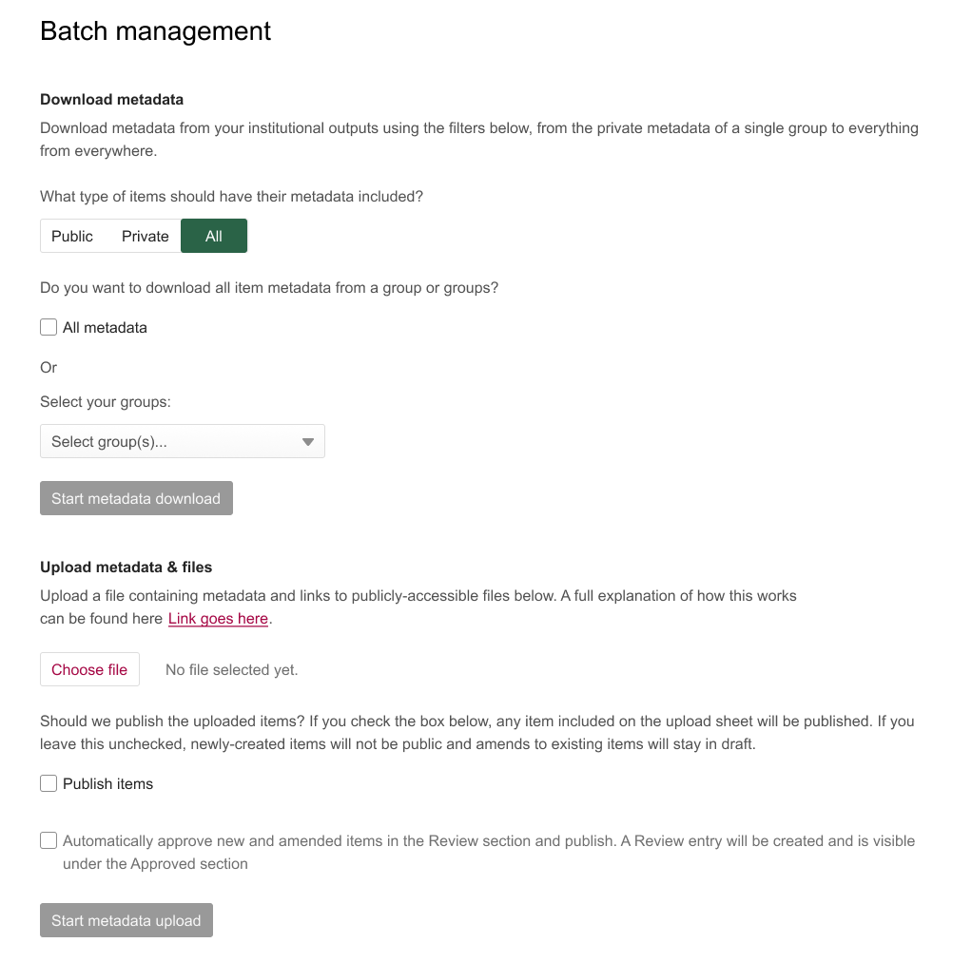
Batch upload

Slide 33
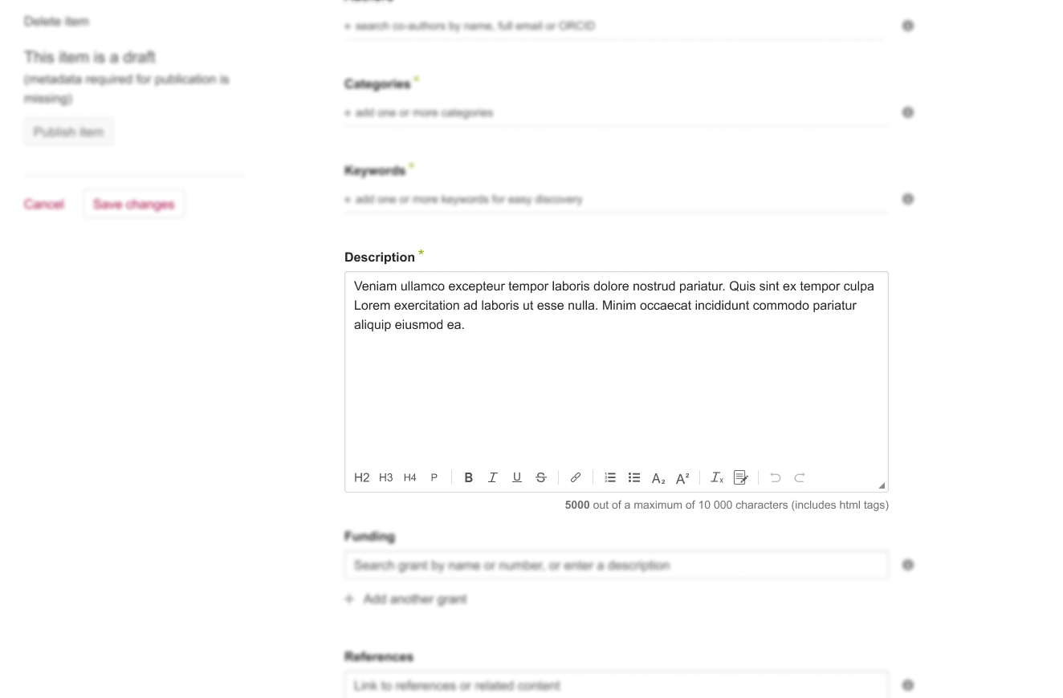
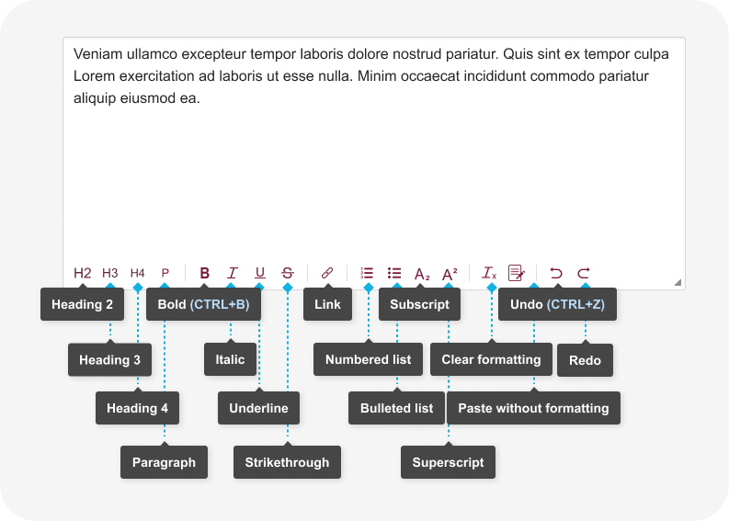
New Text editor

Slide 34
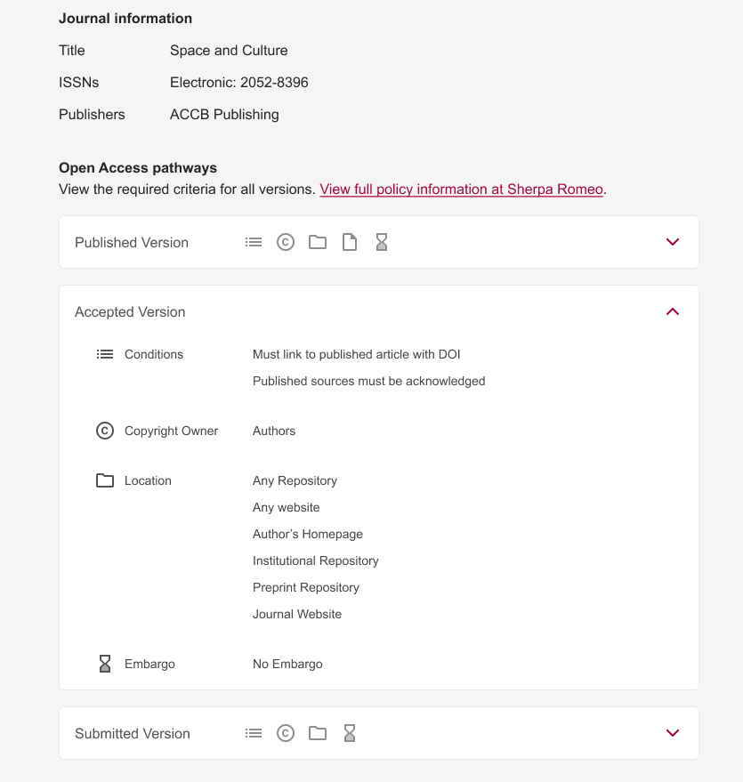
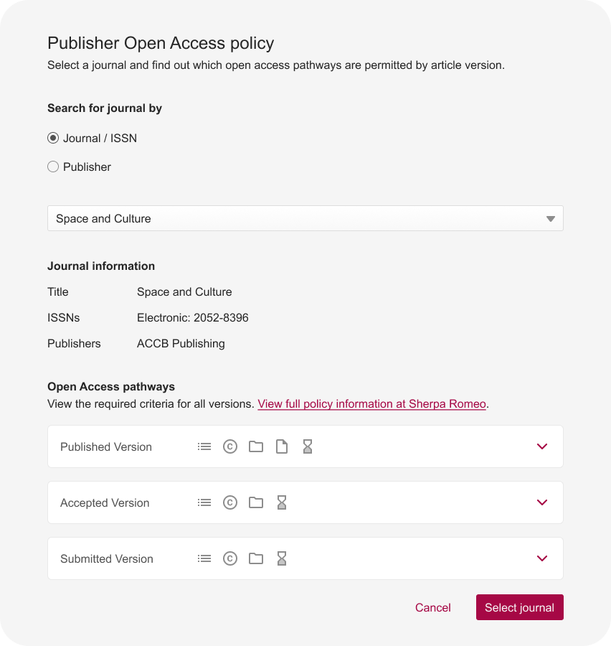
Sherpa Romeo

Slide 35
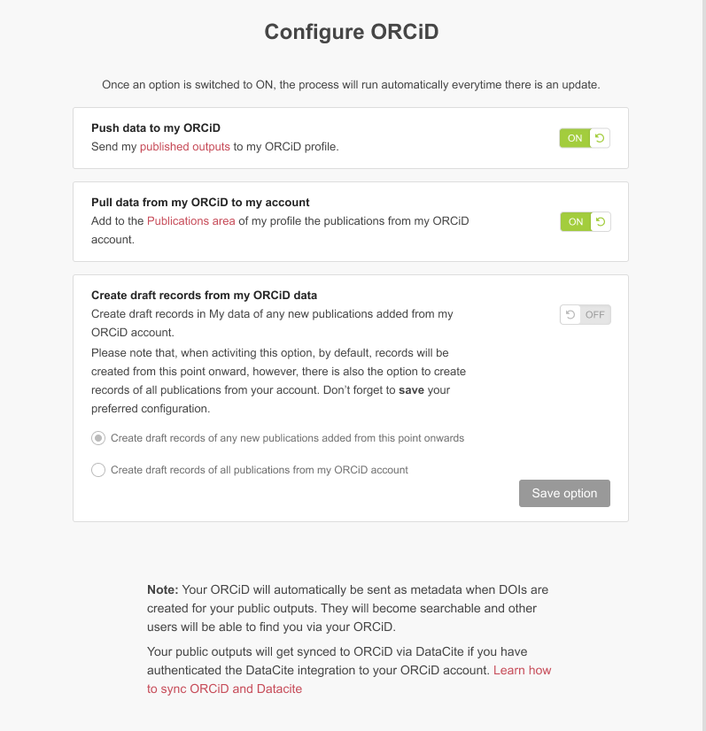
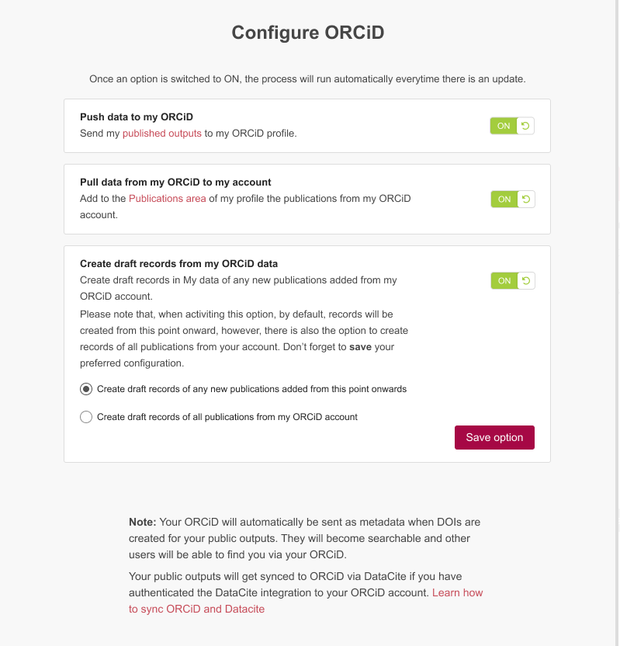
ORCID integration

Slide 36
TEI viewer

Slide 37
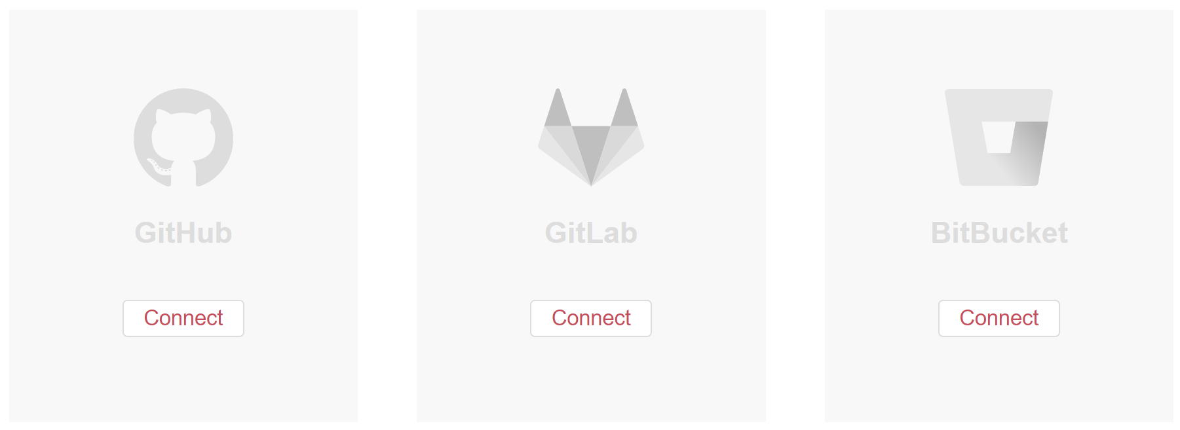
Github
Gitlab
Bitbucket
ç

Slide 38
What are we planning on doing for the next 12 months?
New cookie banner
Admin edit & Curation - direct link
References overhaul
Expiry dates for private links
Custom thumbnails
Custom DOI/Handle
Fileset ordering
Publication year default facet
Funder body search default facet

Slide 39
What are we planning on doing for the next 12 months?
Full text
Custom facets
Custom fields searchable
Remove download option
Add institution by ROR
ROR migration
Maintain folder structure
Begin work on:
Publishing to multiple groups
Metadata by item type by group

Slide 40
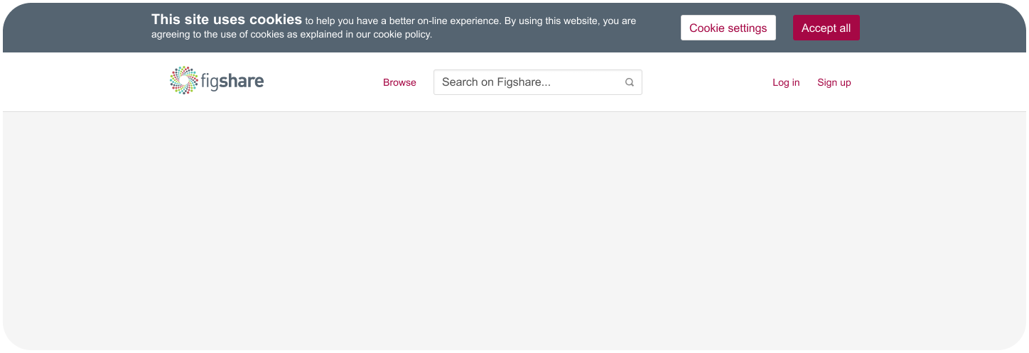
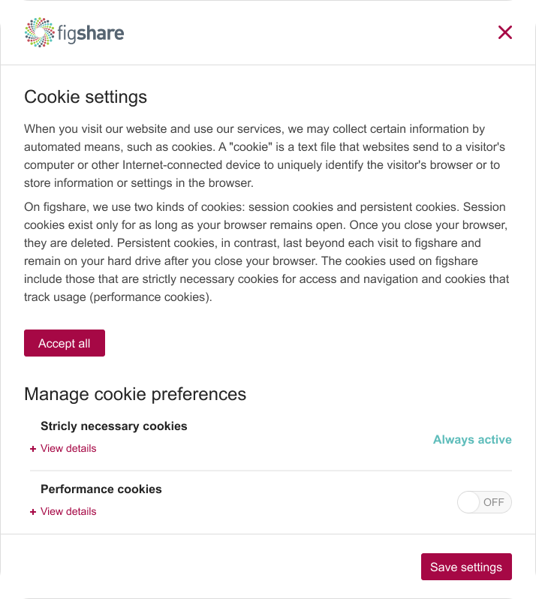
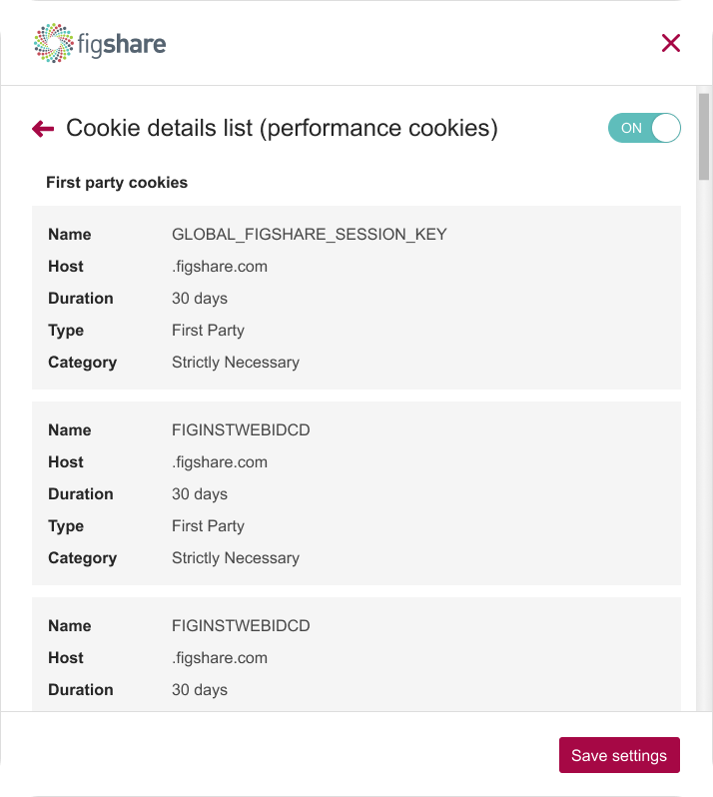
New cookie
banner

Slide 41
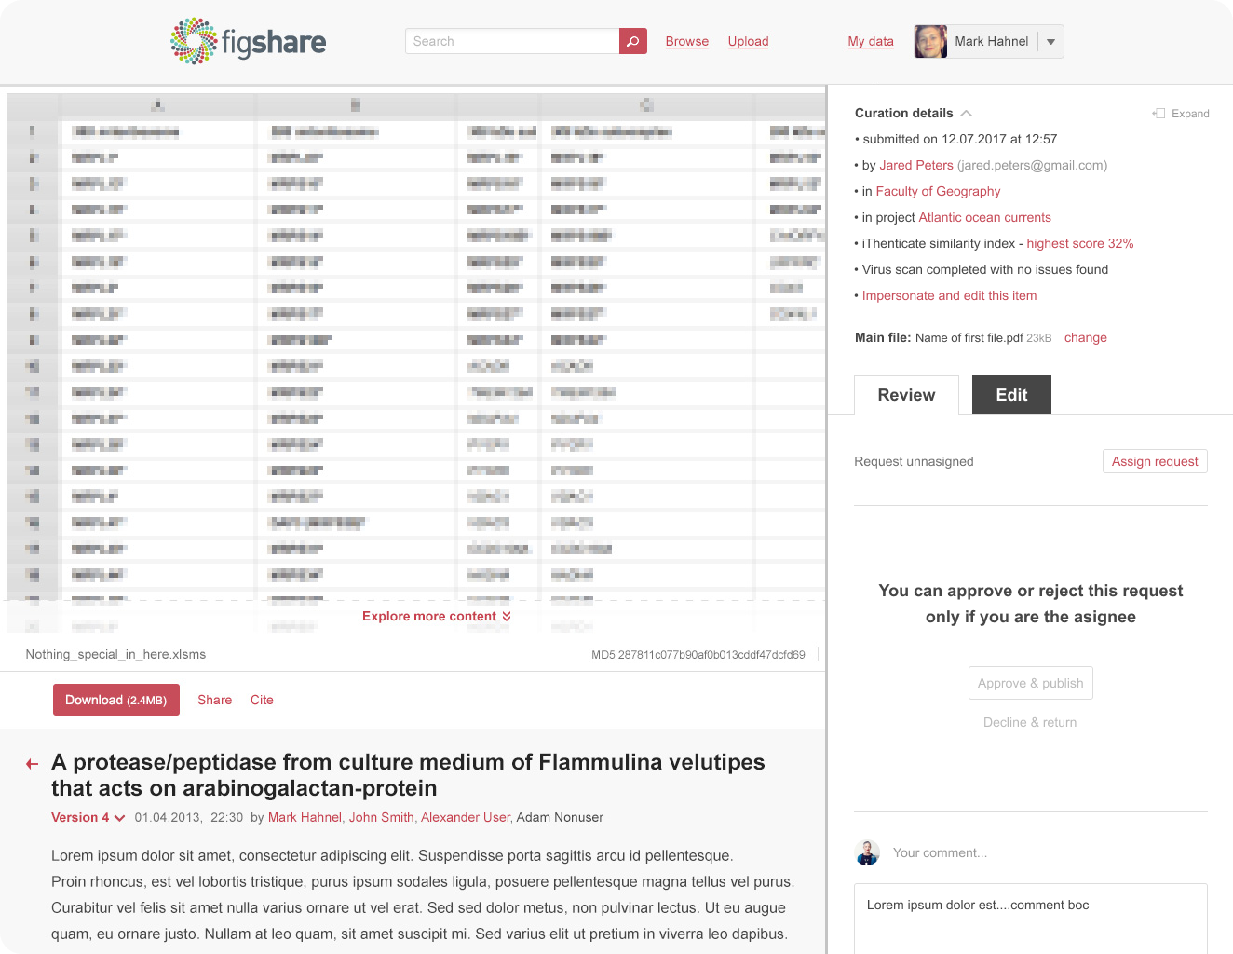
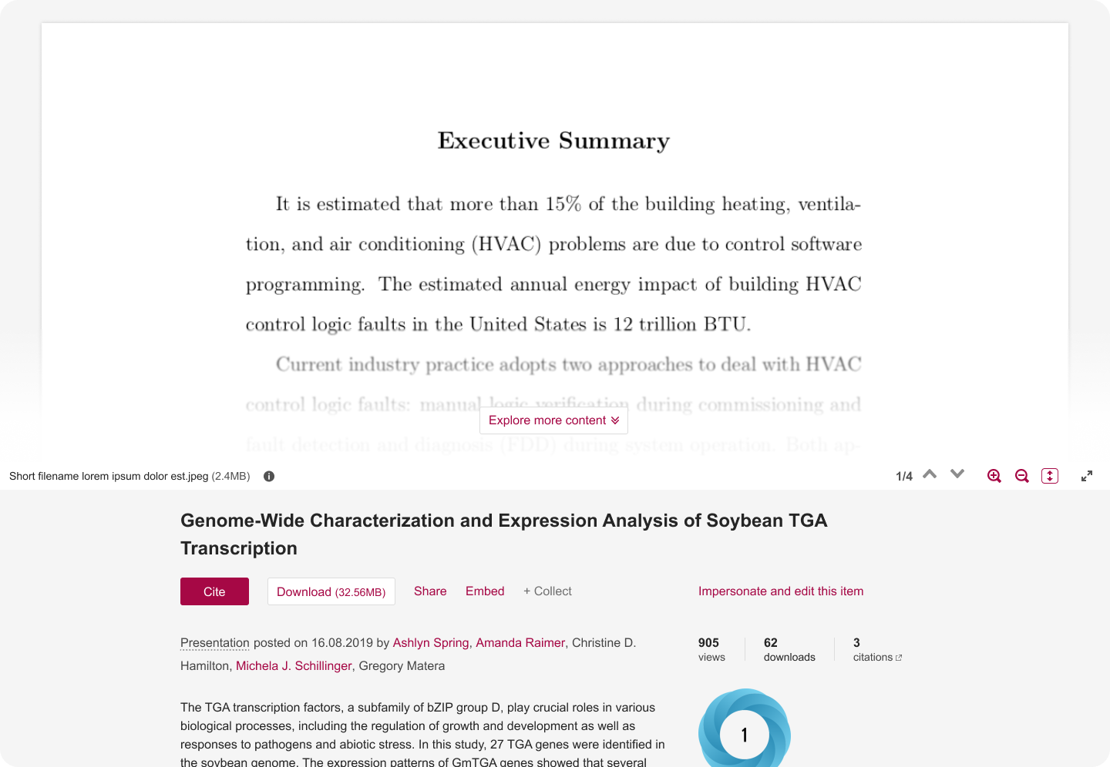
Admin edit - direct link

Slide 42
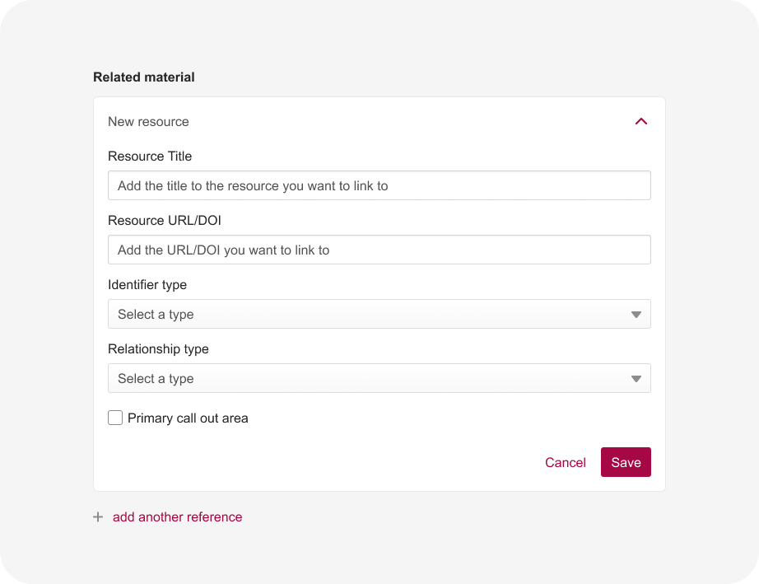
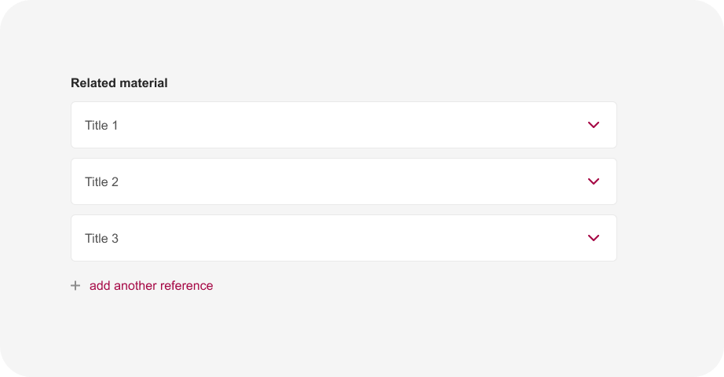
References overhaul

Slide 43
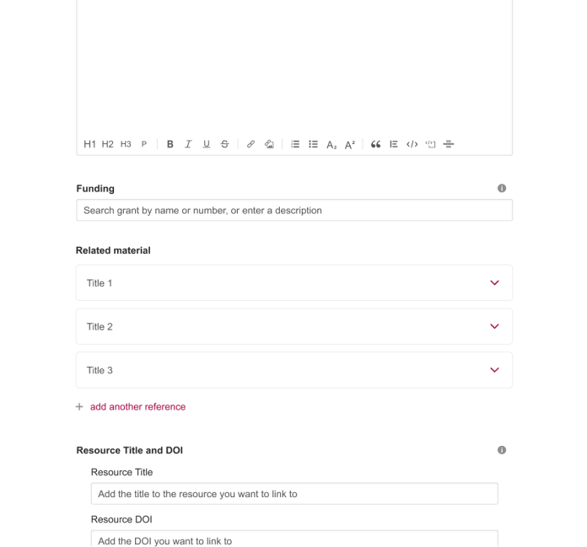

Slide 44
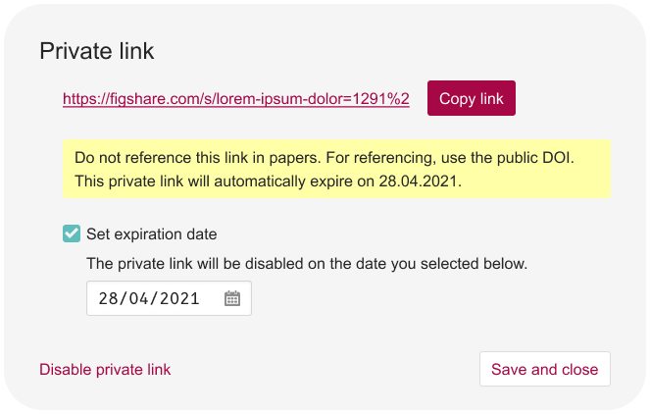
Private link - expiry dates

Slide 45
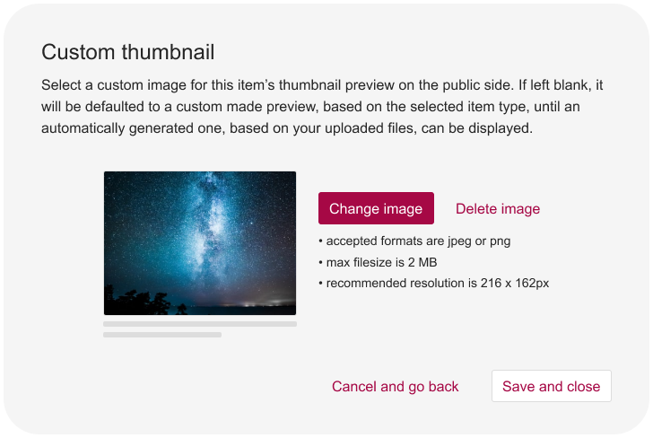
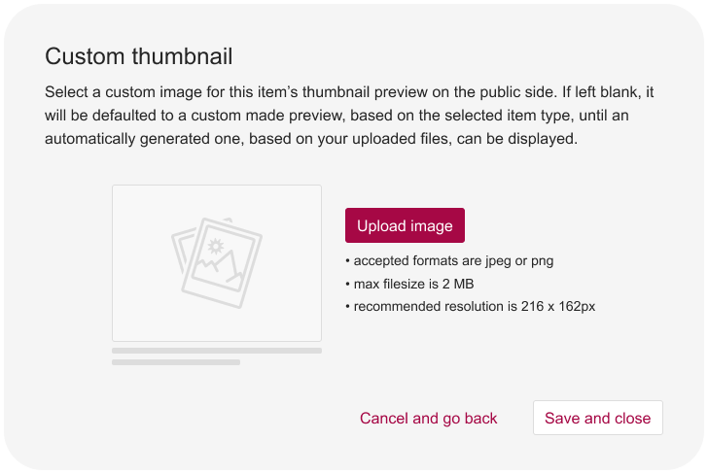
Custom thumbnails

Slide 46
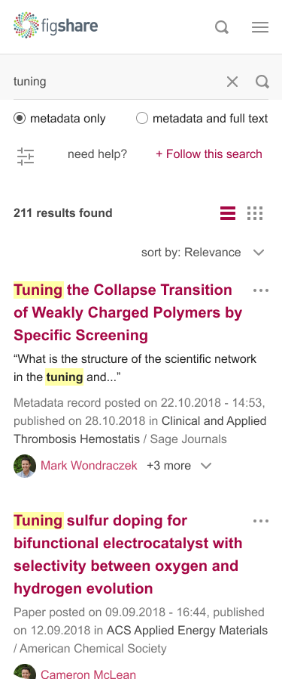
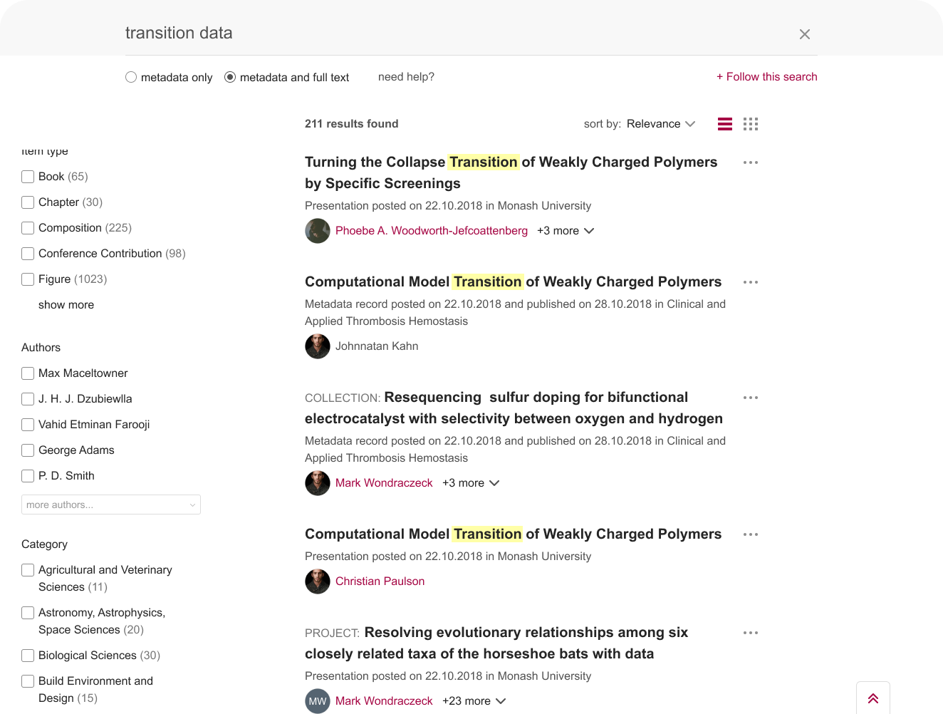
Full text search

Slide 47
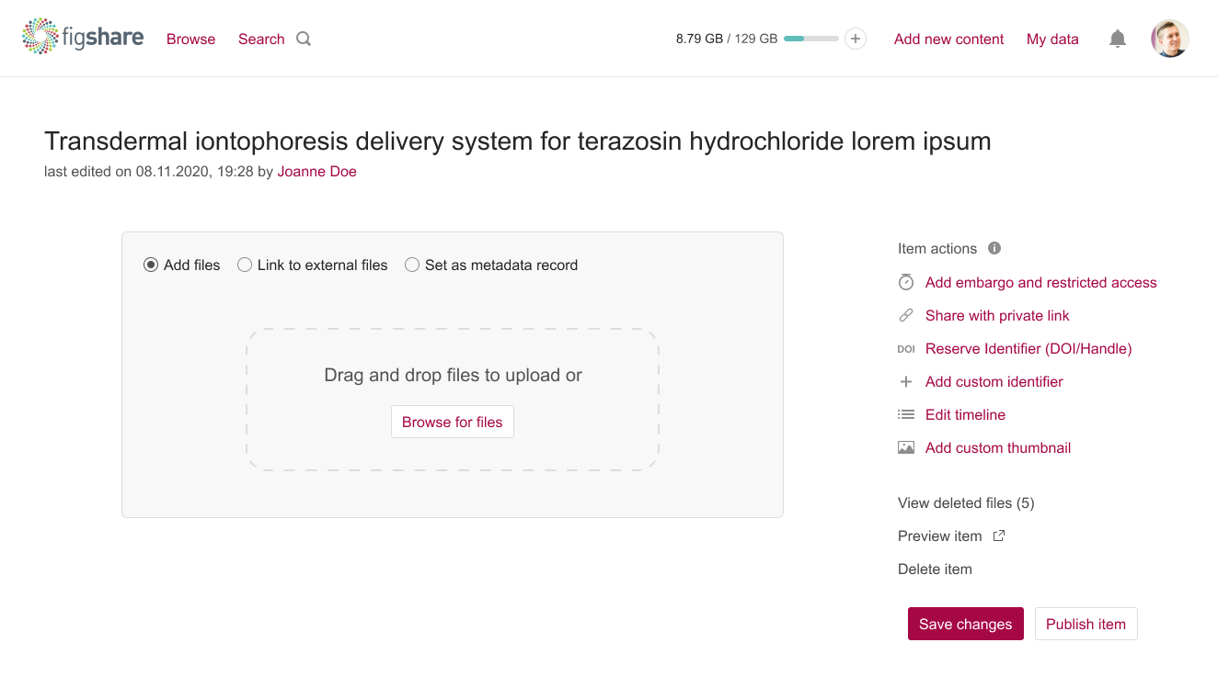
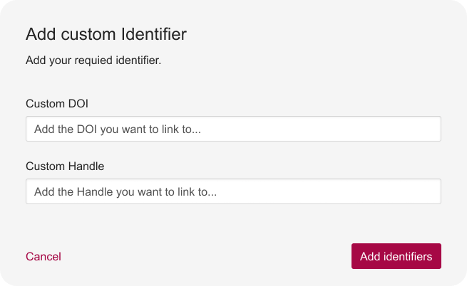
Custom DOI/Handle on edit item

Slide 48
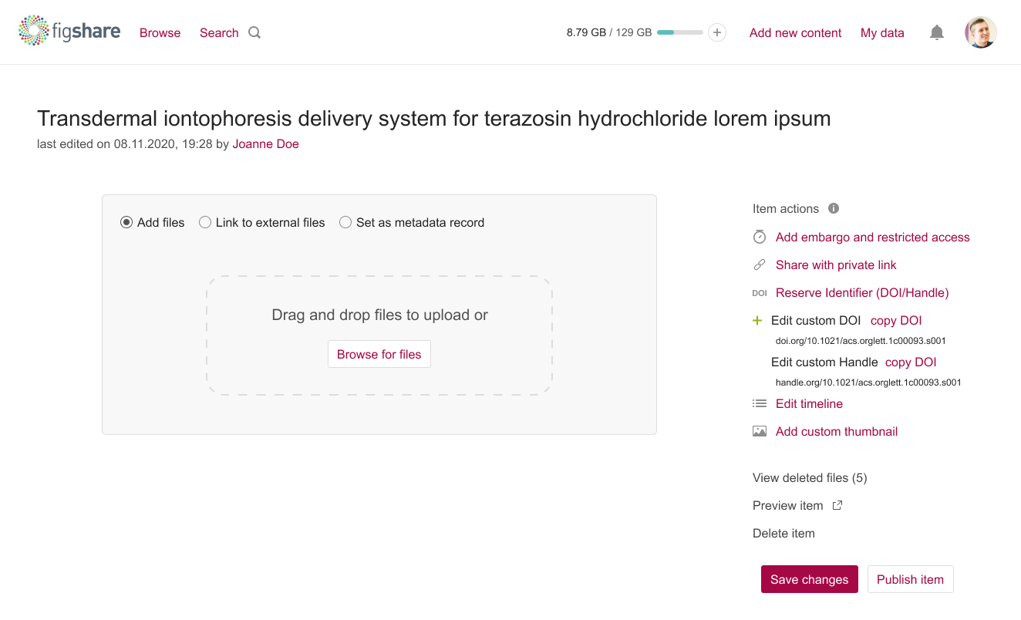
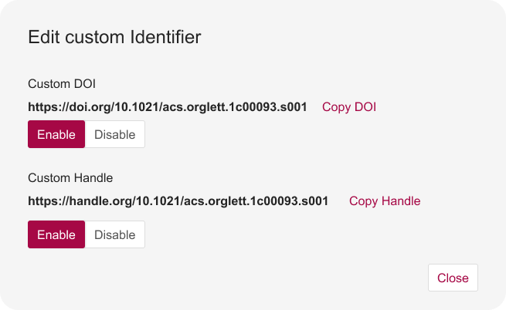

Slide 49
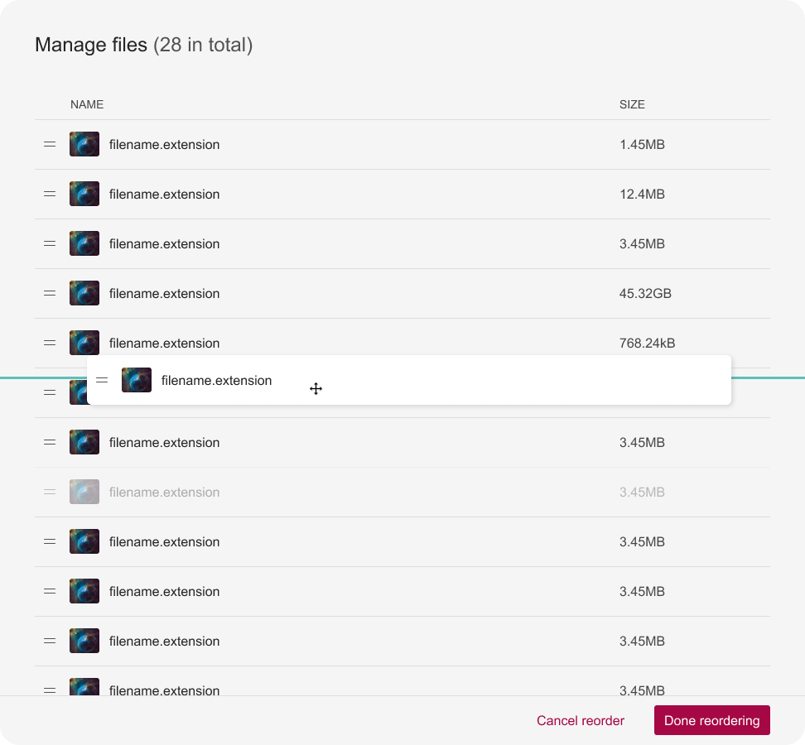
Fileset
ordering

Slide 50
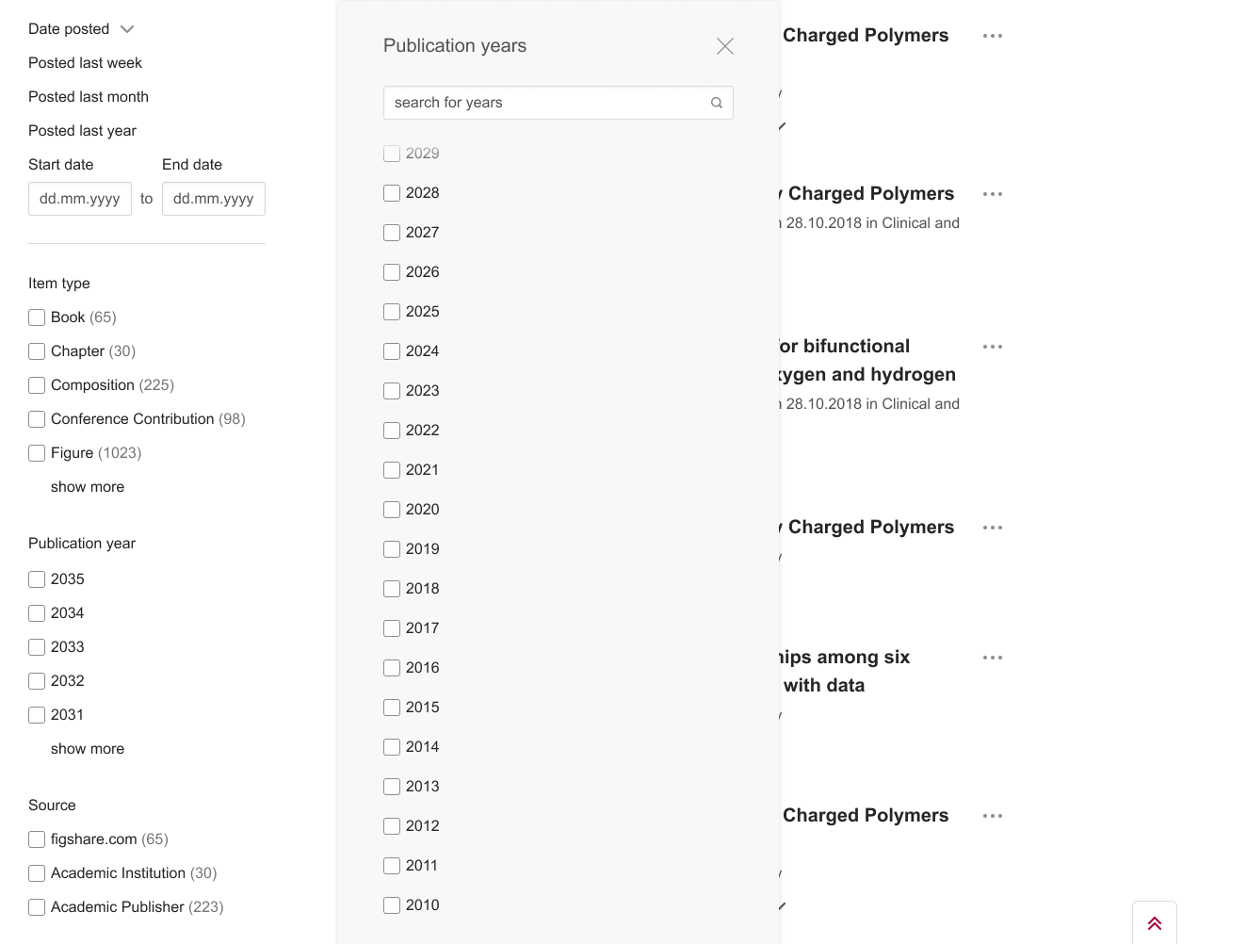
Publication year
default facet

Slide 51
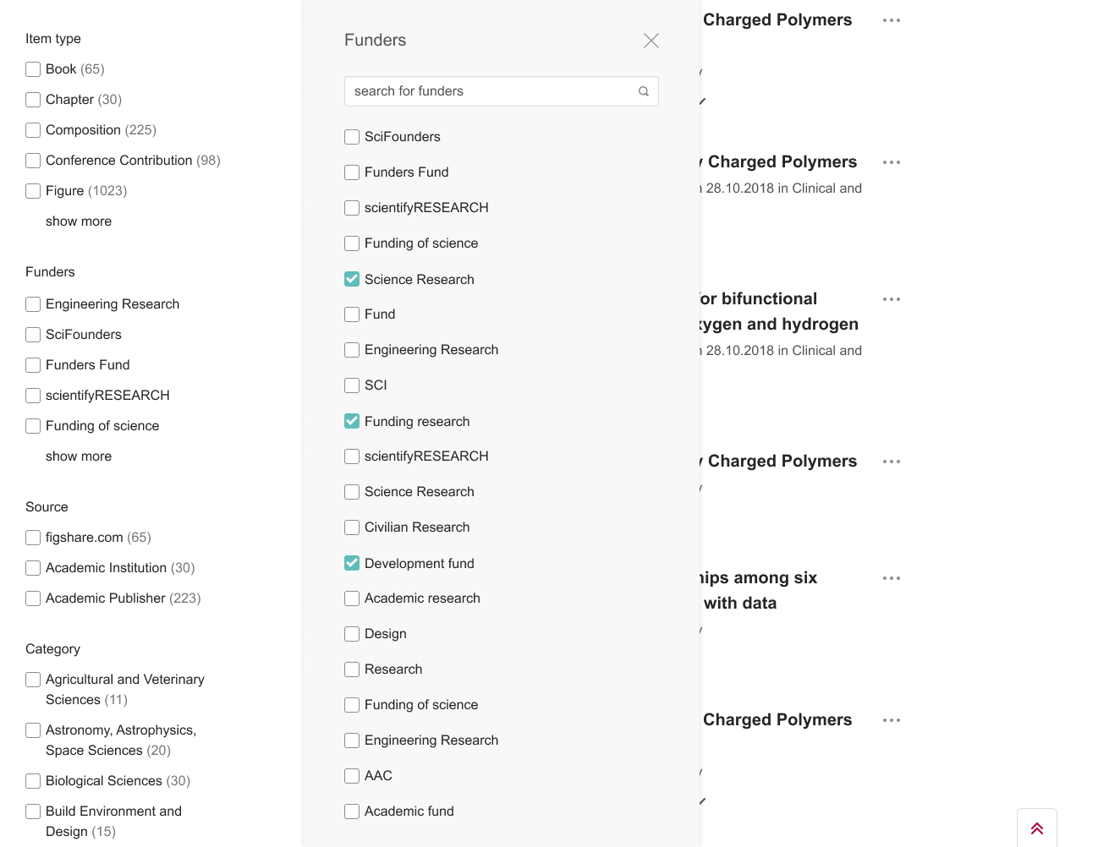
Funder body search default facet

Slide 52
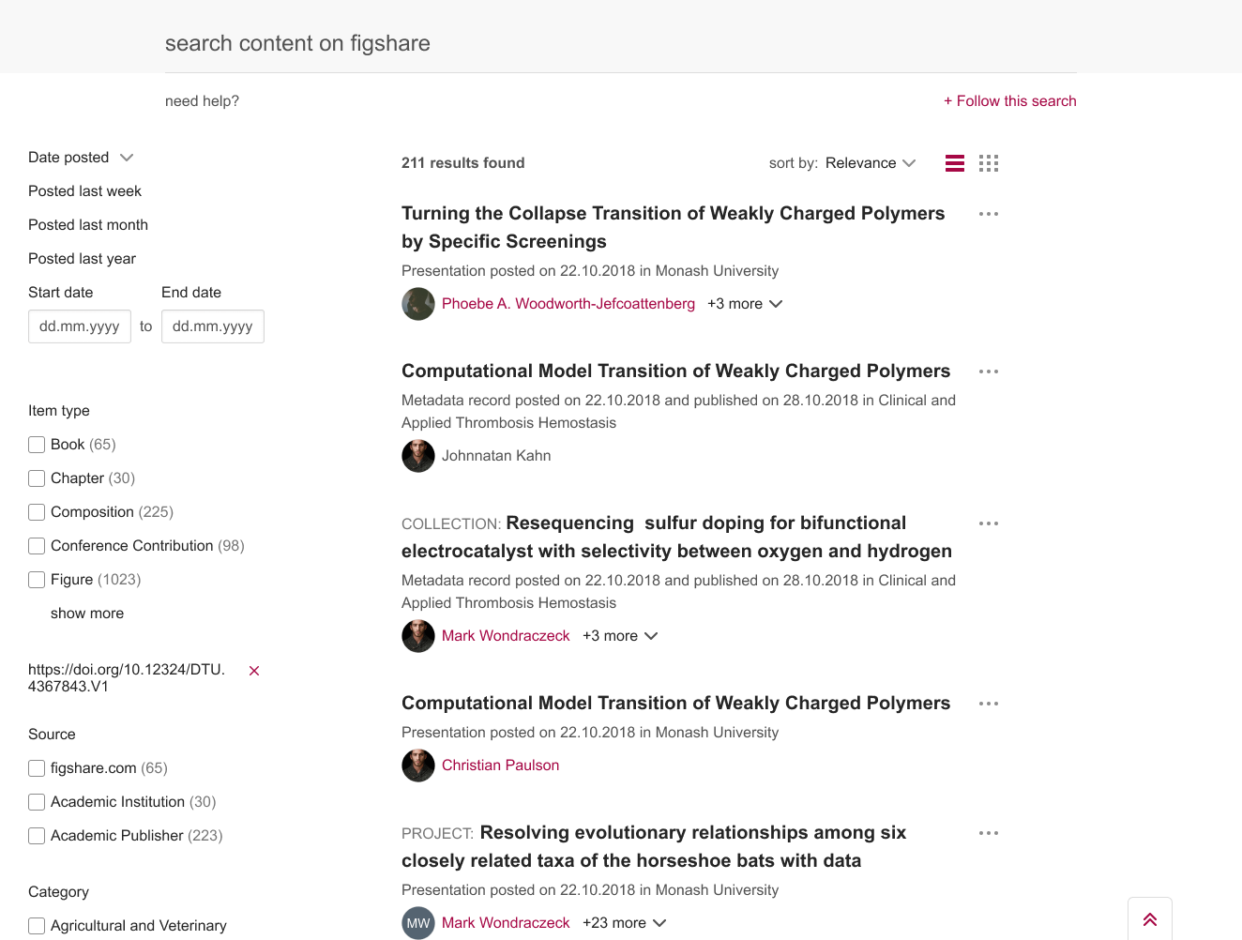
Custom facets

Slide 53
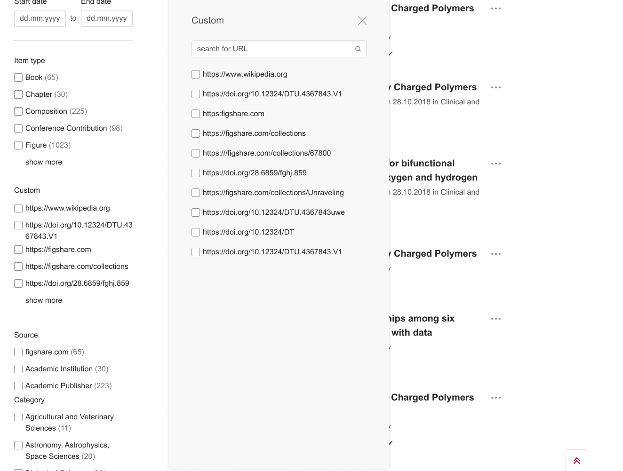

Slide 54
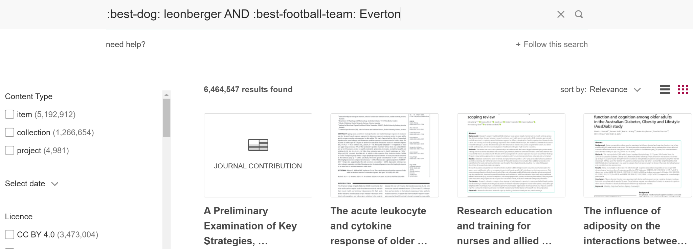
Custom fields indexed

Slide 55
Remove download
option

Slide 56
Add institution by ROR

Slide 57
Maintain folder structure

Slide 58
Publishing to multiple groups

Slide 59
Metadata by item type by group

Slide 62
Looking further ahead - 2024/2025
All private areas overhauled
Co-editing
On an item
On a project
Restricted publishing private links
Personal batch upload
Admin metadata - private/hidden
Default metadata by item type
Email notifications area
Items from the figshare IR roadmap

Slide 63
Thanks for listening
Questions, feedback: chris@figshare.com
@figshare

Slide 64
The State of Open Data and the Opportunities in Open Science
Oct 22
Dr Mark Hahnel - Founder, CEO

Slide 65
An infrastructure that you have to build and maintain simply configure and let run
The Figshare platform is ready to run and constantly maintained, enabling your researchers/authors to store and publish their data with ease. Integrations are available, allowing to use institution IDs and Single Sign On (SSO).
The workflows are made for research data, and customisations and extra services such as curation can be added on.

Slide 66
Policy Compliant Infrastructure
ISO27001
ISO 27001 is a specification for an information security management system (ISMS). An ISMS is a framework of policies and procedures that includes all legal, physical and technical controls involved in an organisation's information risk management processes.
DataCite Node
Region Specific Storage
Single Sign on Integrations
Customisable Terms and Conditions
WCAG 2.1 AA, Section 508, and EN 301 549
Google Scholar
Google Dataset Search Alpha Partner
ORCID Founding Member
Make Data Count

Slide 68
The goal, Dr. Gray insisted, was not to have the biggest, fastest single computer, but rather “to have a world in which all of the science literature is online, all of the science data is online, and they interoperate with each other.”

Slide 69
Assuming no research funding

Slide 71
What researchers say

Slide 72
The State of Open Data
Has been running for 7 years
Had over 25,000 respondents from 192 countries over that time
Provided us with a sustained look at the state of open data over time

Slide 73
Notes:
More than two-thirds of respondents are supportive “to some extent” of a national mandate for making research data openly available. This number has been declining since 2019.

Slide 74
Should funders make the sharing of research data part of their requirements for awarding grants?
Should funders withhold funding from (or penalise in other ways) researchers who do not share their data if the funder has mandated that they do so?

Slide 75
The growing push

Slide 76
“Linking papers to their supporting data in a repository was associated with on average a 25% increase in citations”
https://doi.org/10.1371/journal.pone.0230416

Slide 78
GREI Repositories
Dryad
Dataverse
Figshare
Mendeley Data
Open Science Framework
Vivli

Slide 79
52 funders listed on Sherpa Juliet require data archiving as a condition of funding, while a further 34 encourage it.
More than two-thirds of respondents of the State of Open Data 2022 are supportive “to some extent” of a national mandate for making research data openly available. This number has been declining since 2019

Slide 80
Who Researchers would be willing to receive support from to help in reviewing, curating and preparing their data for public release
38% upon their own Institution (including research offices, peers and librarians
41% relied upon Publishers

Slide 81
Credit for your Data
Overall, 75% of respondents believe that researchers get too little credit for sharing data.
Of those who had previously shared data, 66% had received some form of recognition for their efforts – most commonly via full citation in another article (41%)

Slide 82
Different countries have different needs
Of those who had an awareness of data management plans, 58% indicated that they felt capable of developing a practical plan were they required to do so (this corresponds to 28% of respondents overall).
69% of those in the US indicated that they felt sufficiently competent to develop a practical data management plan which was more than those in China and Japan who were significantly more likely to indicate that they would require moderate training or further information to do so (50% and 58% respectively).

Slide 83
What researchers do

Slide 84
Digital Science Report
The State of Trust & Integrity in Research
Perspectives on data sharing, policies and practices
Ripeta. Online resource. https://doi.org/10.6084/m9.figshare.20497062.v2
“We identified and analysed five leading global industry funders. This included one non-governmental funder, the Bill & Melinda Gates Foundation, and four government funding agencies: European Commission (EC), US National Institutes of Health (NIH), National Science Foundation of China (NSFC), and German Federal Ministry of Education and Research (Bundesministerium für Bildung und Forschung, BMBF).”

Slide 85
Data Availability Statements and Location of Datasets
Digital Science Report The State of Trust & Integrity in Research Perspectives on data sharing, policies and practices
Ripeta. Online resource. https://doi.org/10.6084/m9.figshare.20497062.v2

Slide 86
Most frequently used repository types for Data Availability Statements
Digital Science Report The State of Trust & Integrity in Research Perspectives on data sharing, policies and practices
Ripeta. Online resource. https://doi.org/10.6084/m9.figshare.20497062.v2

Slide 87
Number of articles mentioning specific repositories
Note each article can mention >1 repository and be included in multiple categories.
Data from Dimensions.ai

Slide 90
What is next?

Slide 91
DeepMind expands the AlphaFold Protein Structure Database from nearly 1 million to over 200 million structures, including predictions for most proteins in UniProt
Our hope is that AI will be useful for disease research, and ultimately improve the quality of life for millions of patients around the world.

Slide 94
NIH Pilot results
Custom review of deposits by Figshare data experts

Slide 95
The future is bright for open data

Slide 96
Assuming no research funding

Slide 97
Data with no checks that can be useful
Academic files and metadata are available on the internet in repositories that follow best practice norms.
Top level check to make data Findable and Accessible
The metadata is sufficient to be discoverable through a google search
Policy compliant checks - the files have no PII, are under the correct license
Appropriate use of PIDs and metadata standards
Interoperable and Reusable
Files are in an open, preservation-optimised format
Subject specific metadata schemas and file structures are applied in compliance with community best practice
Forensic data checks for editing, augmenting
Re-running of the results to ensure replicability

Slide 98
“The speed at which any given scientific discipline advances will depend on how well its researchers collaborate with one another” -Jim Gray
FAIR-ly provide:
Access to literature
Ability to publish literature
Access to data
Ability to publish data
Tech
People
Culture
Repositories
Libraries
Publishers

Slide 99
Thank you
Mark Hahnel
Founder & CEO, Figshare
mark@figshare.com
@markhahnel
@figshare
10 years of…
open research
open access
striving for FAIR-ness
empowering researchers
disseminating knowledge for scientific advancement

