Slide 1
The State of Open Data in 2022 - data sharing after the pandemic
Mark Hahnel
Founder & CEO, Figshare
Notes:
Outline:
Intro to the history of the State of Open Data
Overview of the survey: Greg Goodey (how it was run, response rate, etc.)
A look at some of the key takeaways based on sector and open data applicability
Summary of the contributions in the report
Q&A

Slide 2
History of the State of Open Data
Been running for 6 years
Had over 21,000 respondents from 192 countries over that time
Provided us with a sustained look at the state of open data over time

Slide 3
Springer Nature involvement
To move to a truly open research environment, we as a community need to get better at taking concrete steps to drive forward appropriate measures to better support our research community. Springer Nature is firmly committed to this and we continue to work closely with our partners, such as Figshare and Digital Science, to better develop solutions and understanding around data sharing together.
Eugenie Regan, Vice President, Research Solutions, Springer Nature

Slide 4
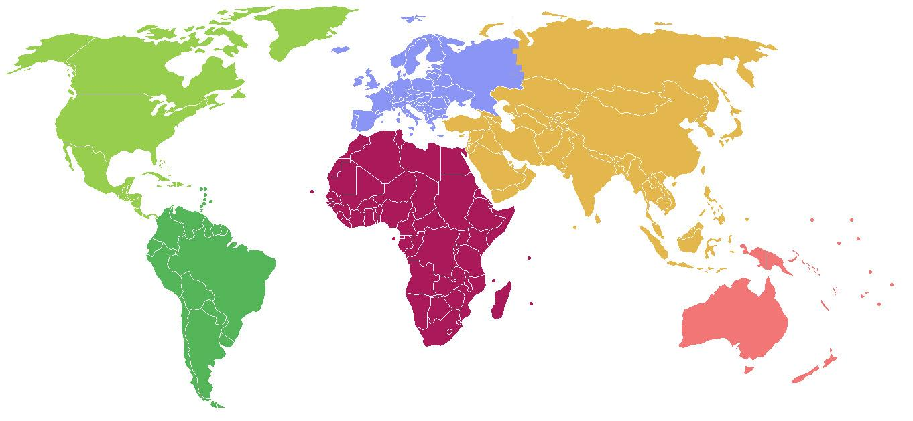
Demographics
2021 survey population
Field of interest
Region
Biomedical sciences:
20%
Biological sciences:
18%
Applied sciences:
15%
HSS:
12%
Europe: 36%
Germany: 6%; UK 5%
North America: 17%
US: 15%
Asia: 30%
India: 11%; China: 3%
Africa: 7%
Nigeria: 2%
Physical sciences:
8%
Earth & environmental sciences:
7%
Other:
19%
South America: 7%
Brazil: 3%
Australasia: 3%
Australia: 2%
Inferred career stage*
Late-career researcher:
58%
Mid-career researcher:
13%
Early-career researcher:
29%
*Career staged inferred from year that the respondent first published a peer review article (LCR - >10 years ago; ECR - < 5 years ago) and tenure status where available

Slide 5
Receptiveness to Open Science
Outlook on open science
Respondents were asked to what extent they
agree or disagree with the following statements:
“Making research articles open access should be common scholarly practice.”
“Making research data openly available should be common scholarly practice.”
“Making all research outputs openly available should be common scholarly practice.”
Open science advocates:
72%
Open science agnostics:
22%
Anti open science:
6%
*Developed using a latent class analysis

Slide 6
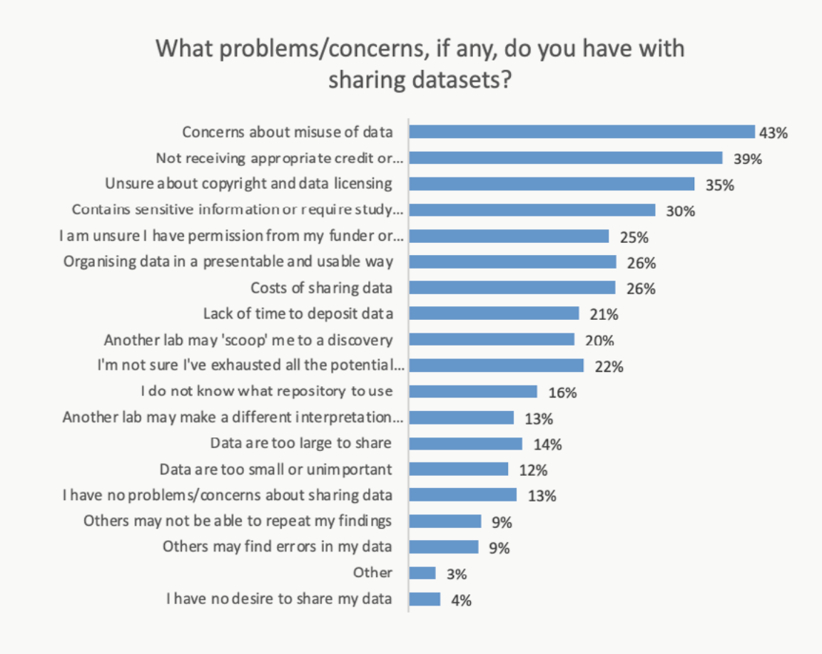
3
Chart from the State of Open Data 2021
key takeaways
1 There is more concern about sharing data than ever before

Slide 7
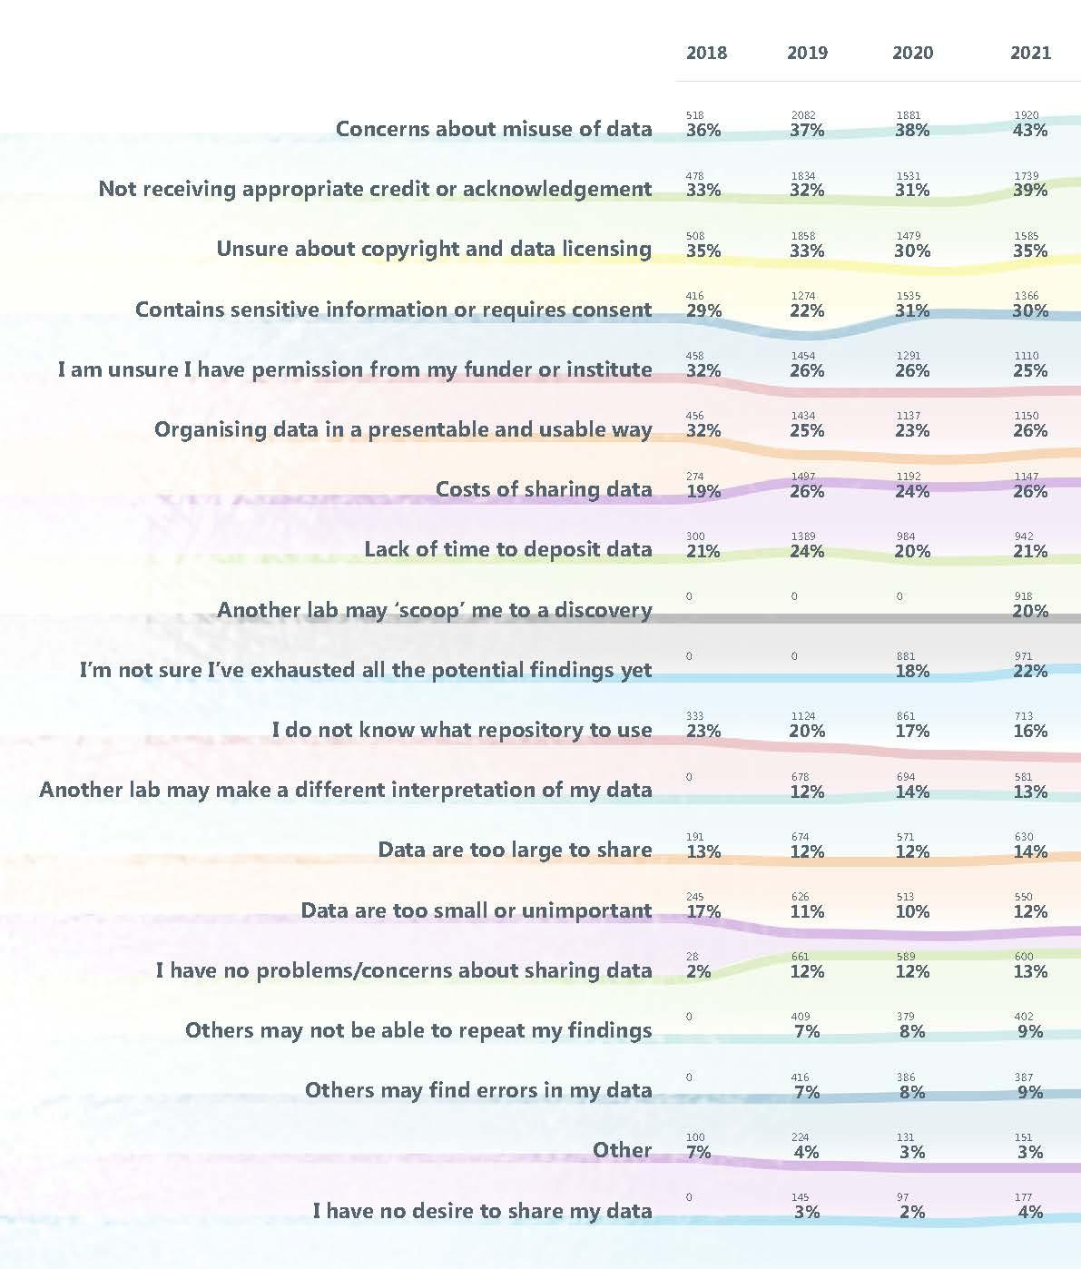
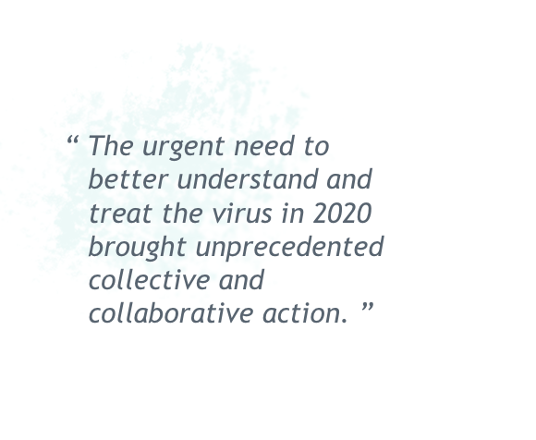
Problems/concerns
with sharing data
over the last 4 years

Slide 8
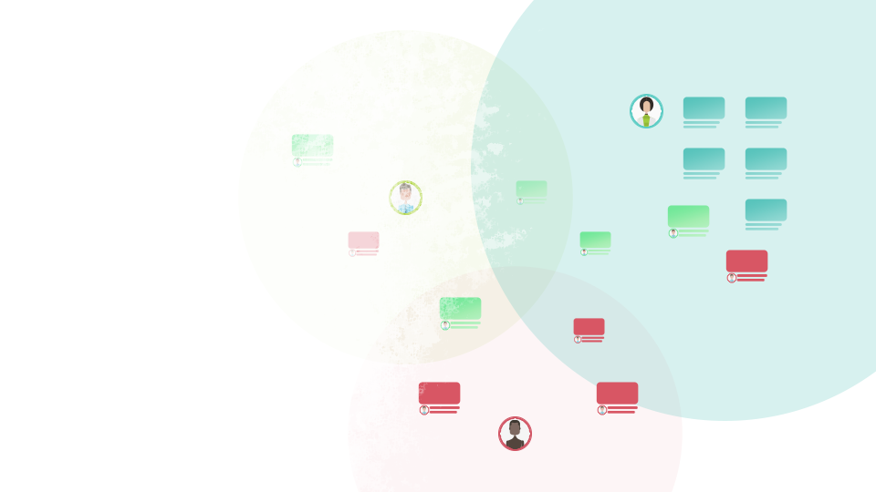
Sharing and reusing Covid data
About a third of respondents indicated that they have reused their own or someone else’s openly accessible data more during the pandemic than before

Slide 9
3
key takeaways
2 There is more familiarity and compliance with the FAIR data principles than ever before

Slide 10
3
key takeaways
3 Repositories, publishers, and institutional libraries have a key role to play in helping make data openly available
34% upon publishers
30% upon institutional libraries
35% relied upon repositories

Slide 11
Key takeaways for institutions
30% of survey
respondents said they would rely upon their institutional library for help making their research data openly available
Almost half of
respondents share their research data in an institutional repository for a public audience
58% of respondents
would like greater guidance from their institution on how to comply with their data sharing policies

Slide 12
Key takeaways for publishers
47% of survey
respondents said they would be motivated to share their data if there was a journal or publisher requirement to do so
53% of survey
respondents obtained research data collected by other research groups from within a published research article
53% of respondents
said it was extremely important that data are available from a publicly available repository

Slide 13
Key takeaways for funders/government agencies
52% of survey
respondents said funders should make the sharing of research data part of their requirements for awarding grants
48% of
respondents said that funding should be withheld (or a penalty incurred) if researchers do not share their data when the funder has mandated that they do so at the grant application stage
73% of survey
respondents strongly or somewhat support the idea of a national mandate for making research data openly available
33% would like
more guidance on how to comply with government policies on making research data openly available

Slide 14
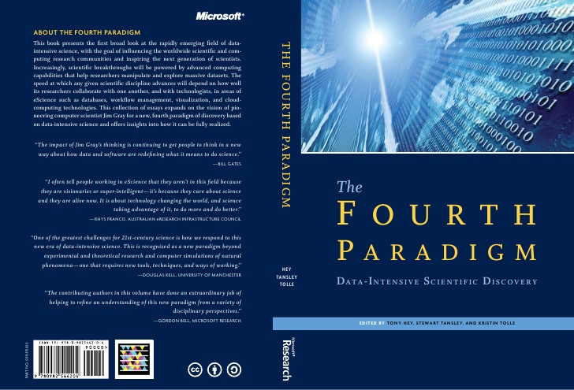
2009
The Fourth Paradigm:
Data-Intensive Scientific Discovery.
Empirical Evidence - The sky is blue
Scientific theory - The sky is blue every day
Computational science - Using advanced computing capabilities to understand and solve complex problems
The goal, Dr. Gray insisted, was not to have the biggest, fastest single computer, but rather “to have a world in which all of the science literature is online, all of the science data is online, and they interoperate with each other.”
Implicit in the idea of a fourth paradigm is the ability, and the need, to share data.

Slide 16
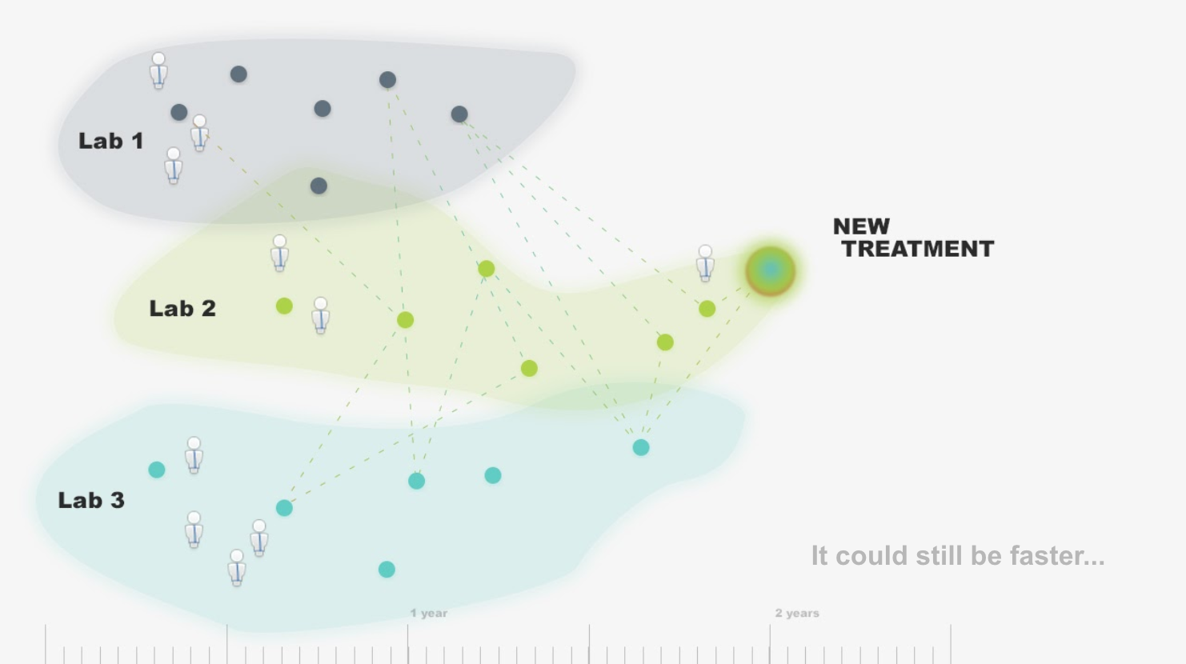

Slide 17
“The speed at which any given scientific discipline advances will depend on how well its researchers collaborate with one another” Jim Gray
FAIR-ly provide:
Access to literature
Ability to publish literature
Access to data
Ability to publish data
Tech
People
Culture
Repositories
Libraries
Archives
Institutions
Publishers
Funders

Slide 18
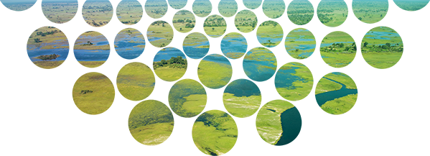
Mark Hahnel
Founder & CEO, Figshare mark@figshare.com @markhahnel @figshare
Read the full State of Open Data 2021
doi.org/10.6084/m9.figshare.17061347
or knowledge.figshare.com/sood
10 years of figshare

